Slide 1
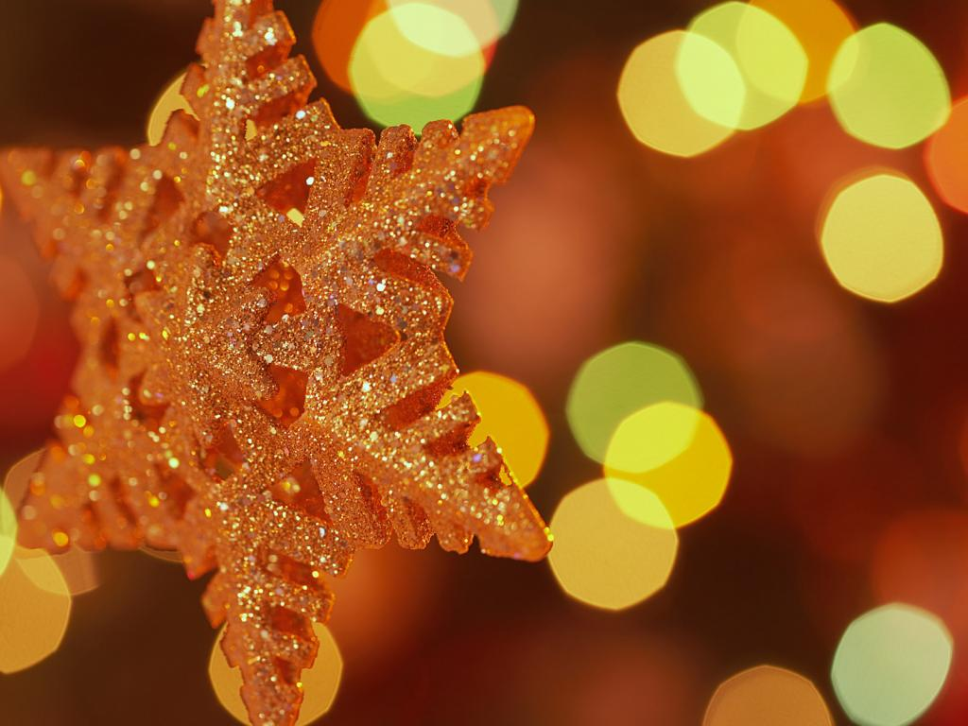
Once Upon a Christmas

Slide 2
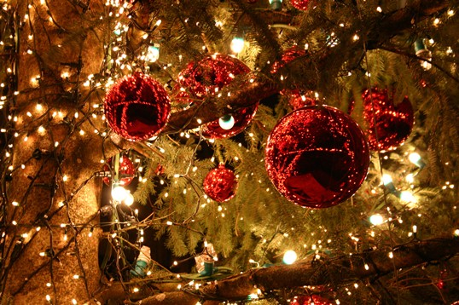

Slide 3
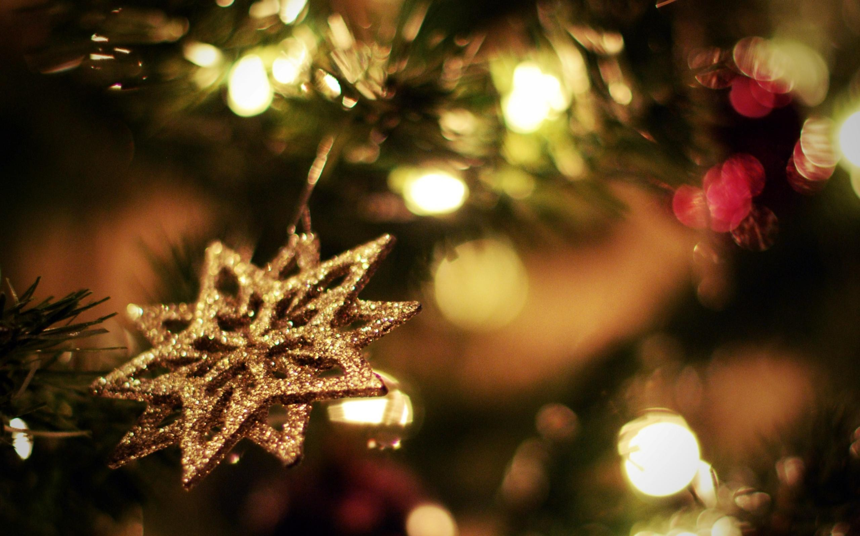
Ding Dong Merrily on High
Ding dong merrily on high,
In Heaven the bells are ringing!
Ding dong verily the sky,
Is riven with angels singing!
Gloria!
Hosanna in the highest!

Slide 5
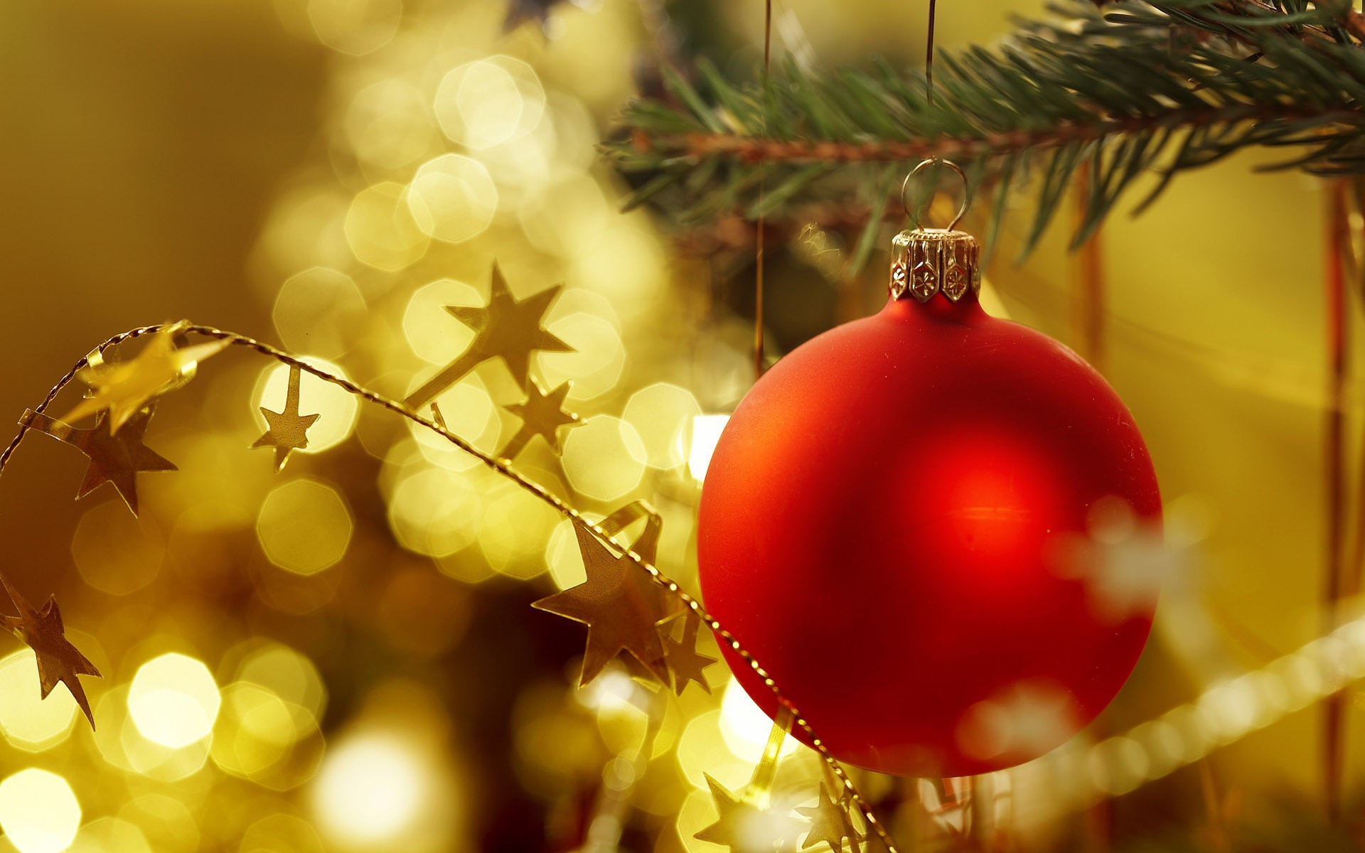
The Virgin Mary had a Baby Boy
The virgin Mary had a baby boy,
The virgin Mary had a baby boy,
The virgin Mary had a baby boy,
And they said that His name was,
JESUS!

Slide 6
The Virgin Mary had a Baby Boy
He come from the glory!
He come from the glorious kingdom!
He come from the glory!
He come from the glorious kingdom!
Oh yes, believer! Oh yes, believer!
He come from the glory!
He come from the glorious kingdom!

Slide 7
The Virgin Mary had a Baby Boy
The angel sang when the baby was born,
The angel sang when the baby was born,
The angel sang when the baby was born,
And they said that His name was,
JESUS!

Slide 8
The Virgin Mary had a Baby Boy
He come from the glory!
He come from the glorious kingdom!
He come from the glory!
He come from the glorious kingdom!
Oh yes, believer! Oh yes, believer!
He come from the glory!
He come from the glorious kingdom!

Slide 10
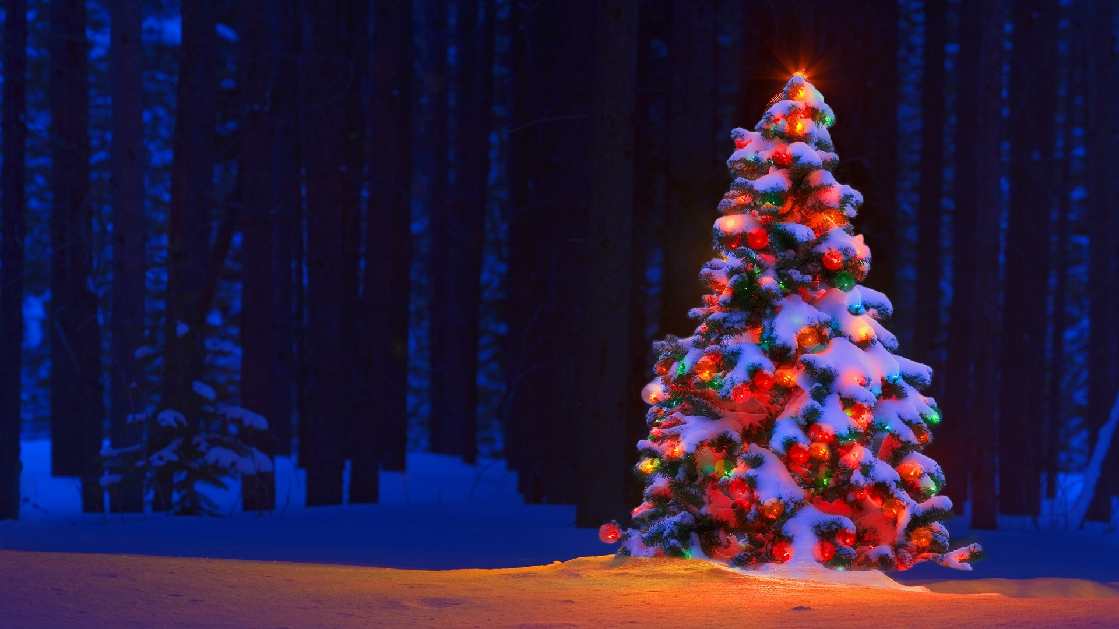
Go Tell it on the Mountain
Go tell it on the mountain!
Over the hills and everywhere!
Go tell it on the mountain
That Jesus Christ is born!

Slide 11
Go Tell it on the Mountain
While shepherds kept their watching
Over silent flocks by night,
Behold! Throughout the heavens
There shown a holy light!

Slide 12
Go Tell it on the Mountain
Go tell it on the mountain!
Over the hills and everywhere!
Go tell it on the mountain
That Jesus Christ is born!

Slide 14
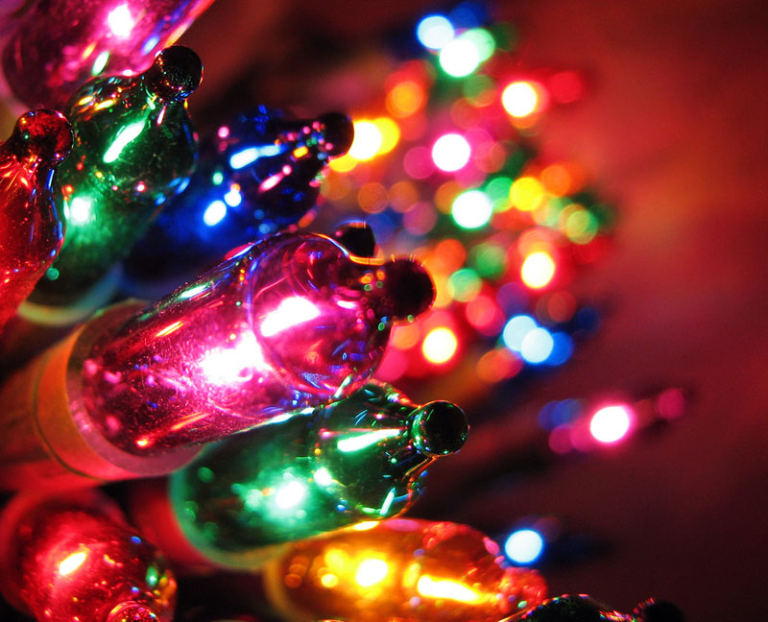
Jesus Loves Me
Jesus loves me this I know,
For the Bible tells me so.
He shed His blood on the cross of Calvary.
He shed His blood on the cross of Calvary.
There He gave His life for me.

Slide 16
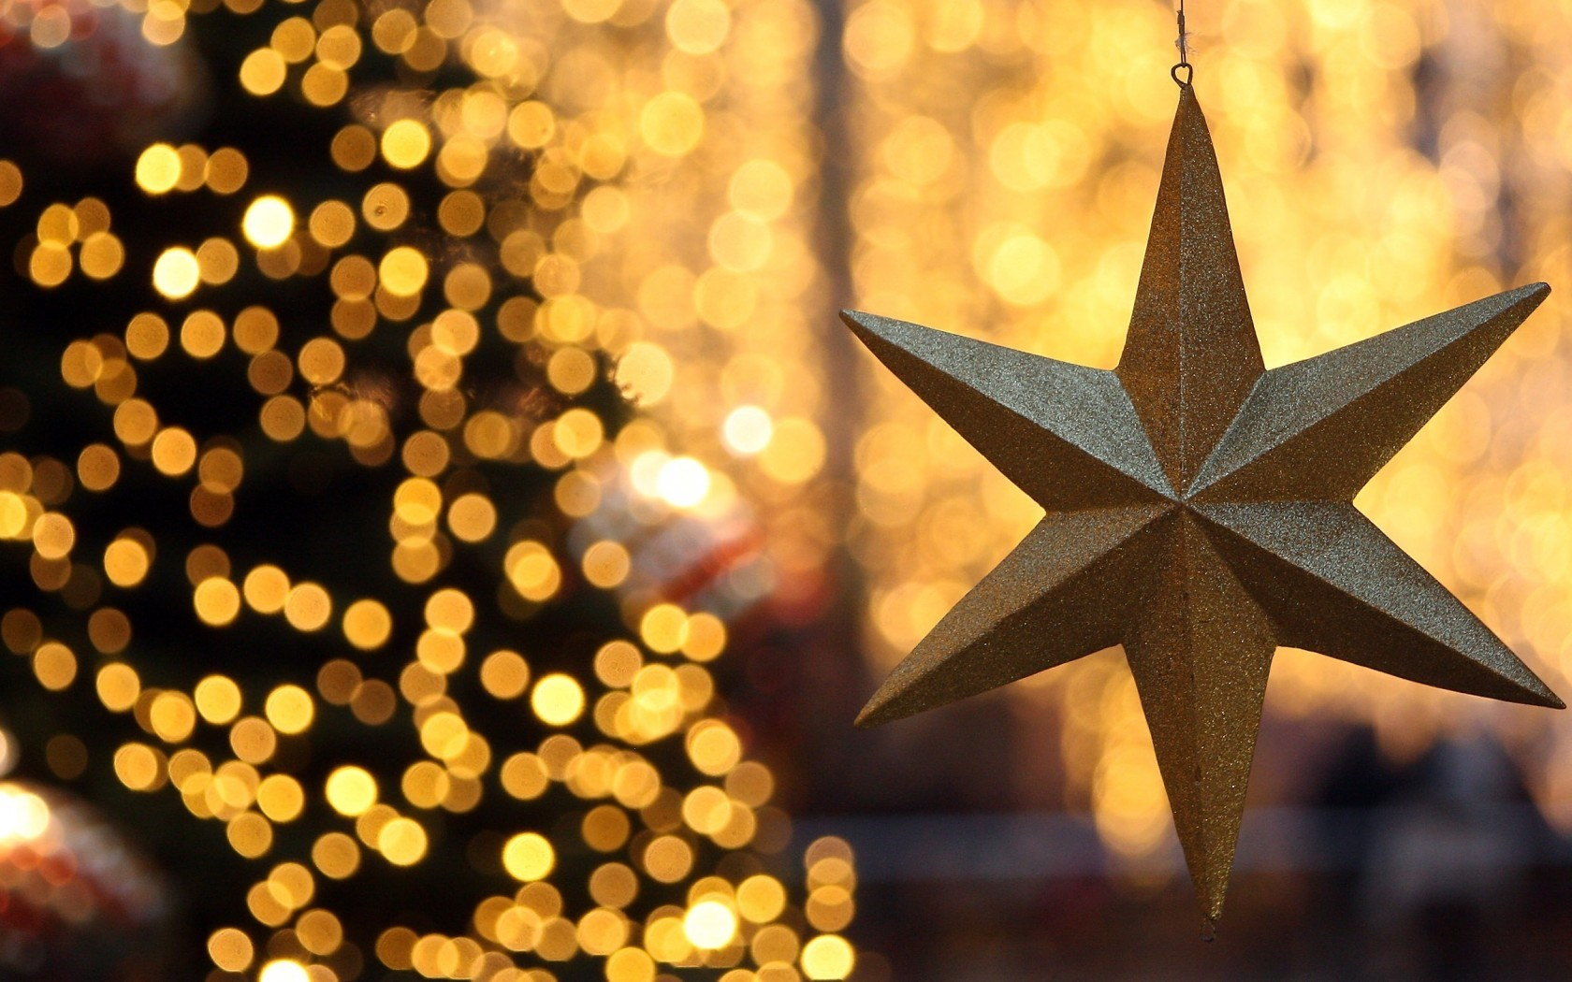
Joy to the World
Joy to the world the Lord is come!
Let earth receive her king!
Let every heart prepare him room
And heaven and nature sing,
And heaven and nature sing,
And heaven and nature sing!

Slide 17
Joy to the World
He rules the world with truth and grace
And makes the nations prove
The glories of His righteousness
And wonders of His love,
And wonders of His love,
And wonders, wonders of His love!

Slide 18
Merry Christmas!

