Slide 1
HAITIANS HELPING HAITIANS
The Church in Haiti Needs Your Help

Slide 2
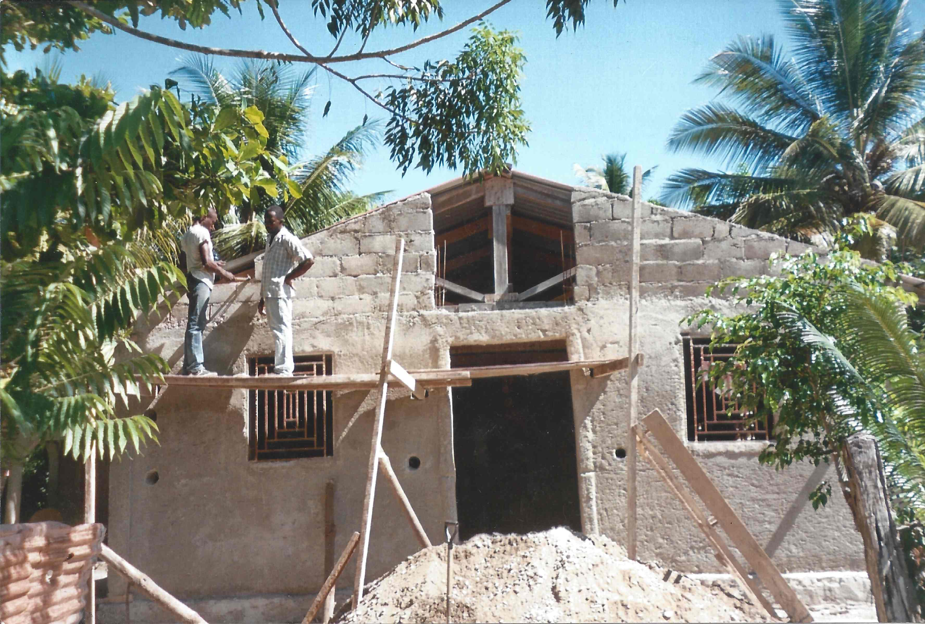
Assembly of Redeemed of Jesus Christ Ka-Houck - 2014

Slide 3
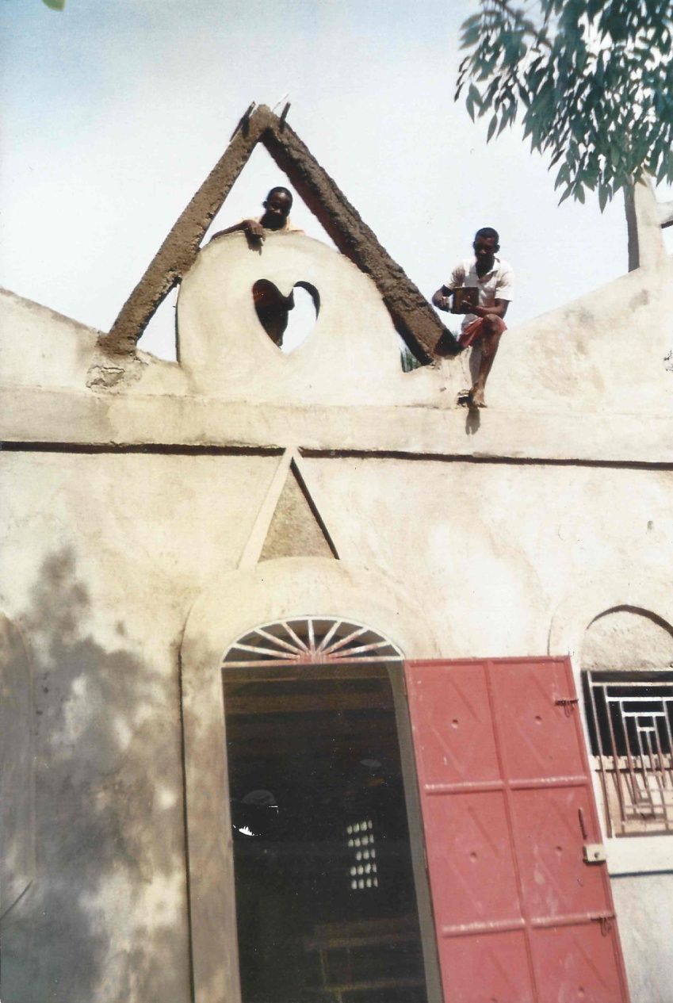
Create Front of Church

Slide 4
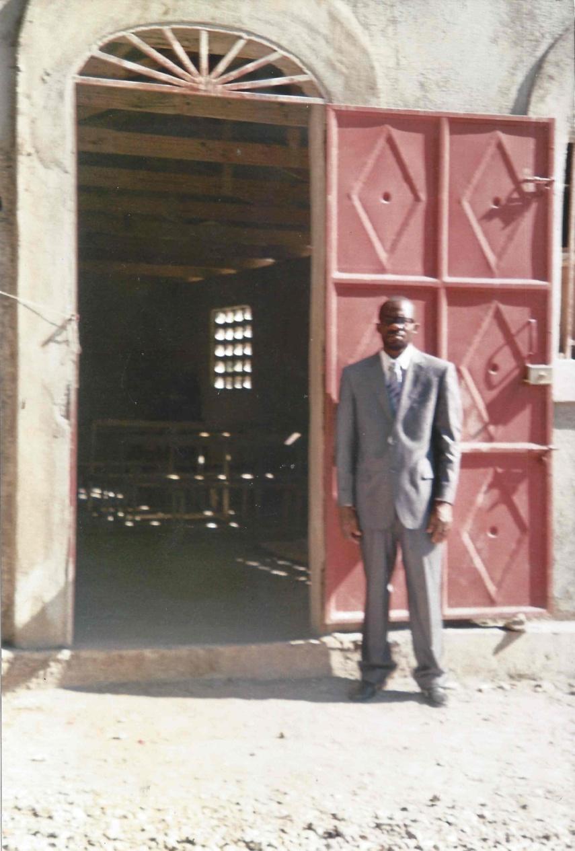
Pastor Prince

Slide 5
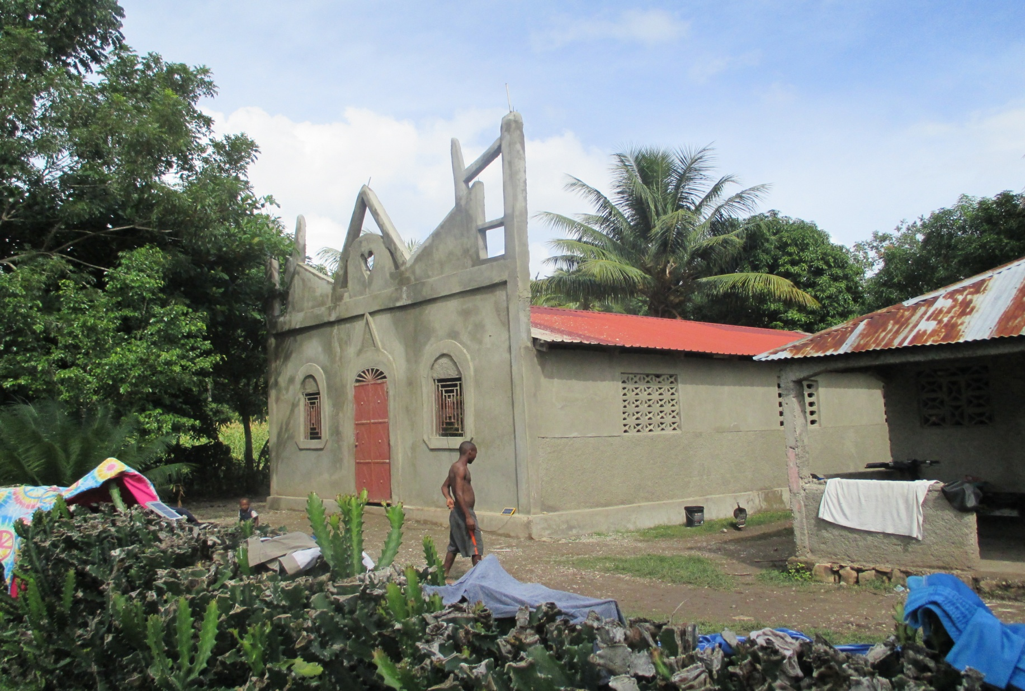
2015 - Finished Outside of Church

Slide 6
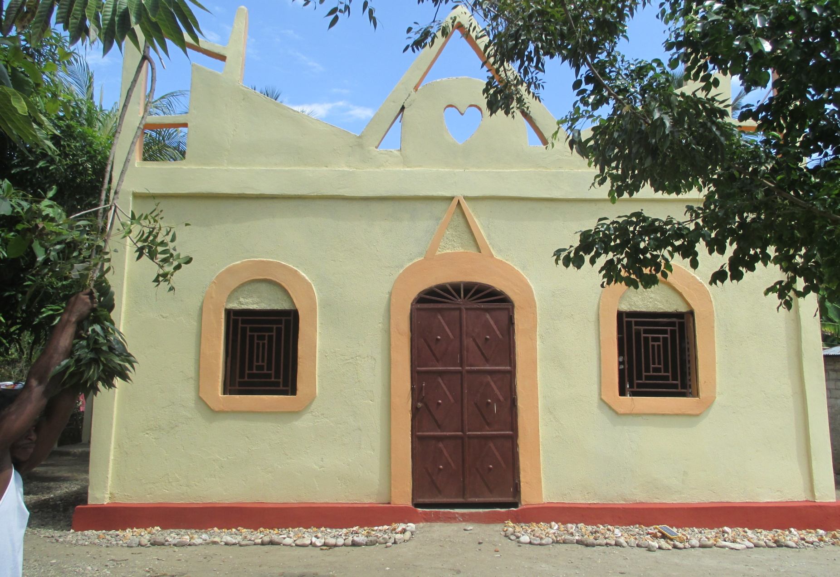
2016 – Church Paint Project

Slide 7
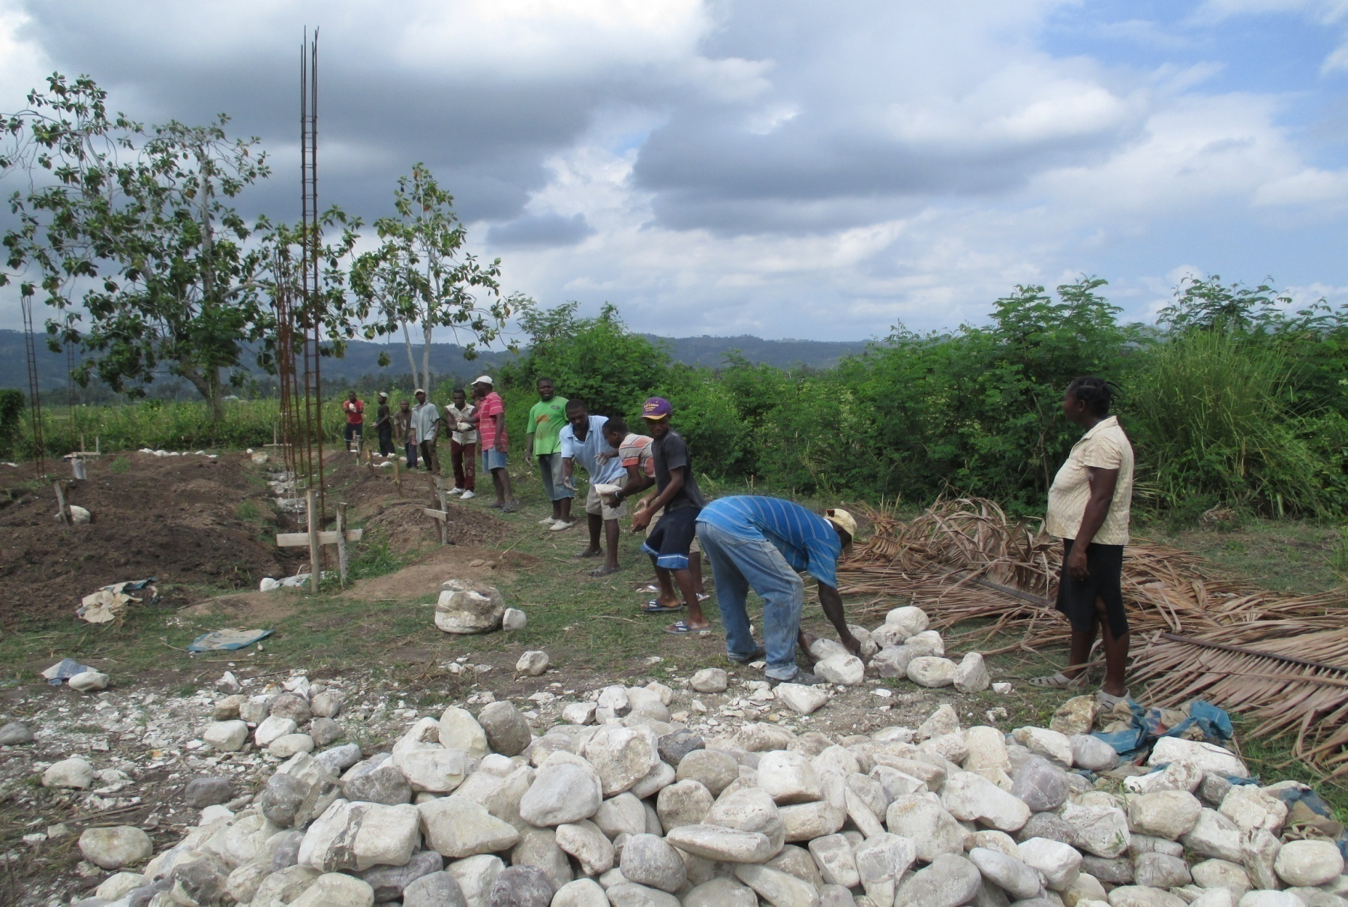
Rock for Foundation of House for Pastor Prince & Family -2015

Slide 8
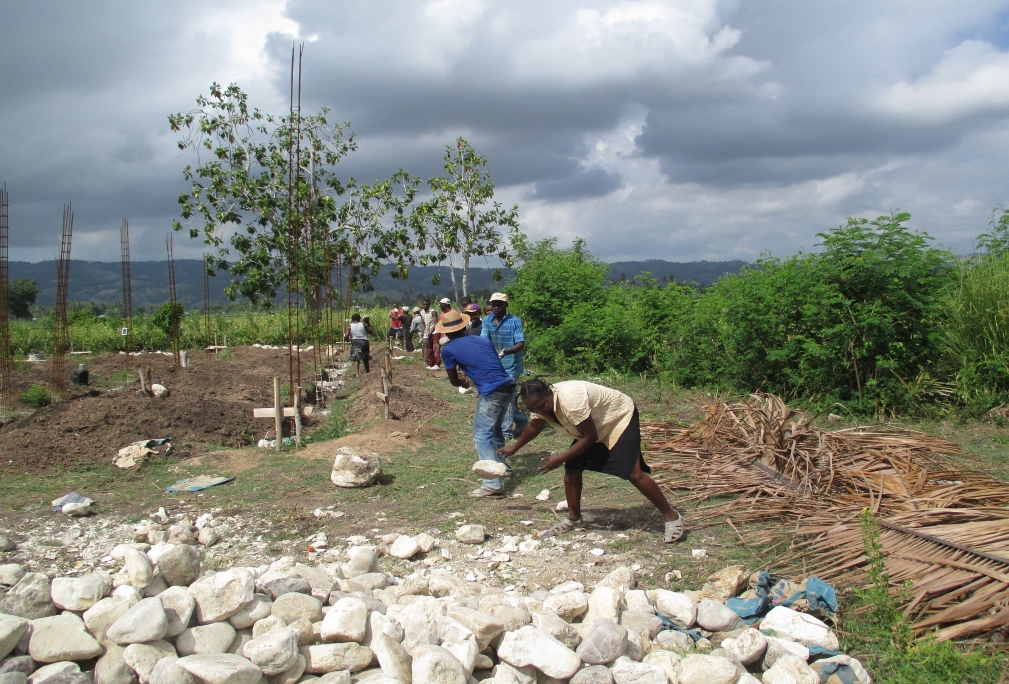

Slide 9
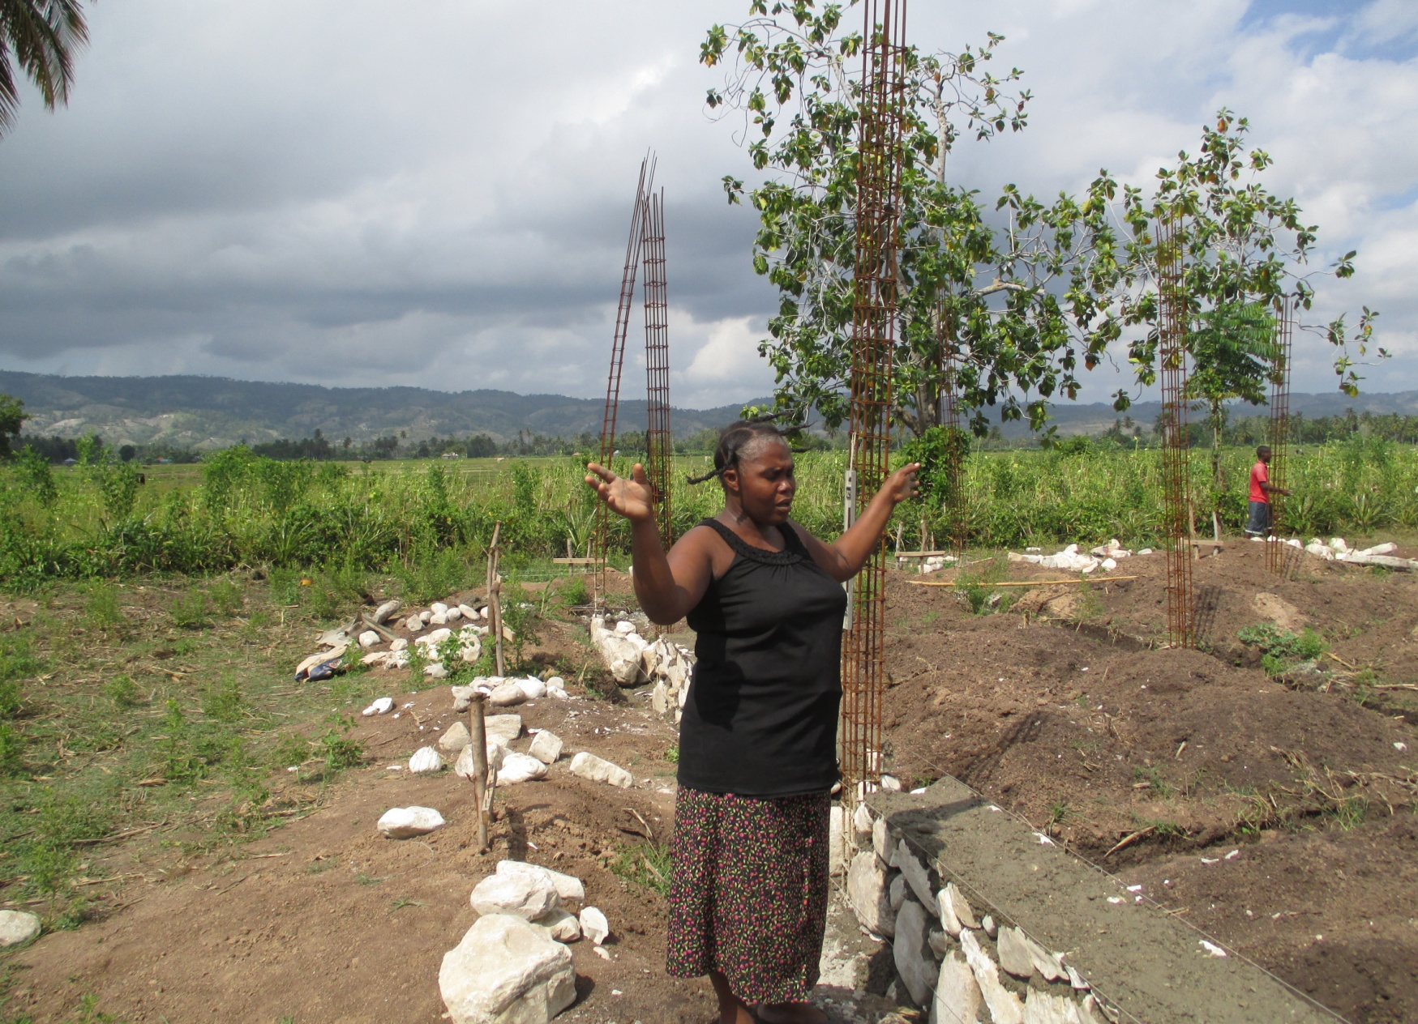
Mrs. Prince Praises God

Slide 10
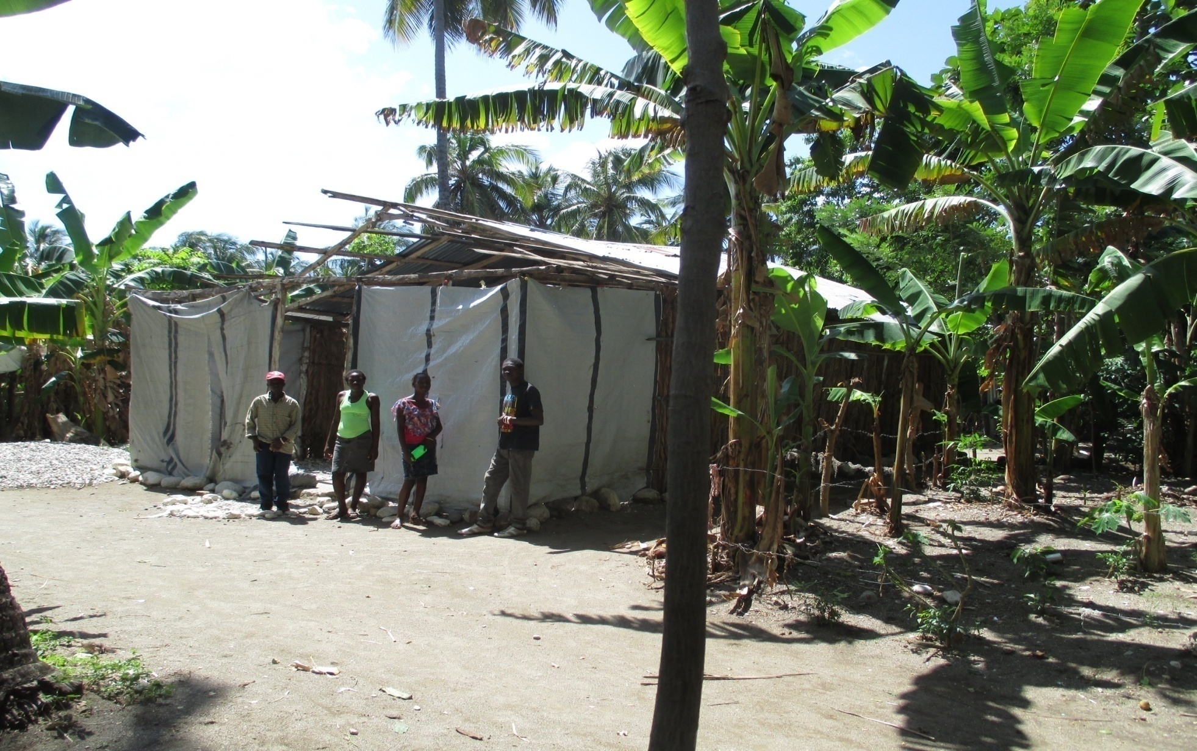
Roche-a-Bateau Church Needs Help to Finish Structure - 2016

Slide 11
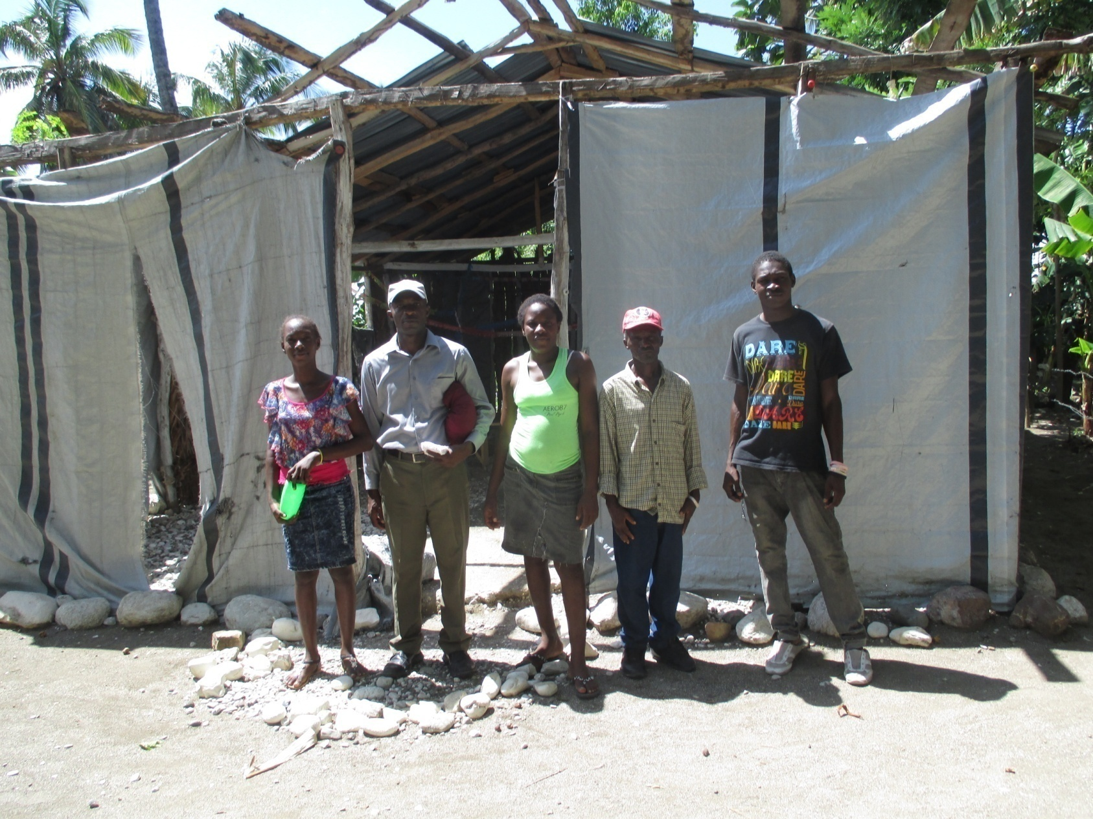
Pastor Mercieux – 2nd from Right

Slide 12
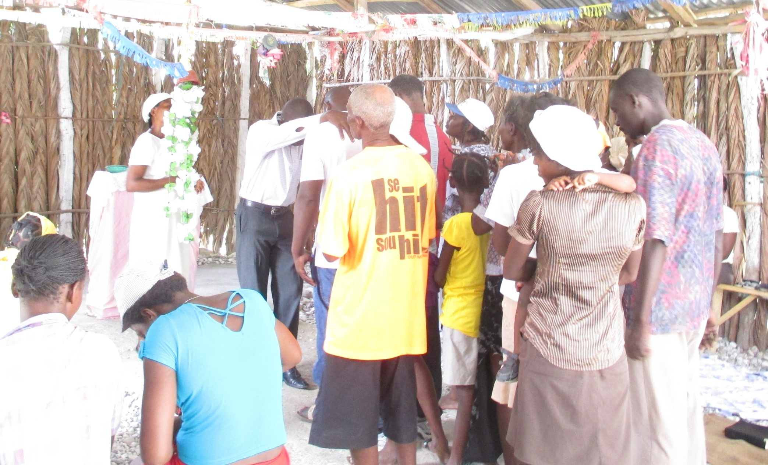
Prayer & Fasting - Prayer for Healing

Slide 13
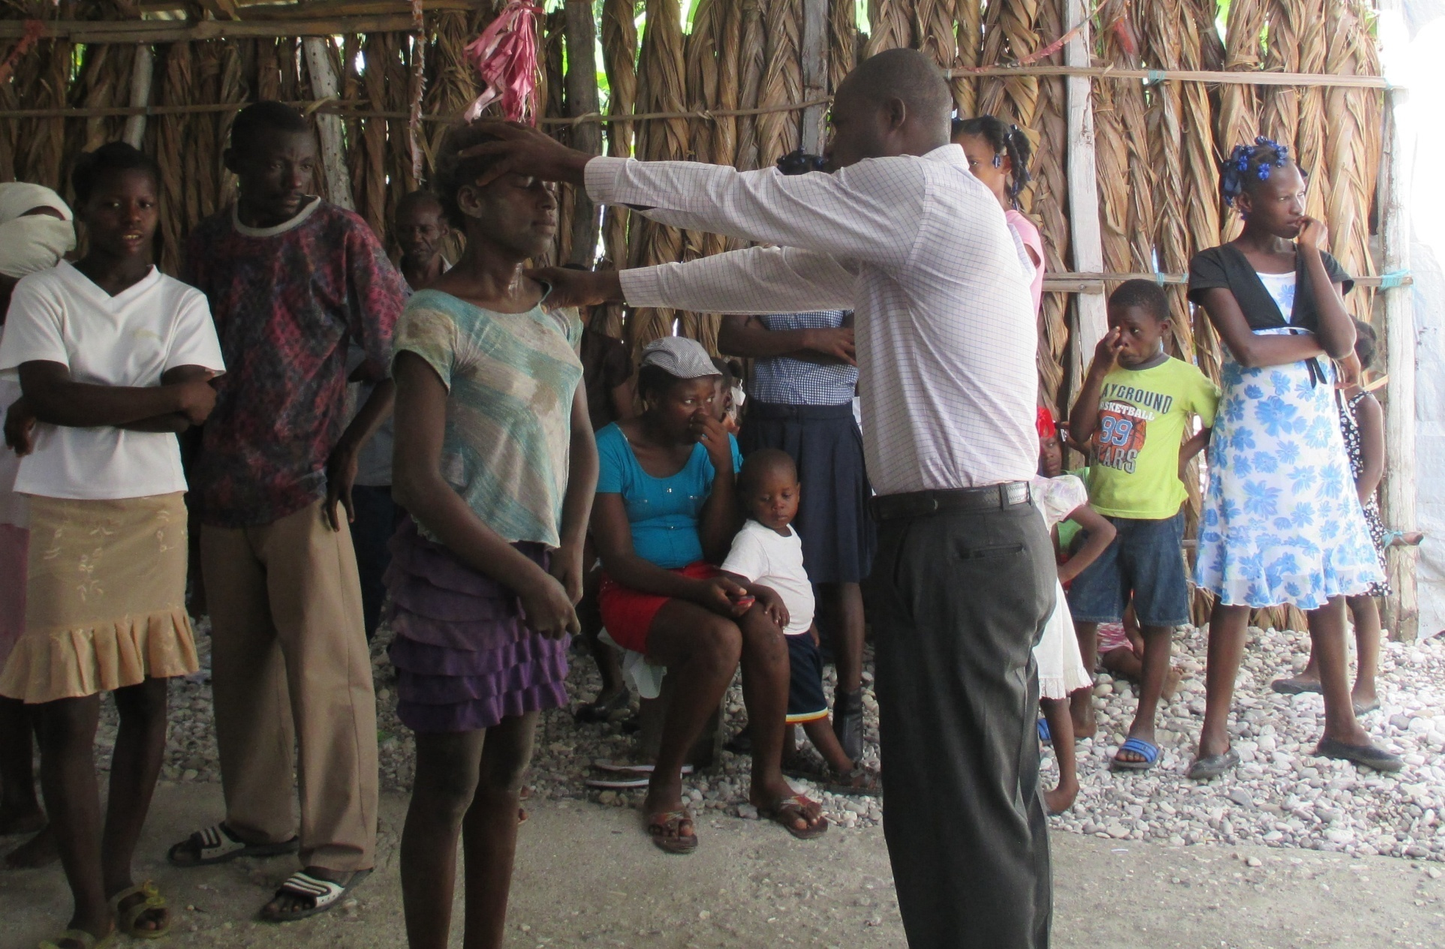

Slide 14
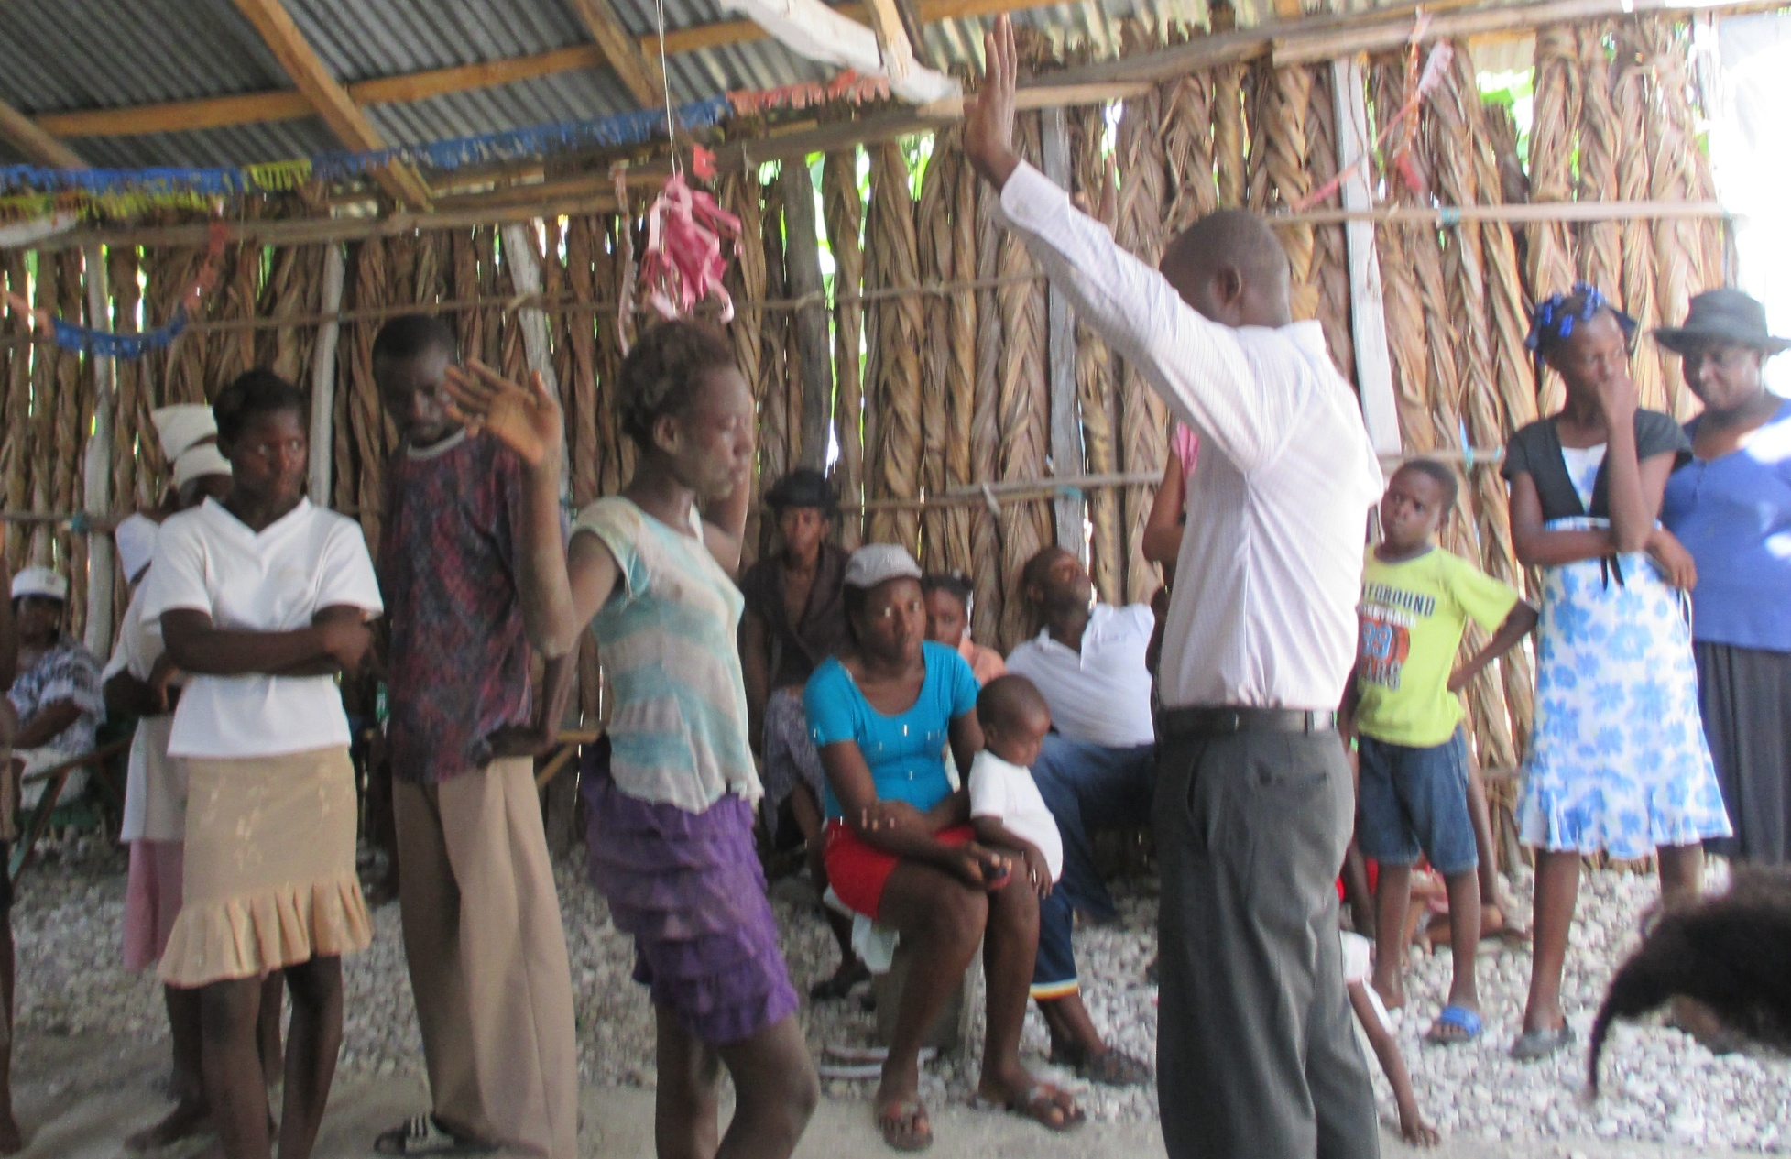

Slide 15
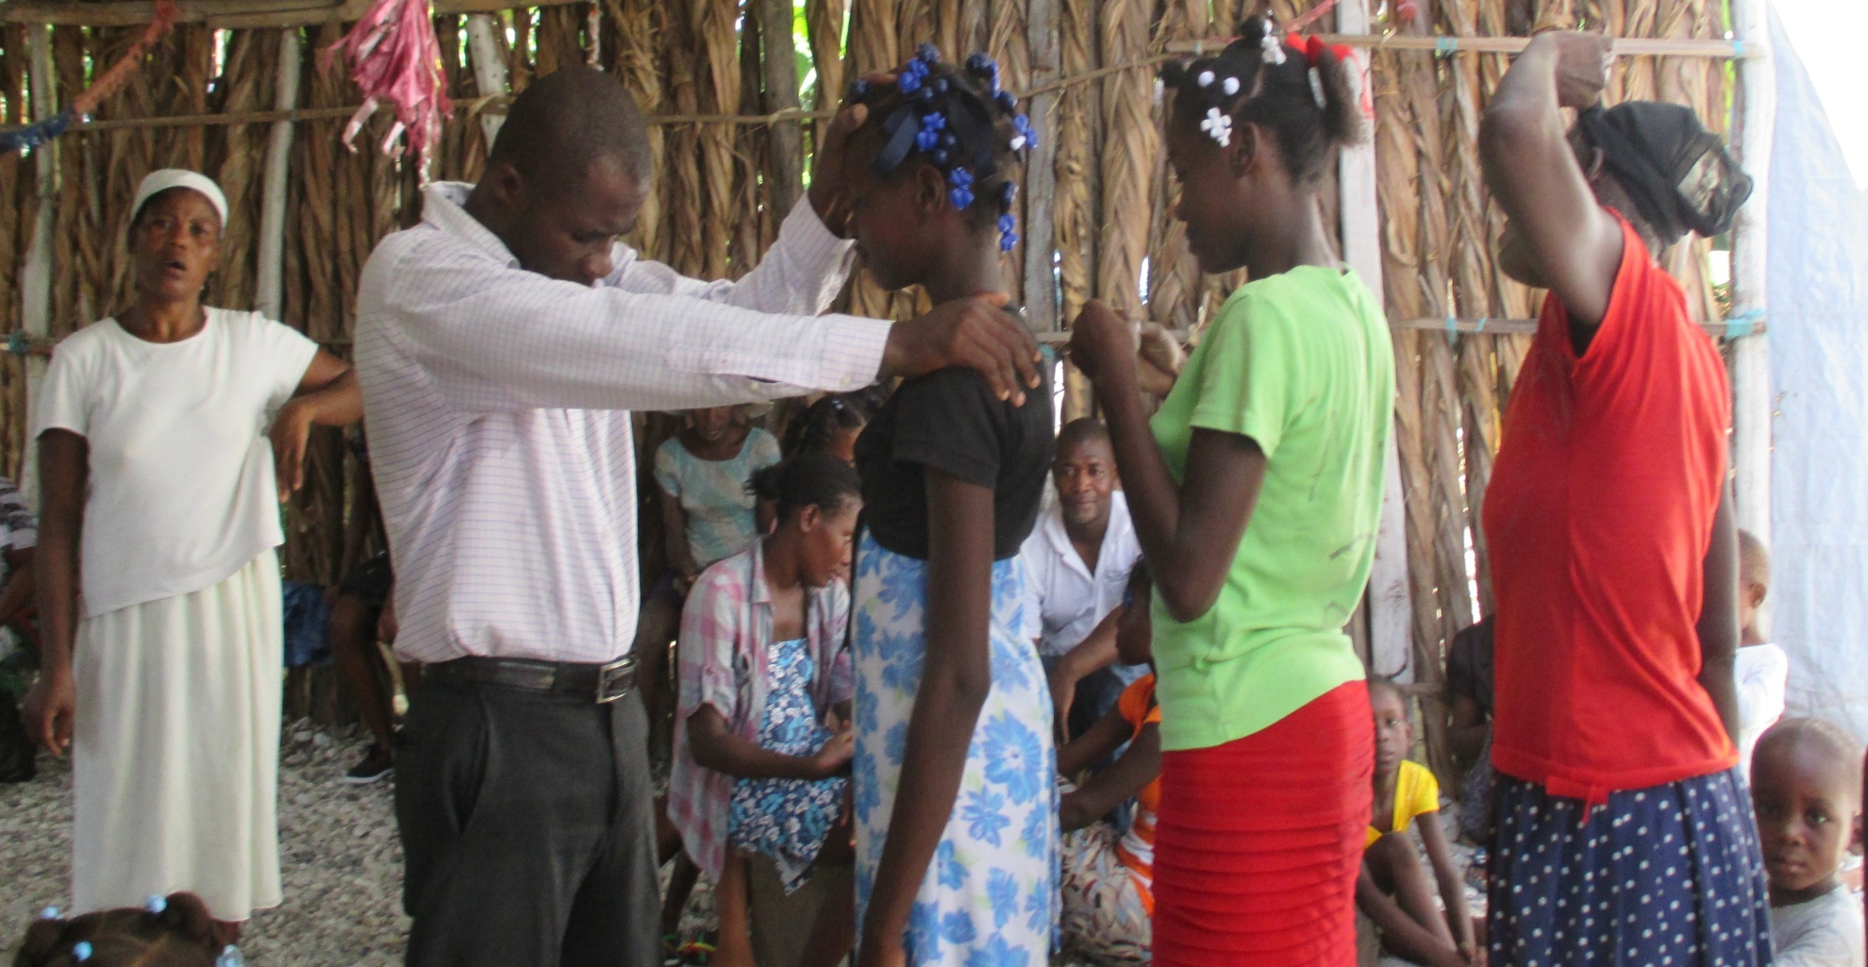

Slide 16
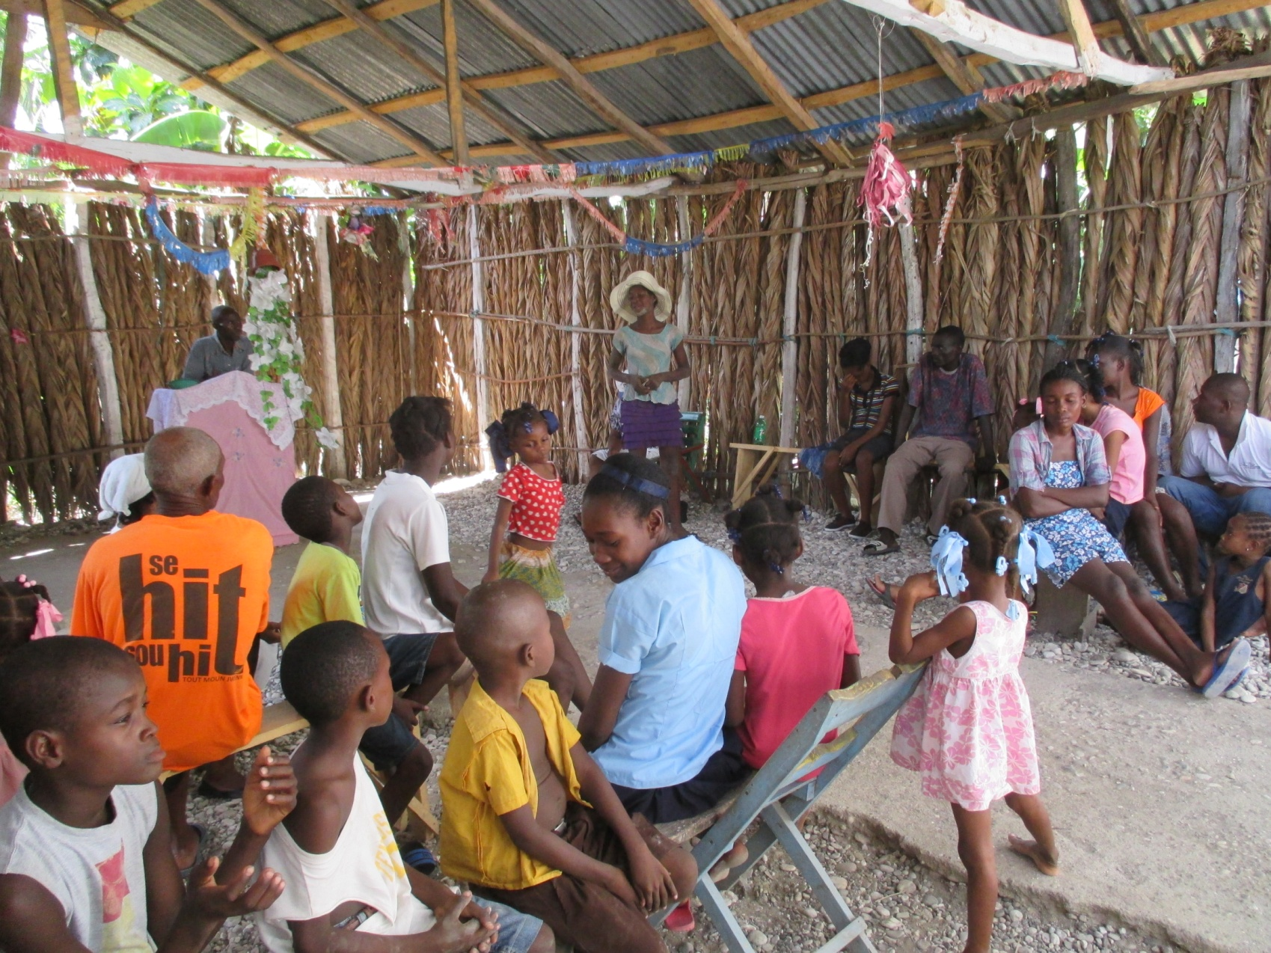

Slide 17
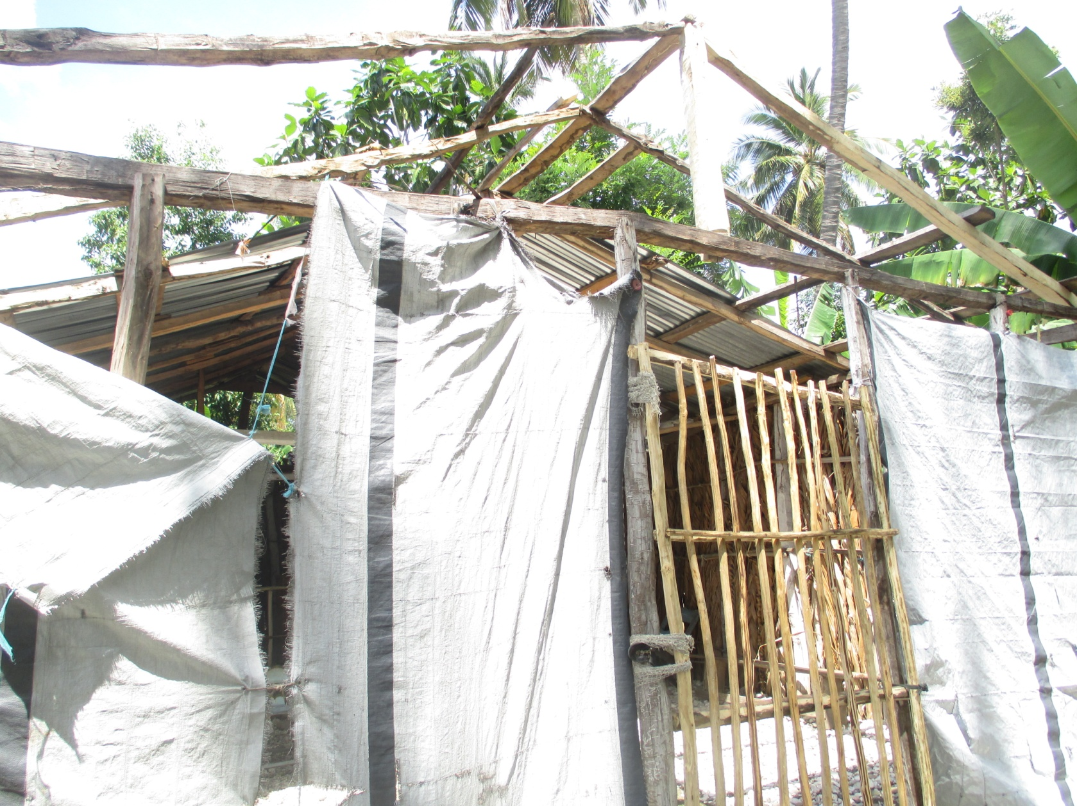
Work on Roof

Slide 18
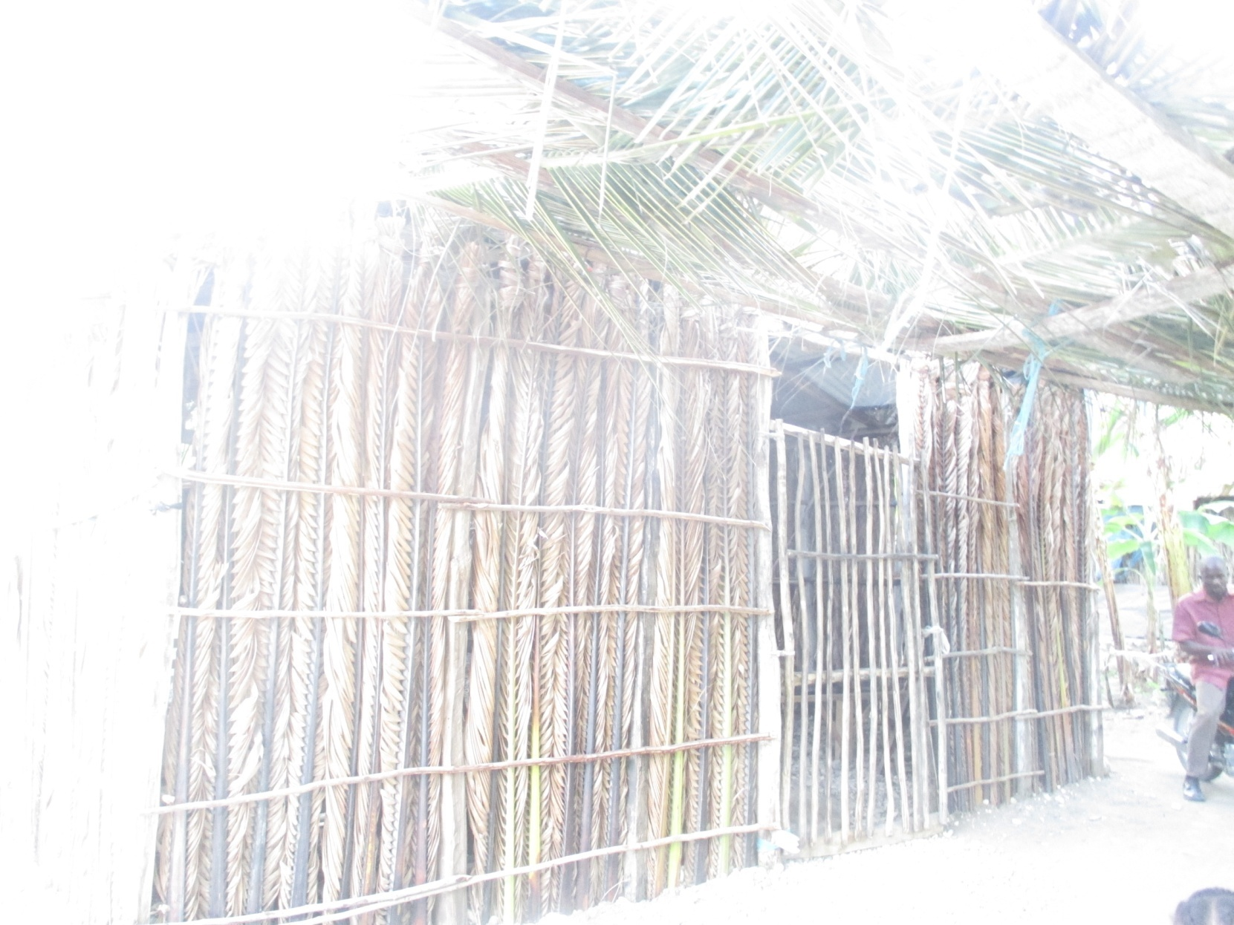
Finish Front of Church

Slide 19
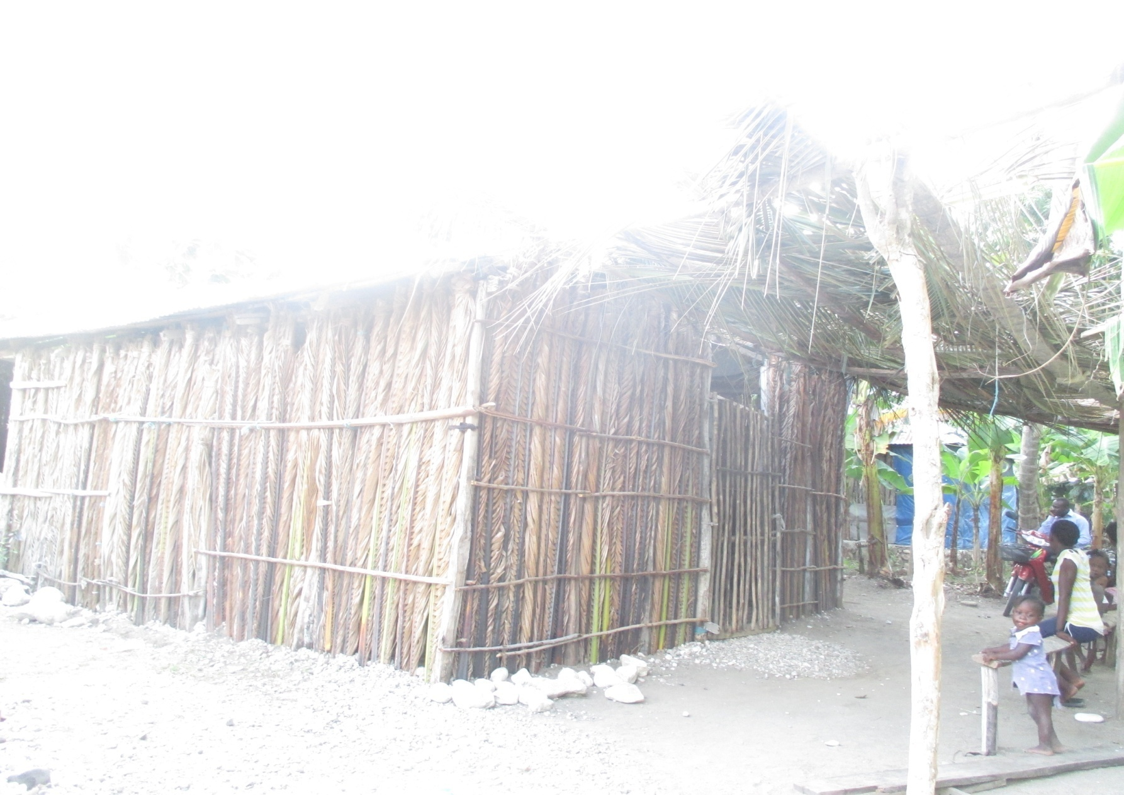

Slide 20
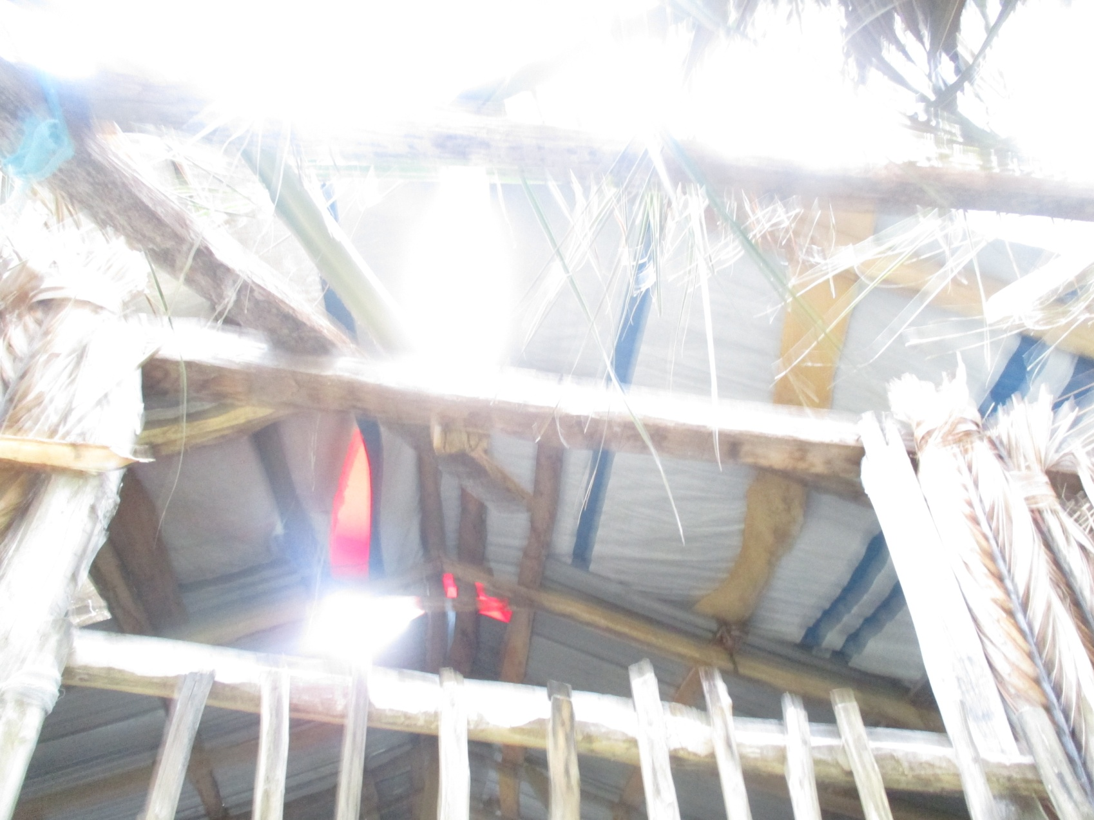
Use Tarp to Finish Roof

Slide 21
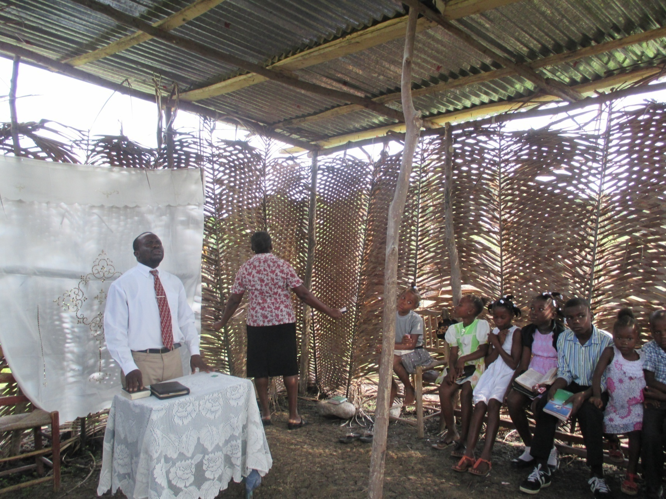
2015 – Church Plant – Chantel

Slide 22
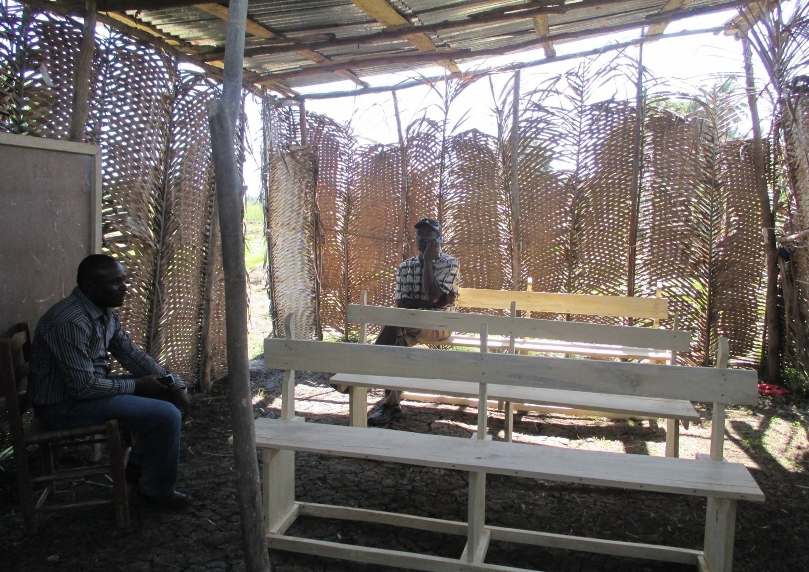
2016 - We Contribute 3 Pews

Slide 23
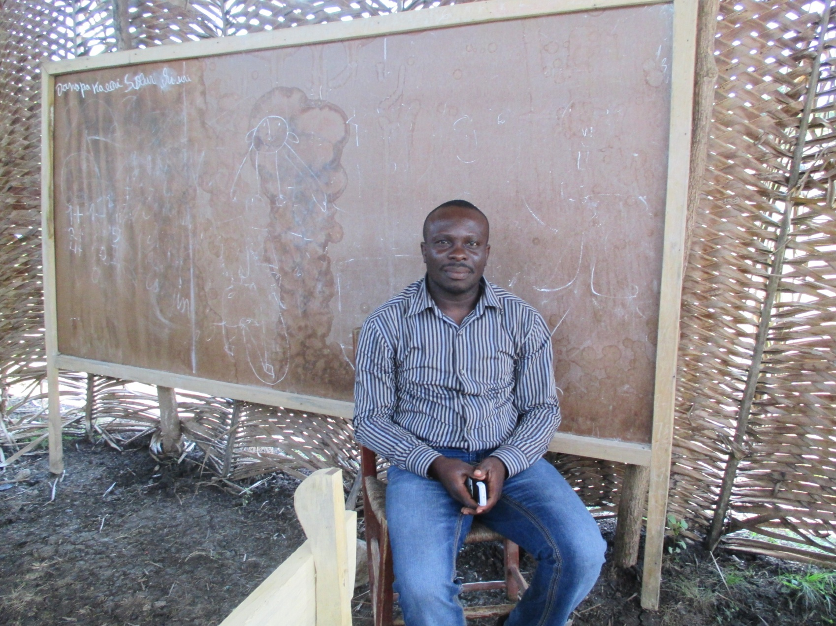
Pastor Oles

Slide 24
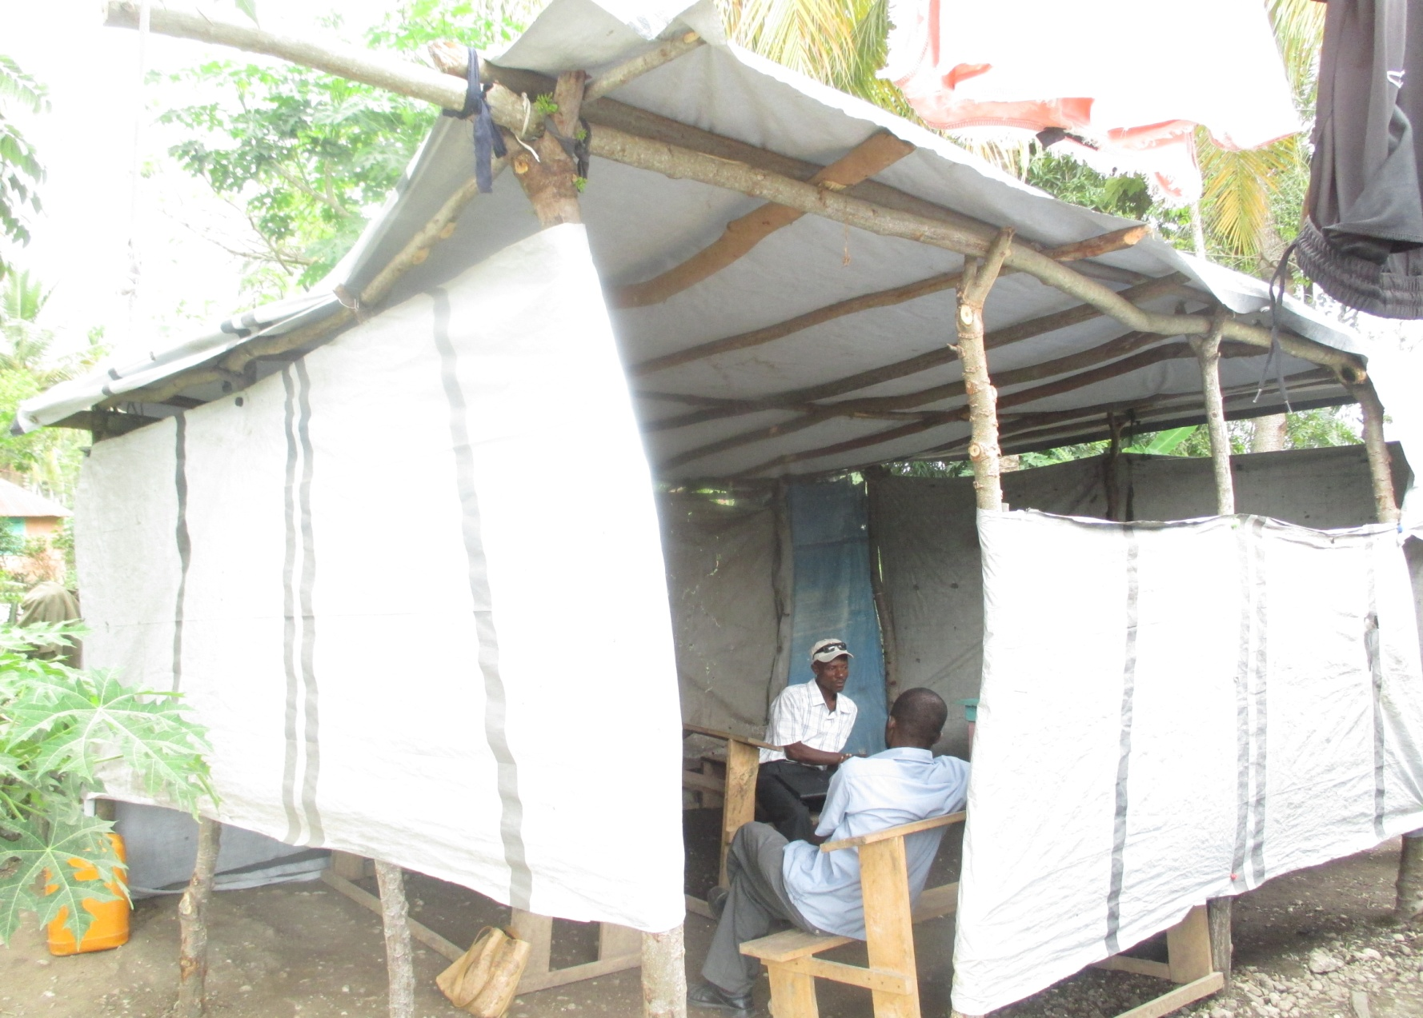
2016 – Another church Plant in Chantel – Pastor St. Jean

Slide 25
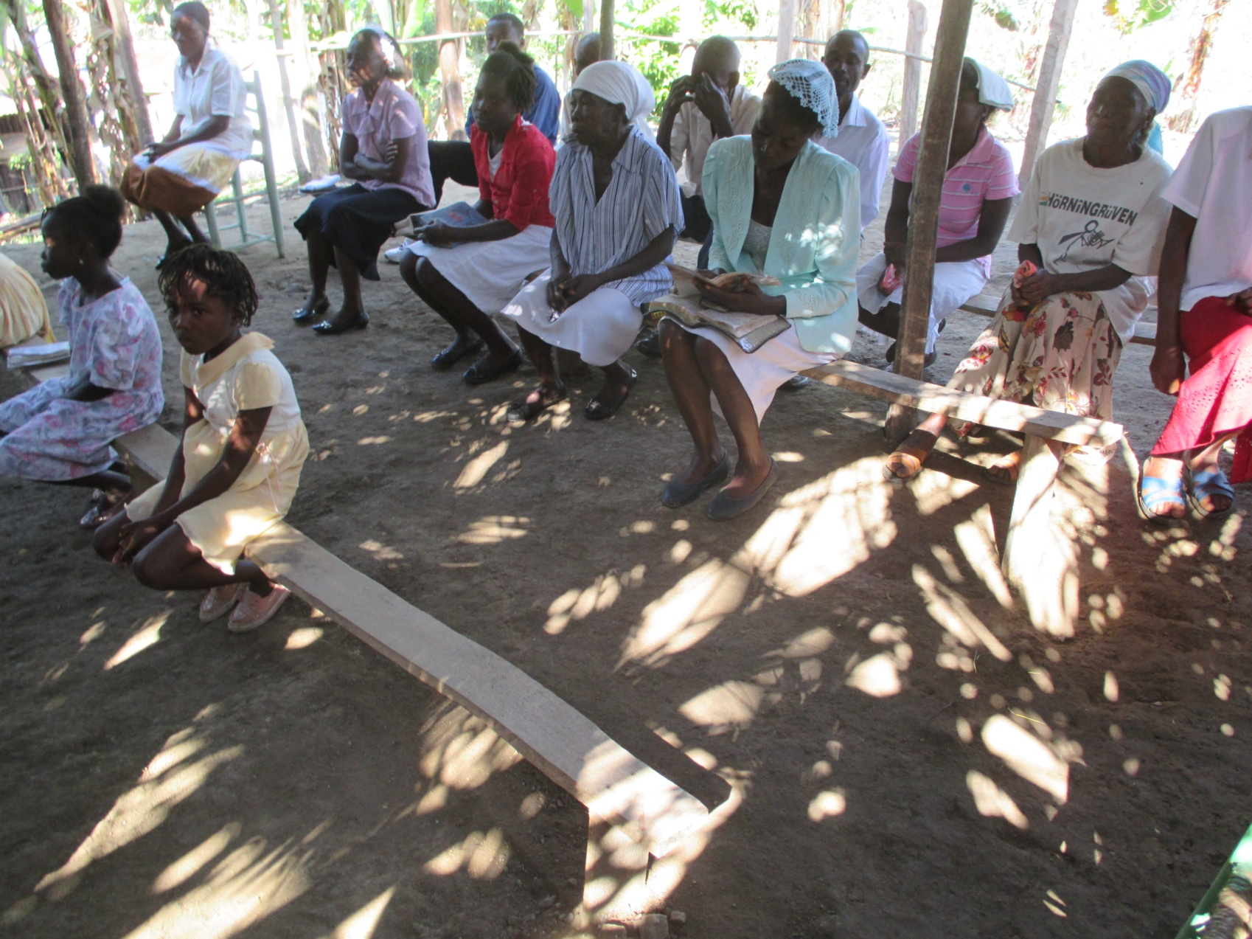
2016 – Church Plant in Beaumont near Jeremie

Slide 26
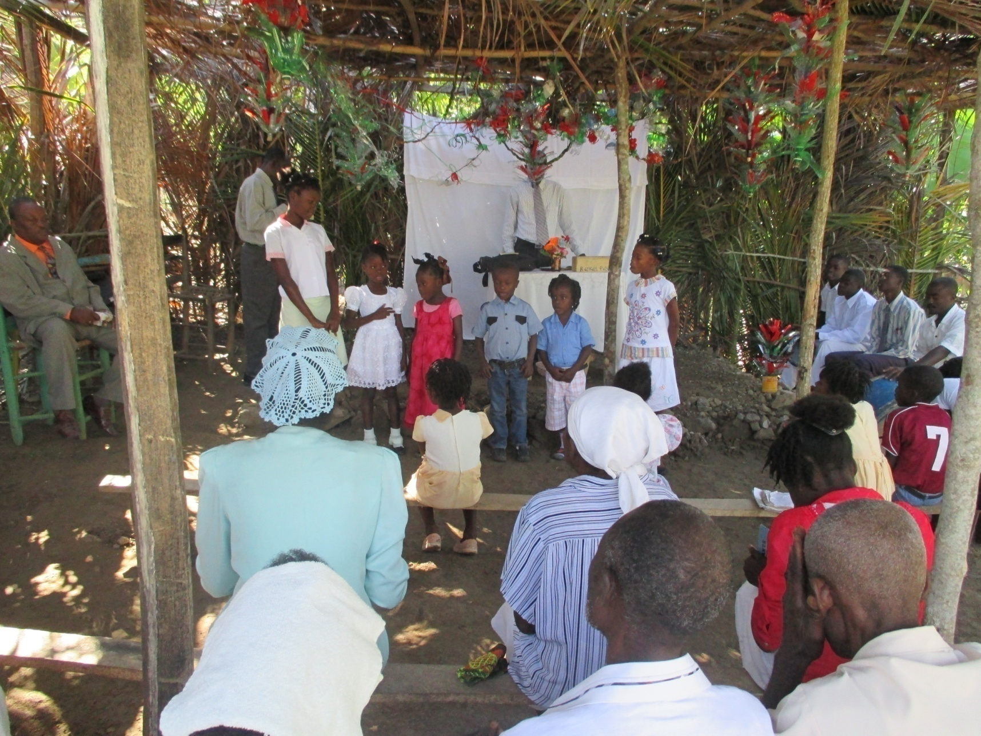
They are So Happy to Have a Church in Their Area

Slide 27
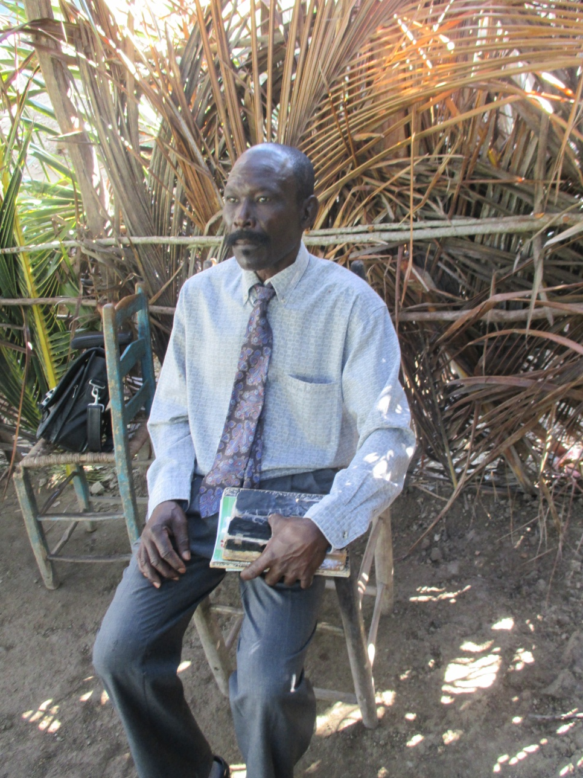
Pastor Richmond

Slide 28
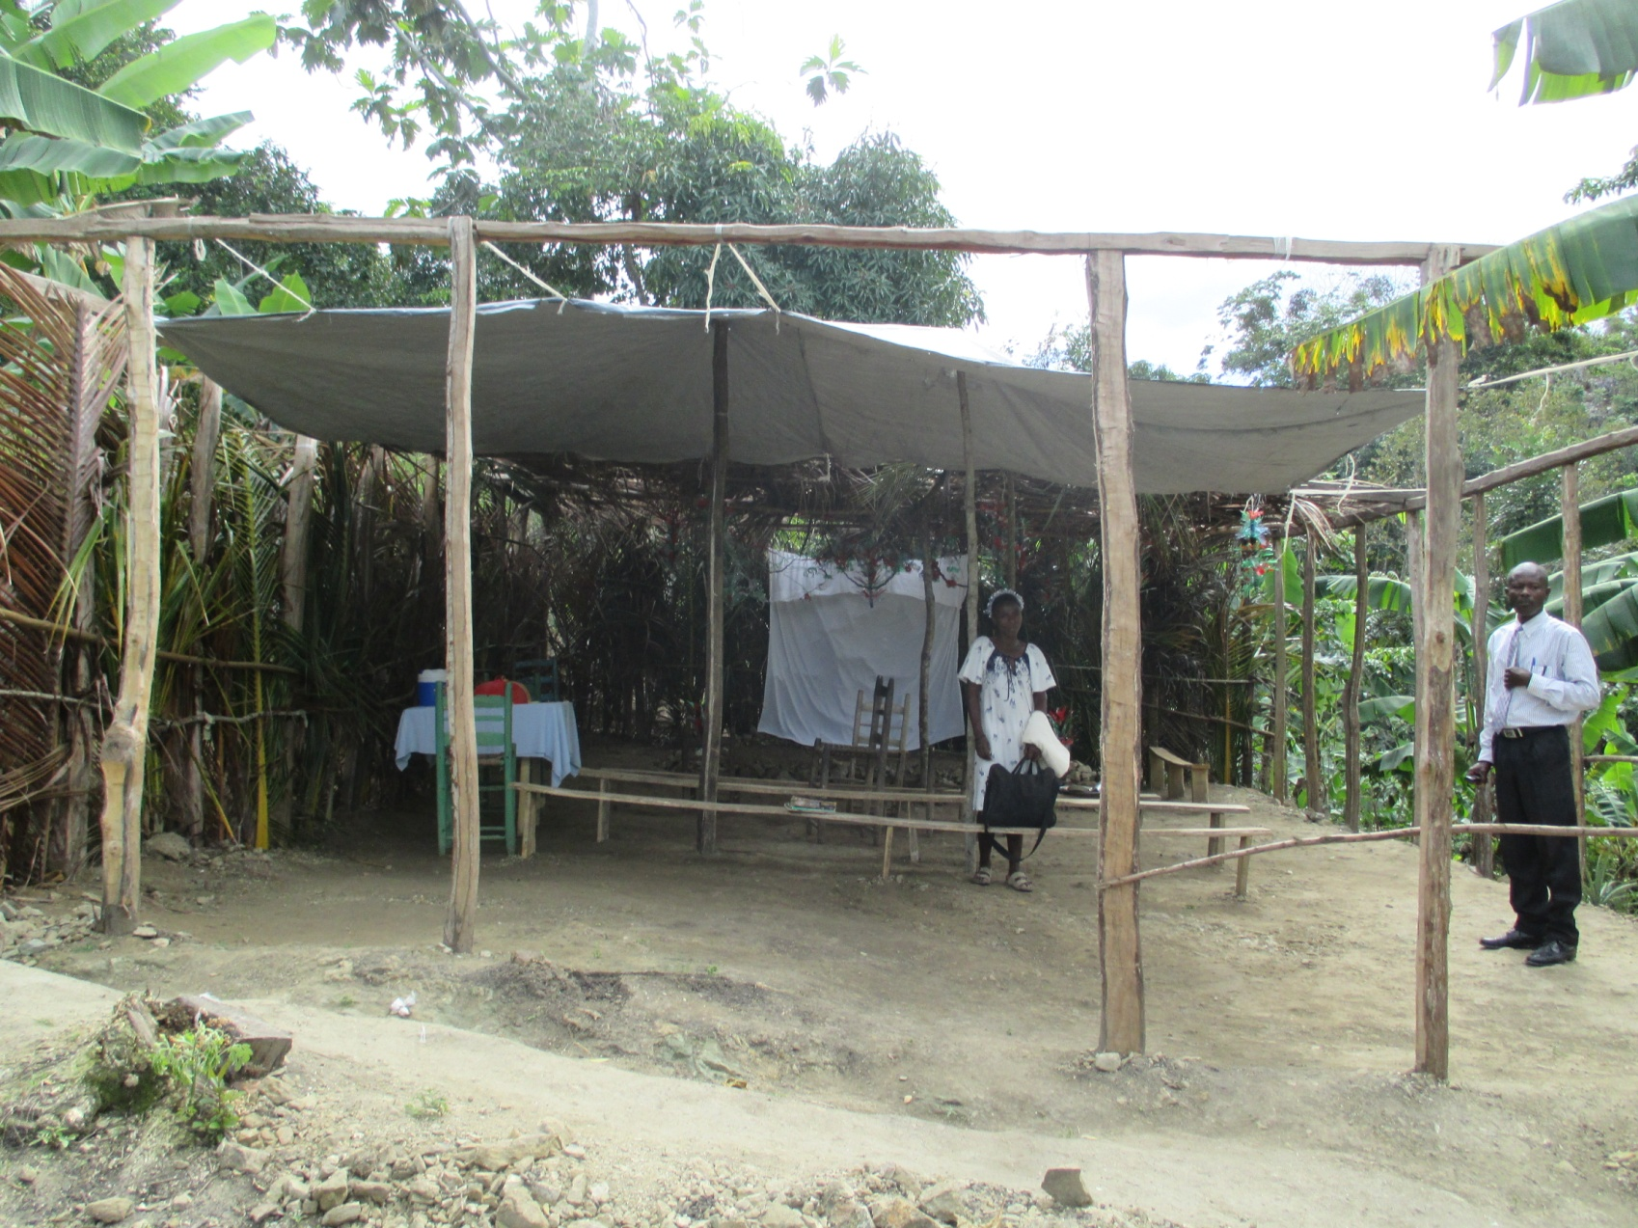
Beaumont – Outside Church Structure

Slide 29
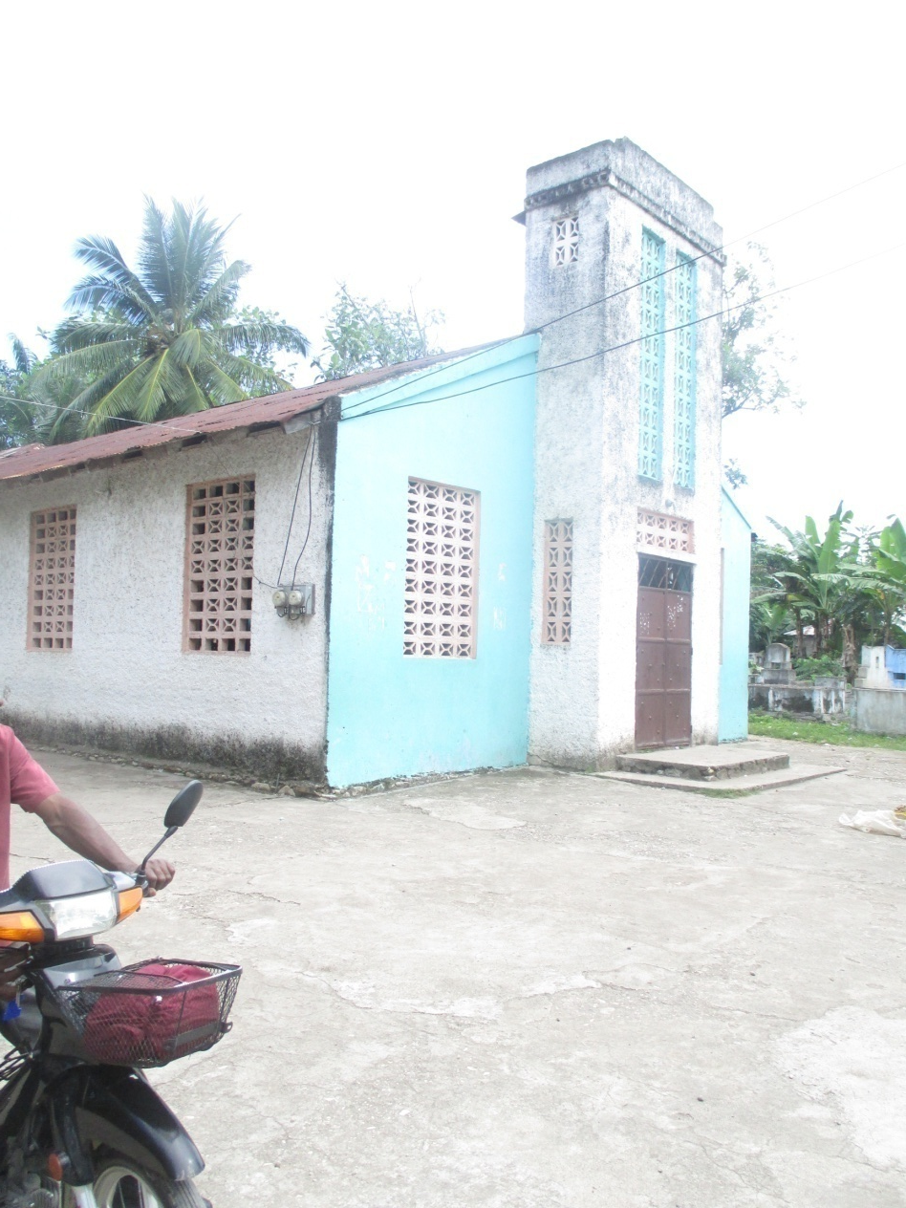
Wesleyan Church – On Main Road

Slide 30
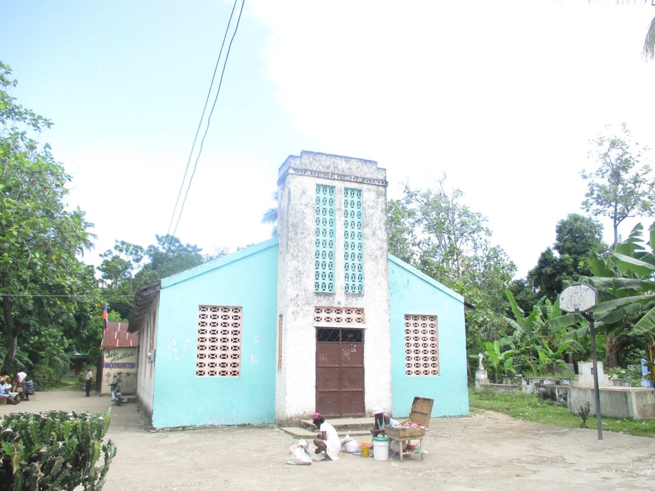
Church Needs Paint and a New Roof

Slide 31
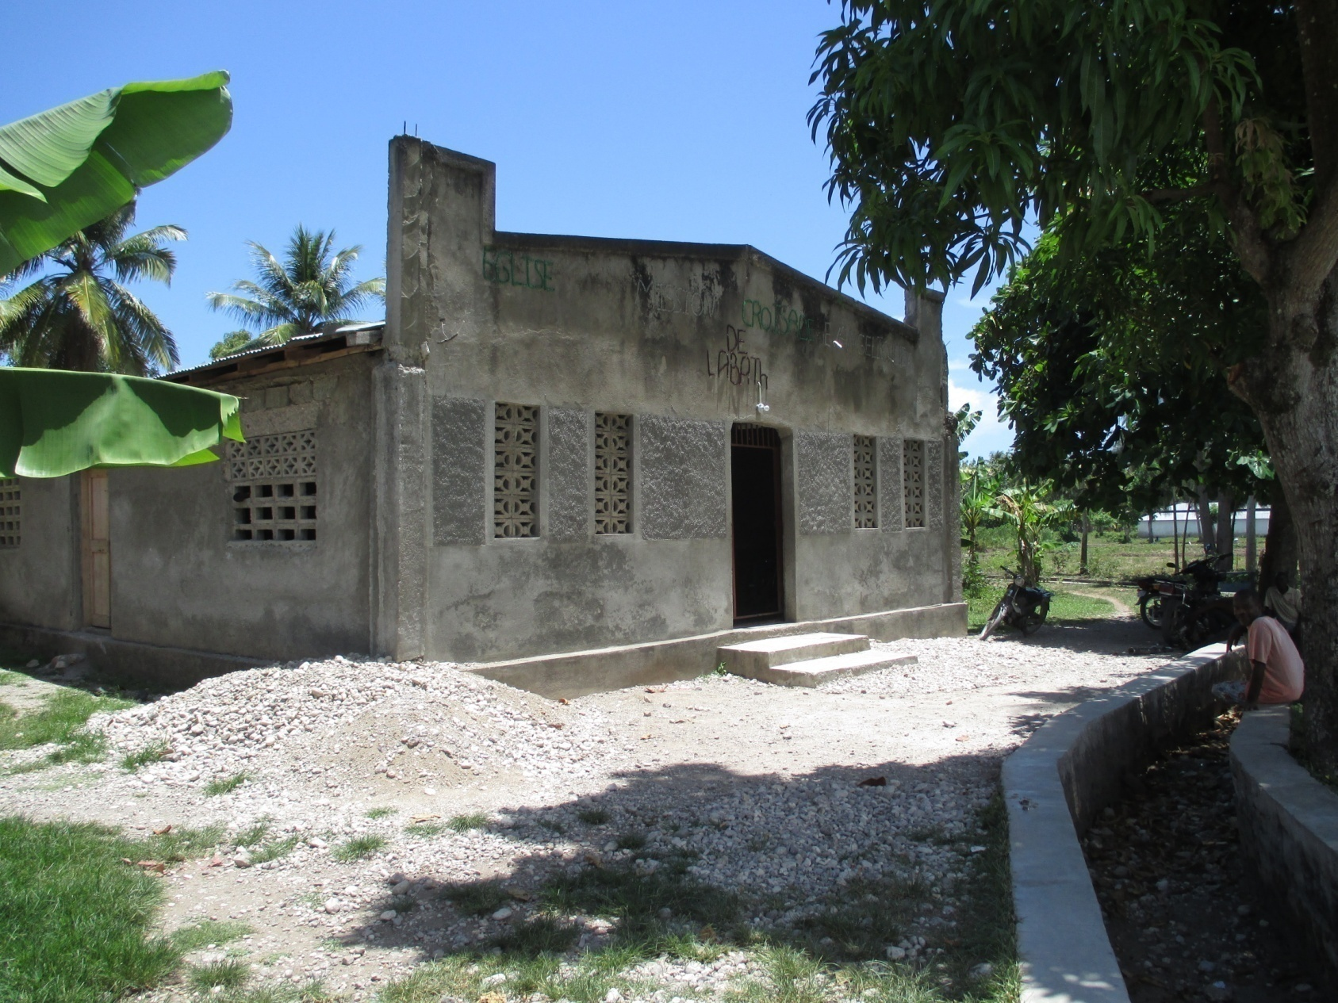
2016 – Crusade Church – Finished Inside; Outside Needs Cement Work

Slide 32
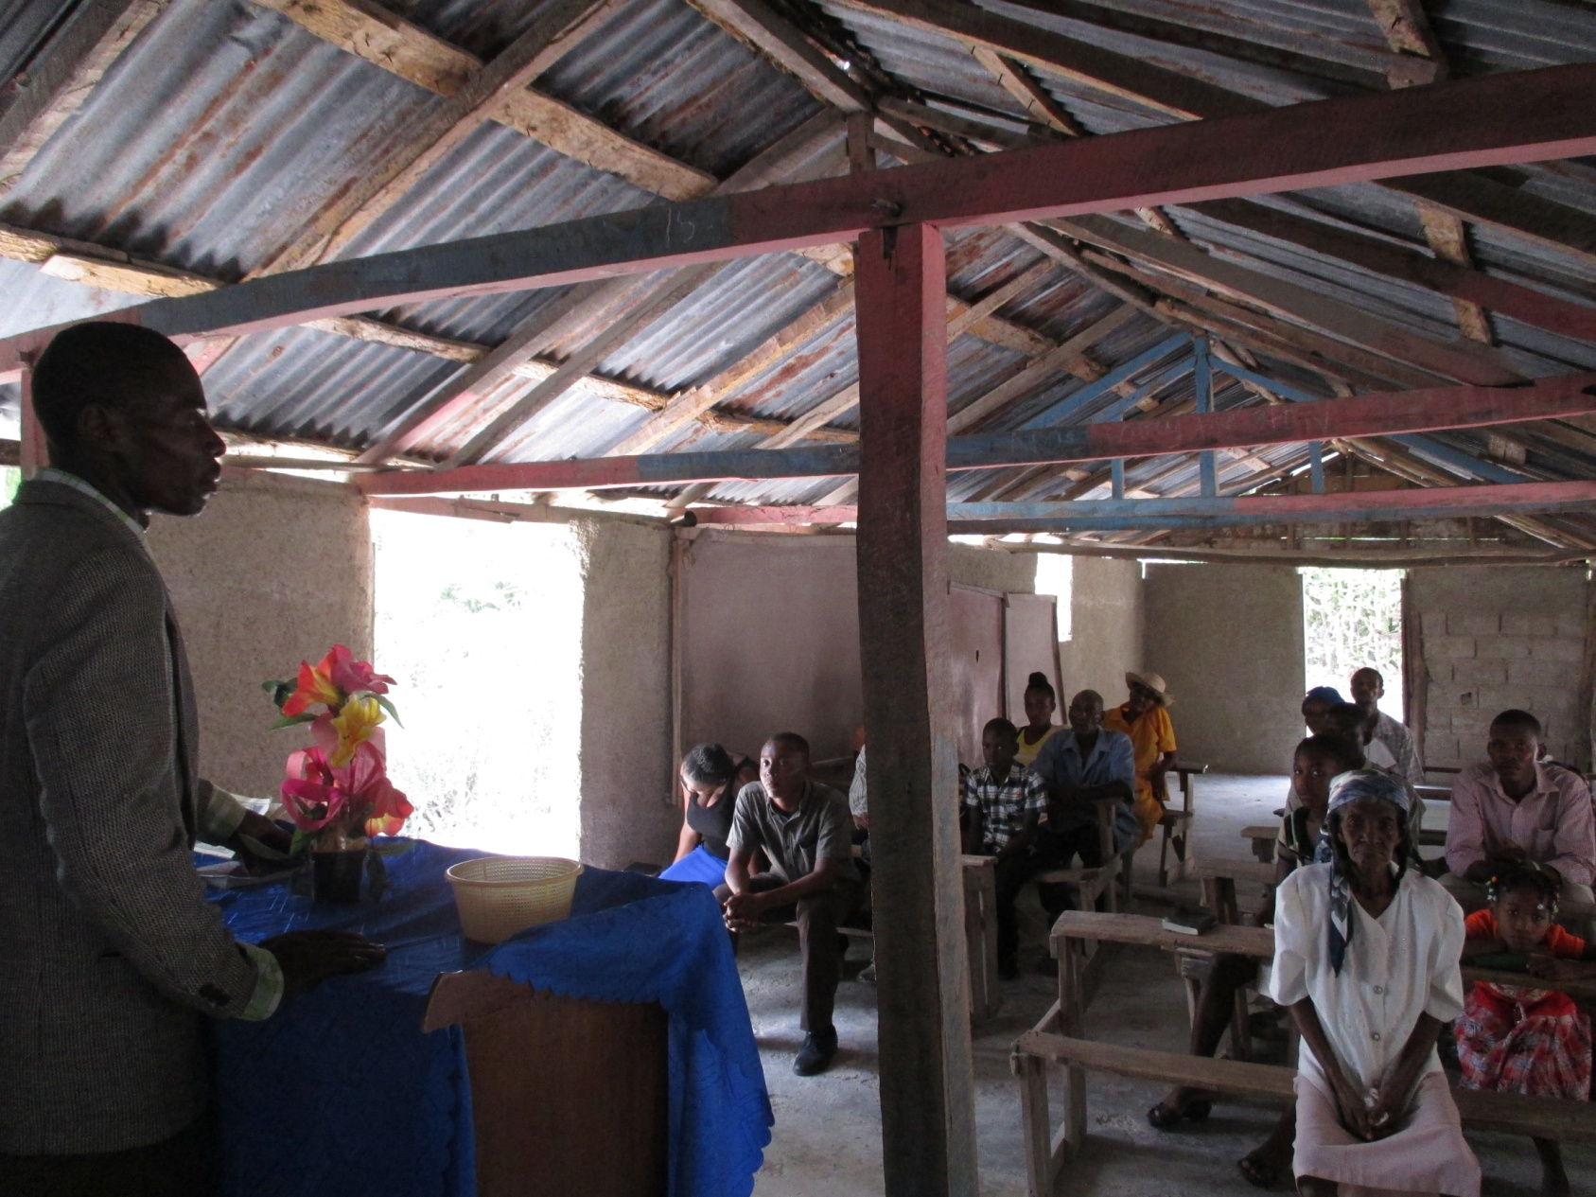
2015 – Fonds des Bleau Church Needs Roof and Structural Repair

Slide 33
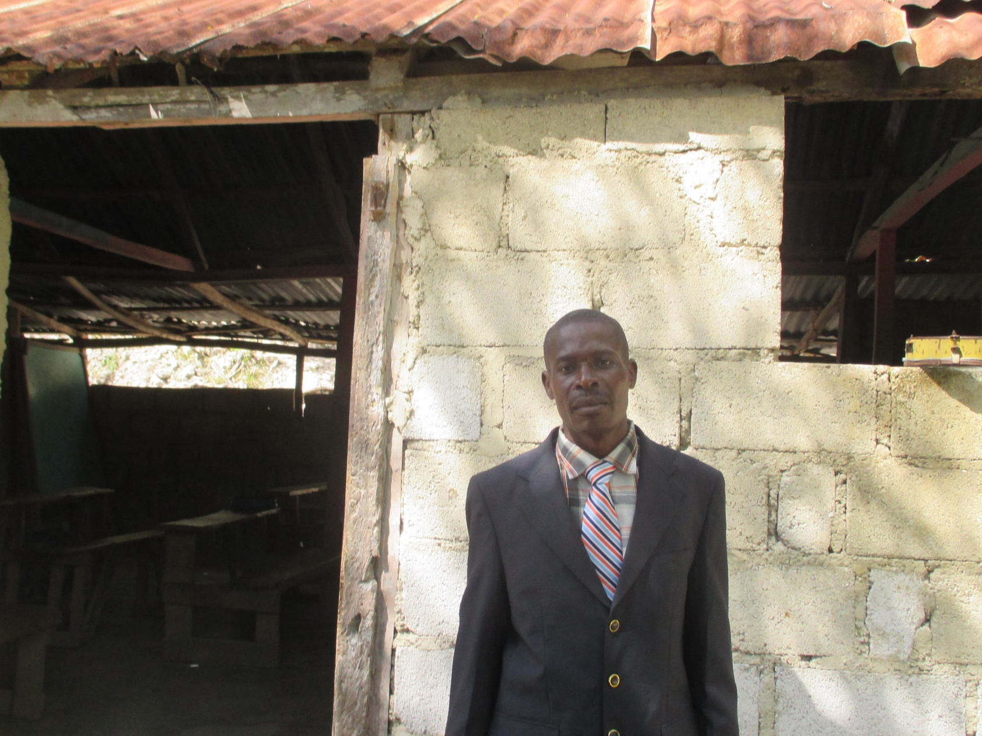
Pastor Labodie

Slide 34
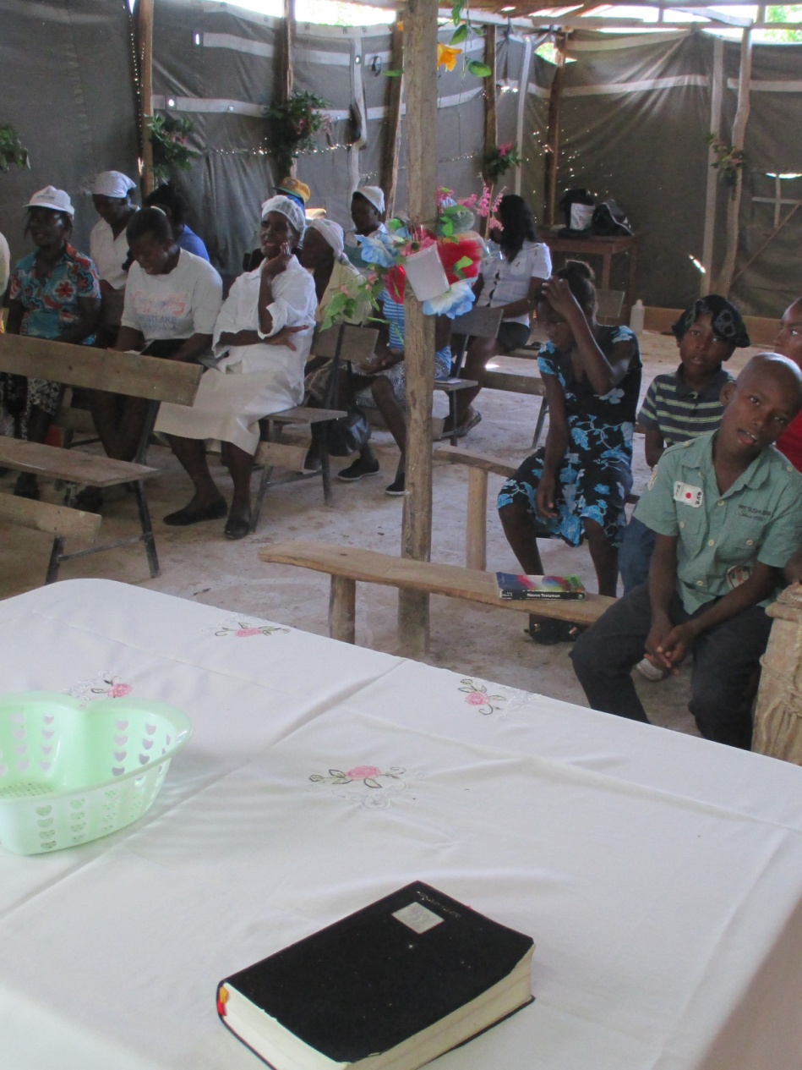
Church East of Fonds des Bleau

Slide 35
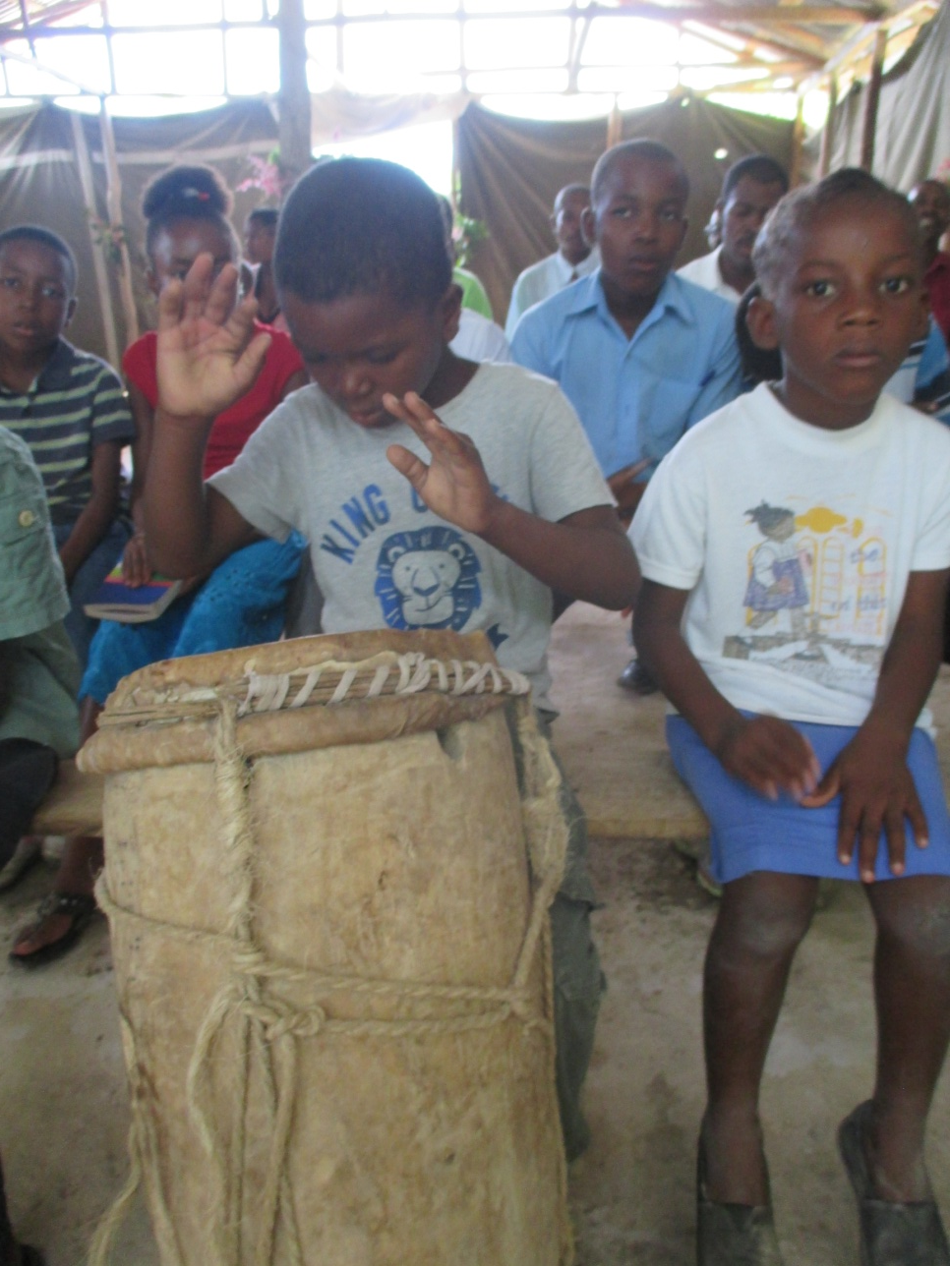

Slide 36
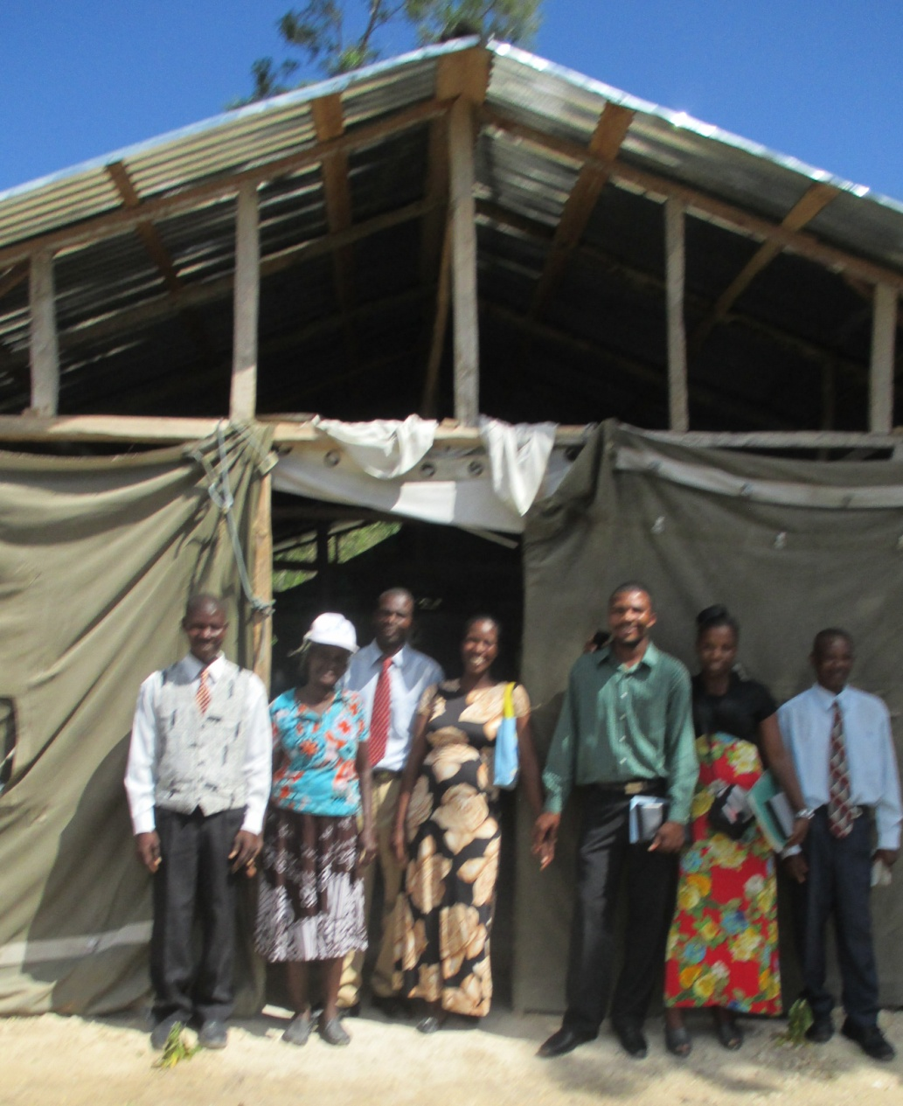
Pastor and Church Leaders Want Help to Finish Church

Slide 37
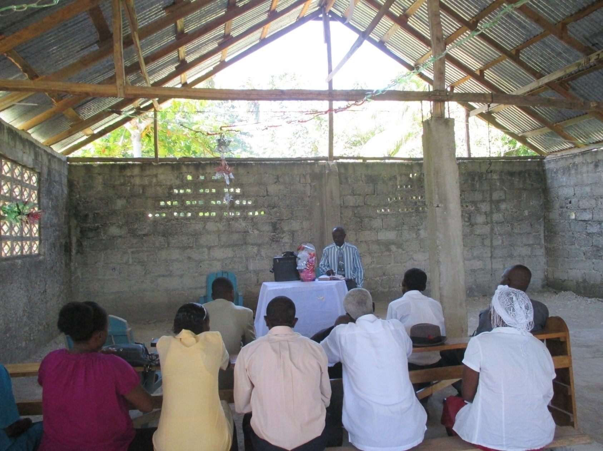
2016 – Camp Perrin Mountain Church

Slide 38
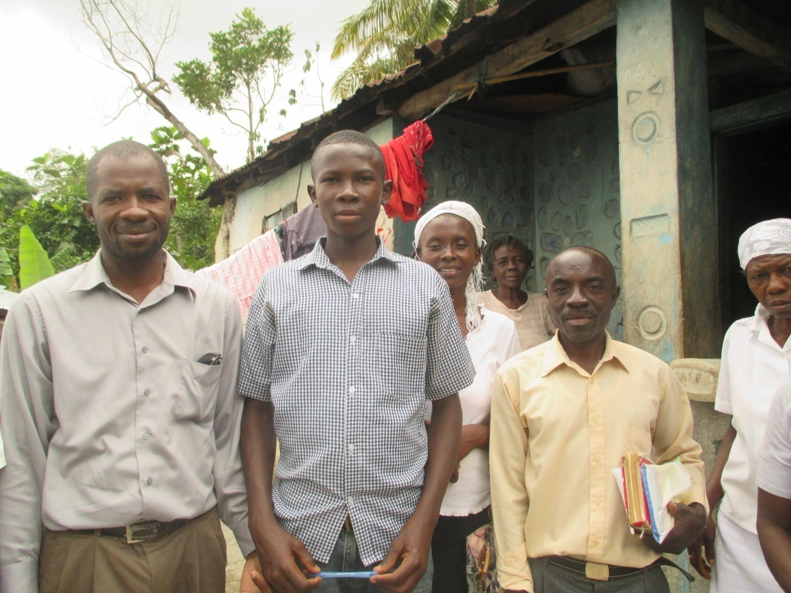
25 Members Go on Evangelism With Us

Slide 39
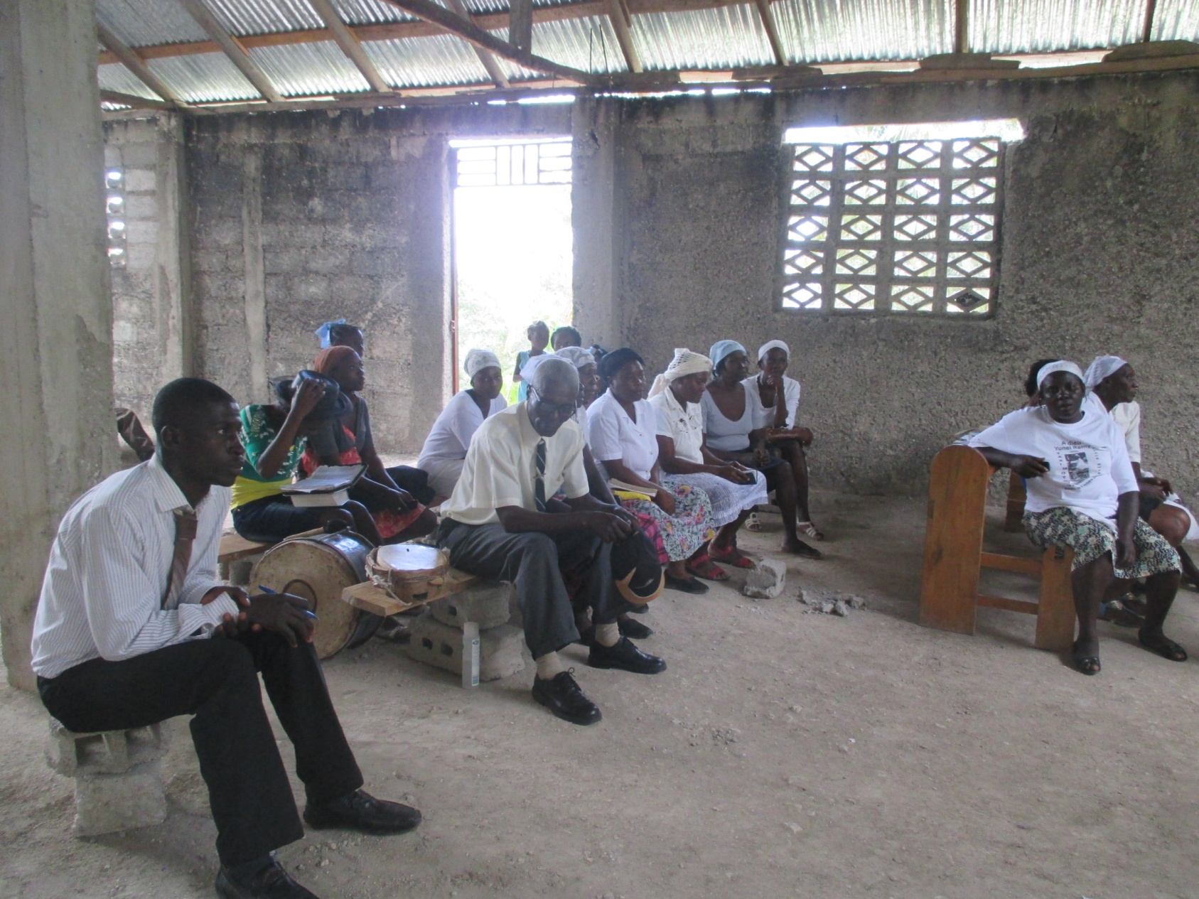
We Give Instruction in Evangelism

Slide 40
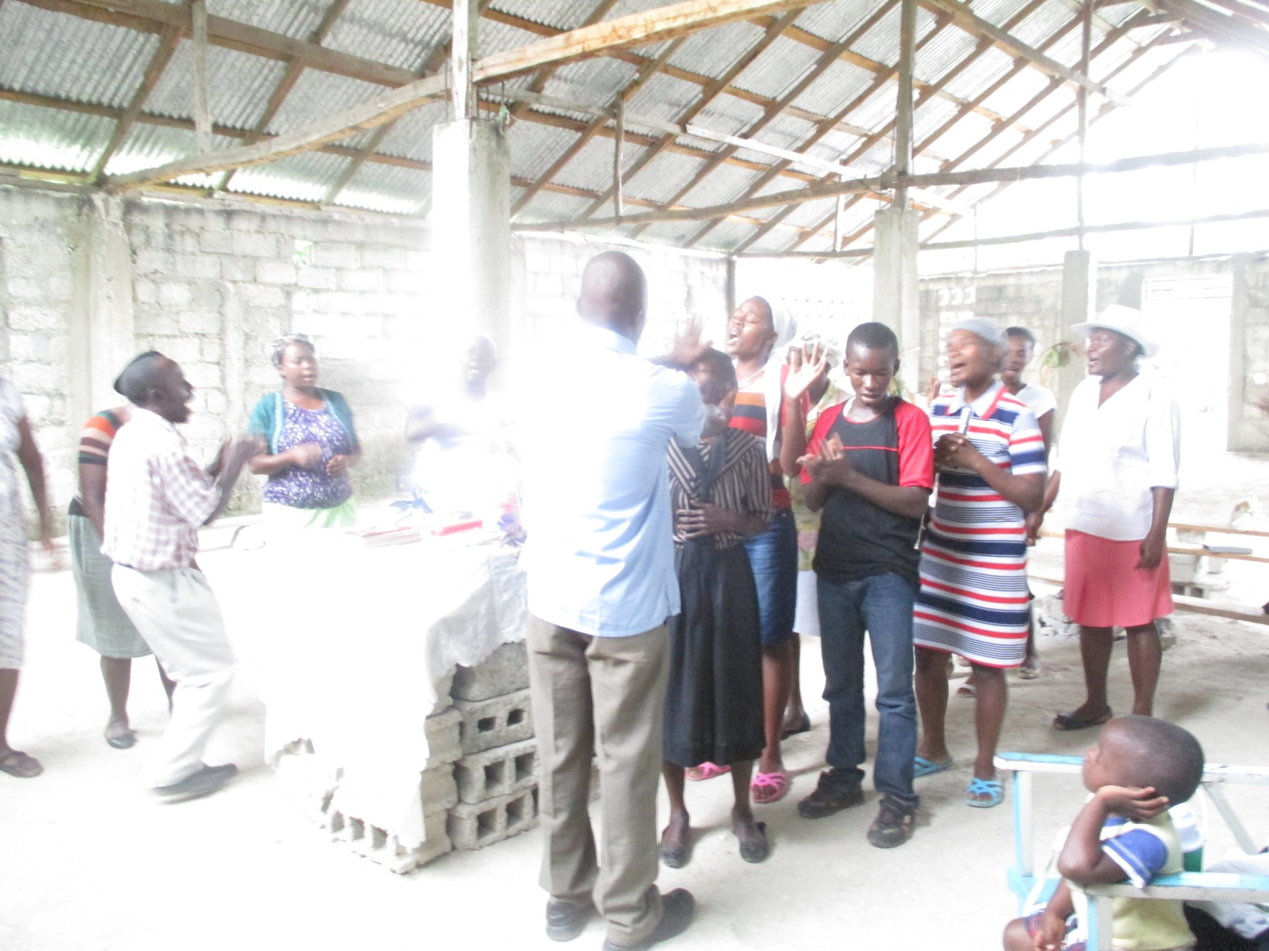
Rained Out – So Had Prayer for Healing

Slide 41
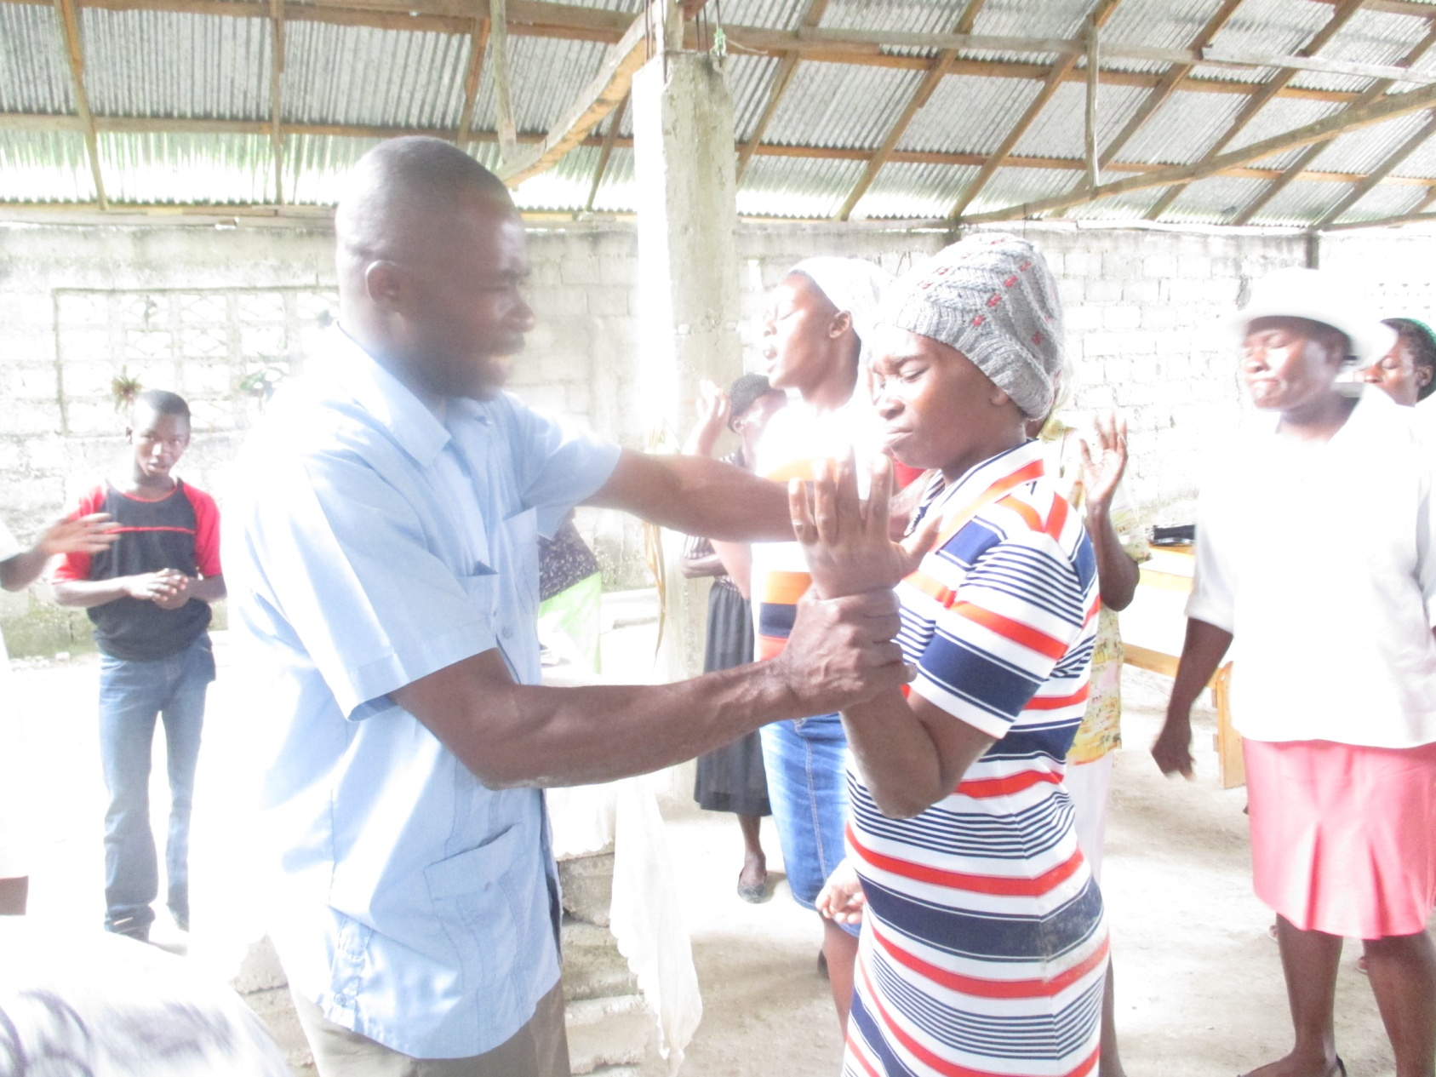

Slide 42
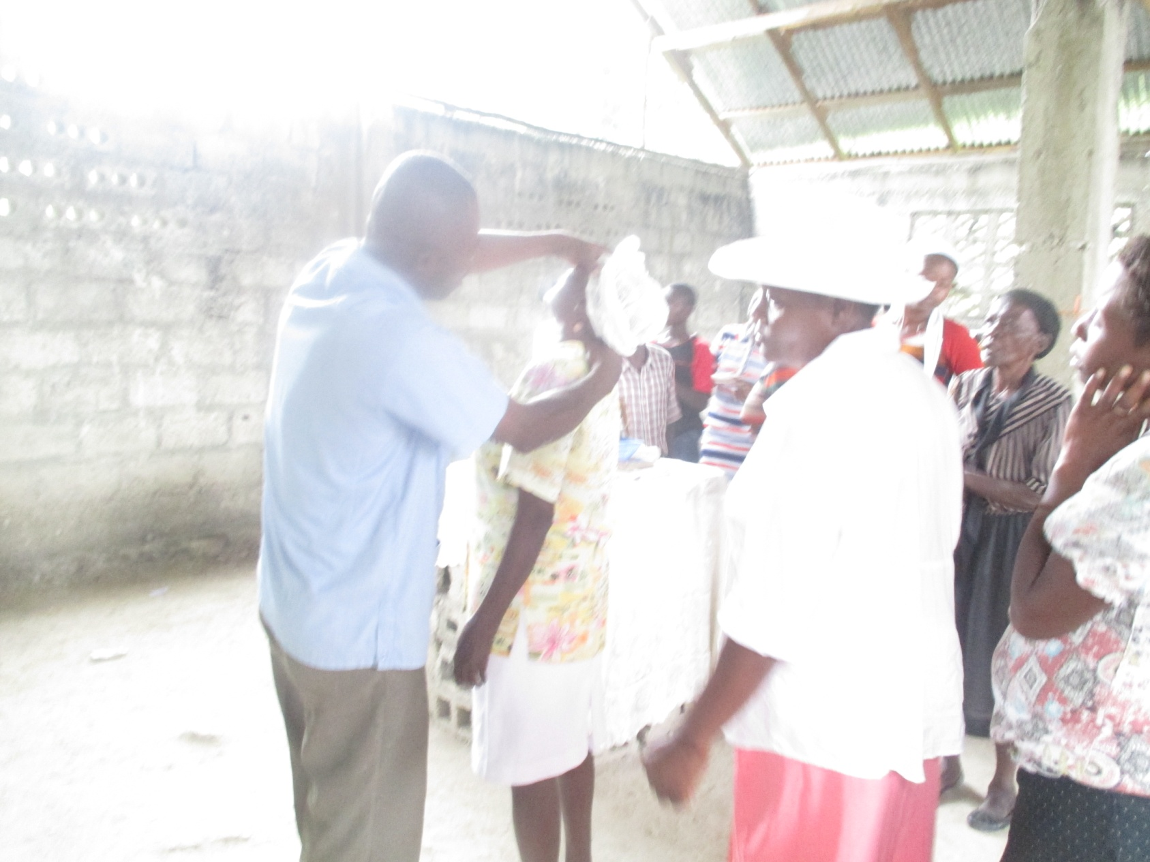

Slide 43
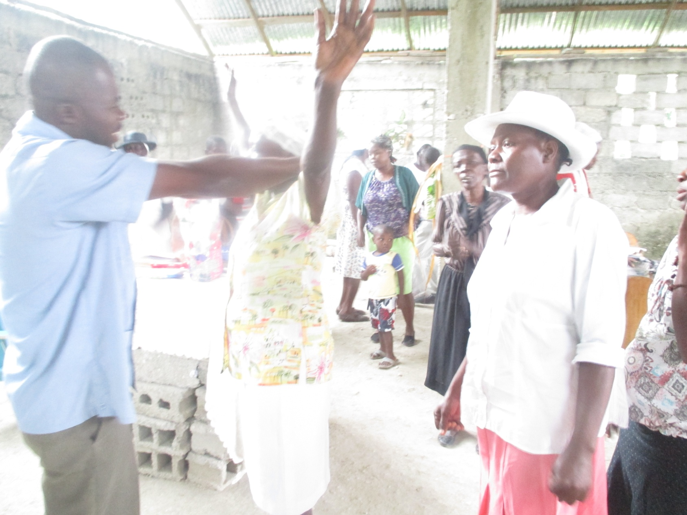

Slide 44
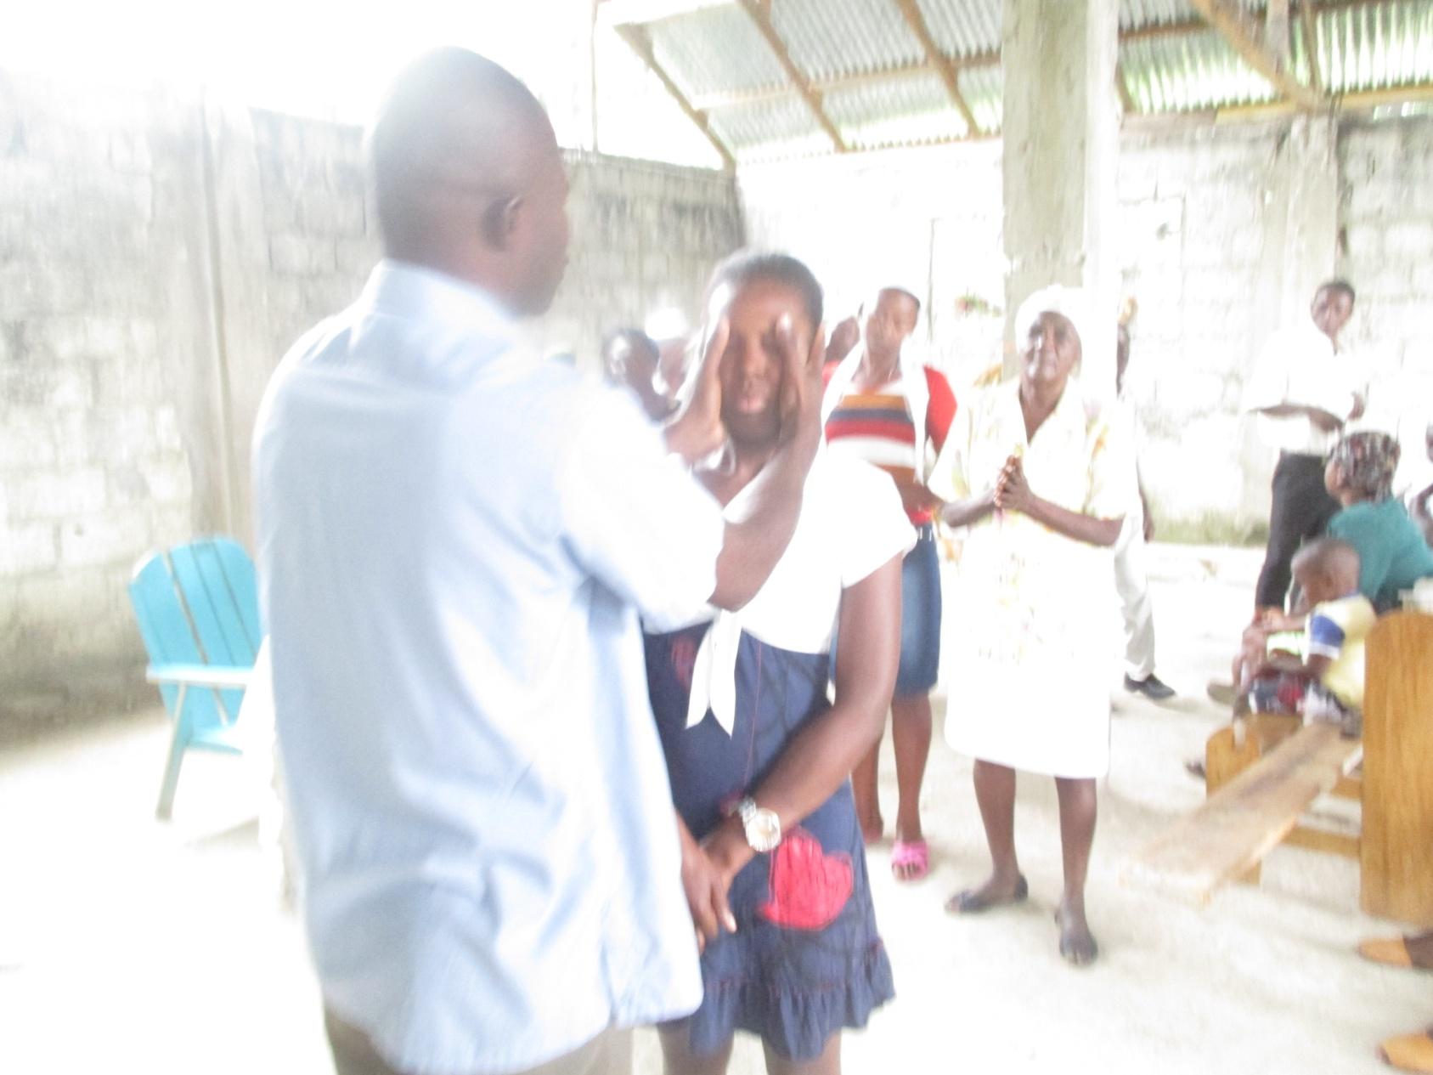

Slide 45
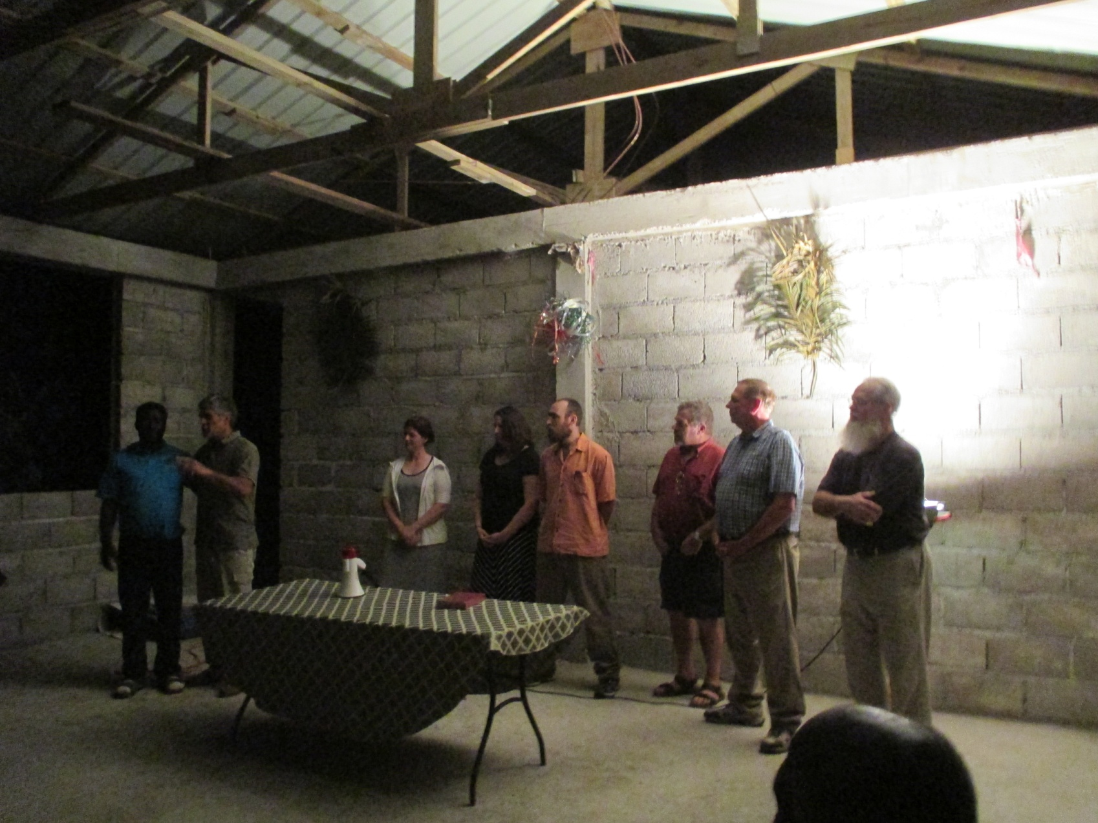
2016 - Bethel Haiti Team Put Roof on Church for Maxon - Testimonies

Slide 46
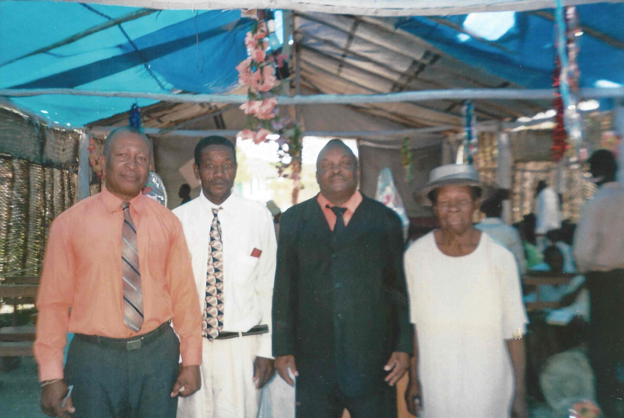
2015 - Pastor Colbert & Leaders – Beraud Church of God

Slide 47
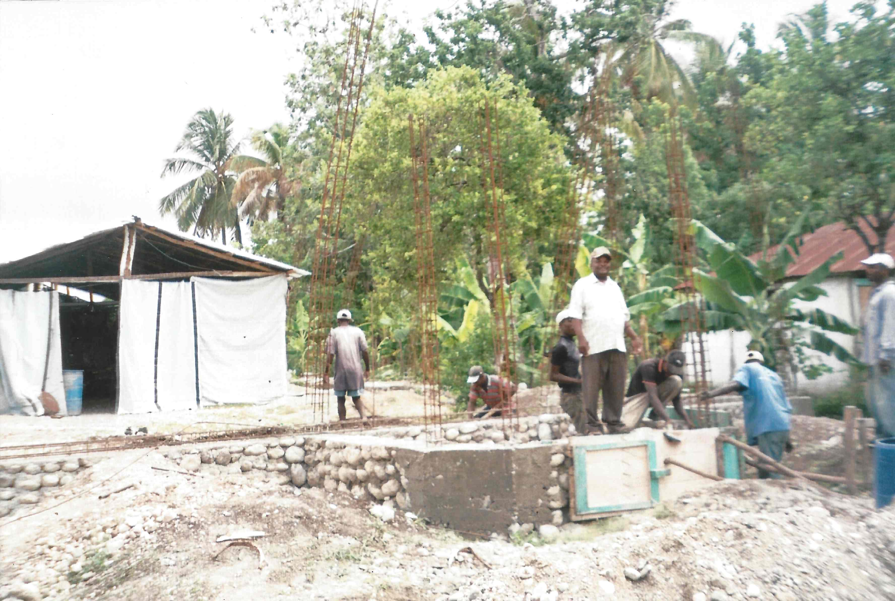
2015 – Pastor Colbert – Finish Foundation for Church Building

Slide 48
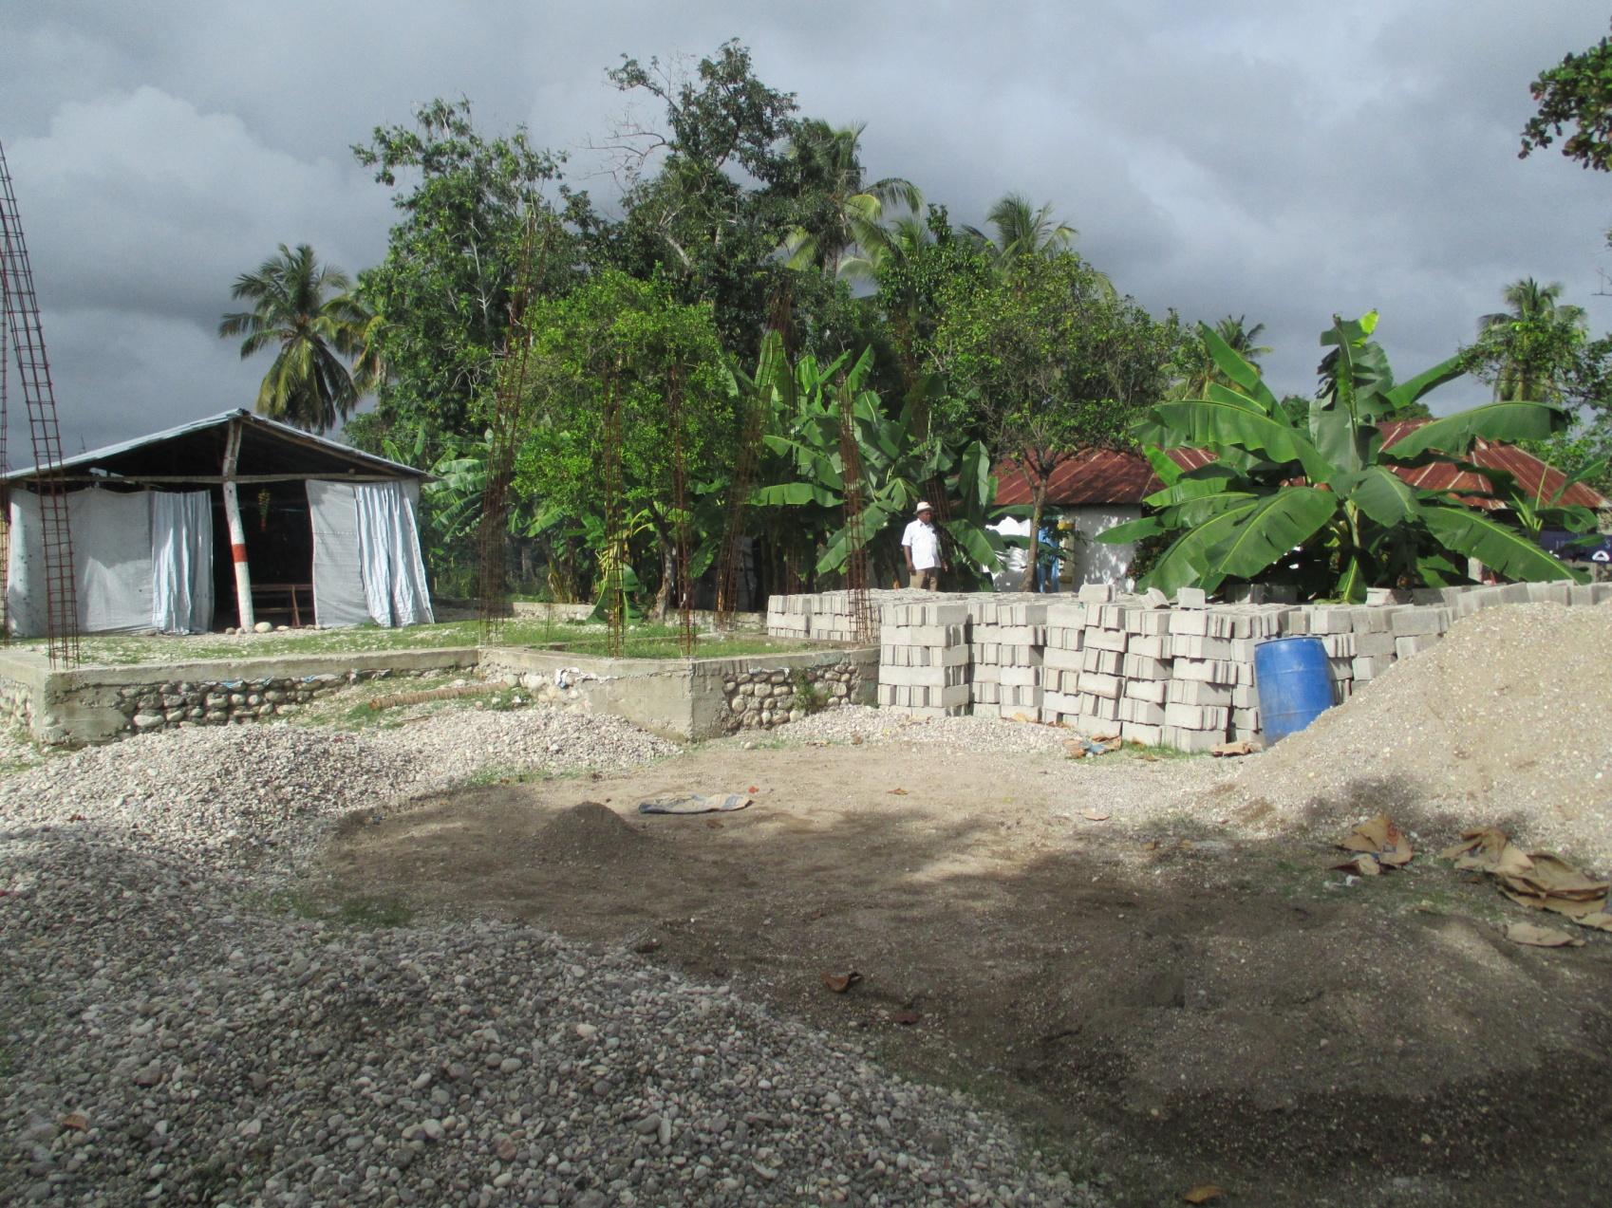
Block Made for Church Building

Slide 49
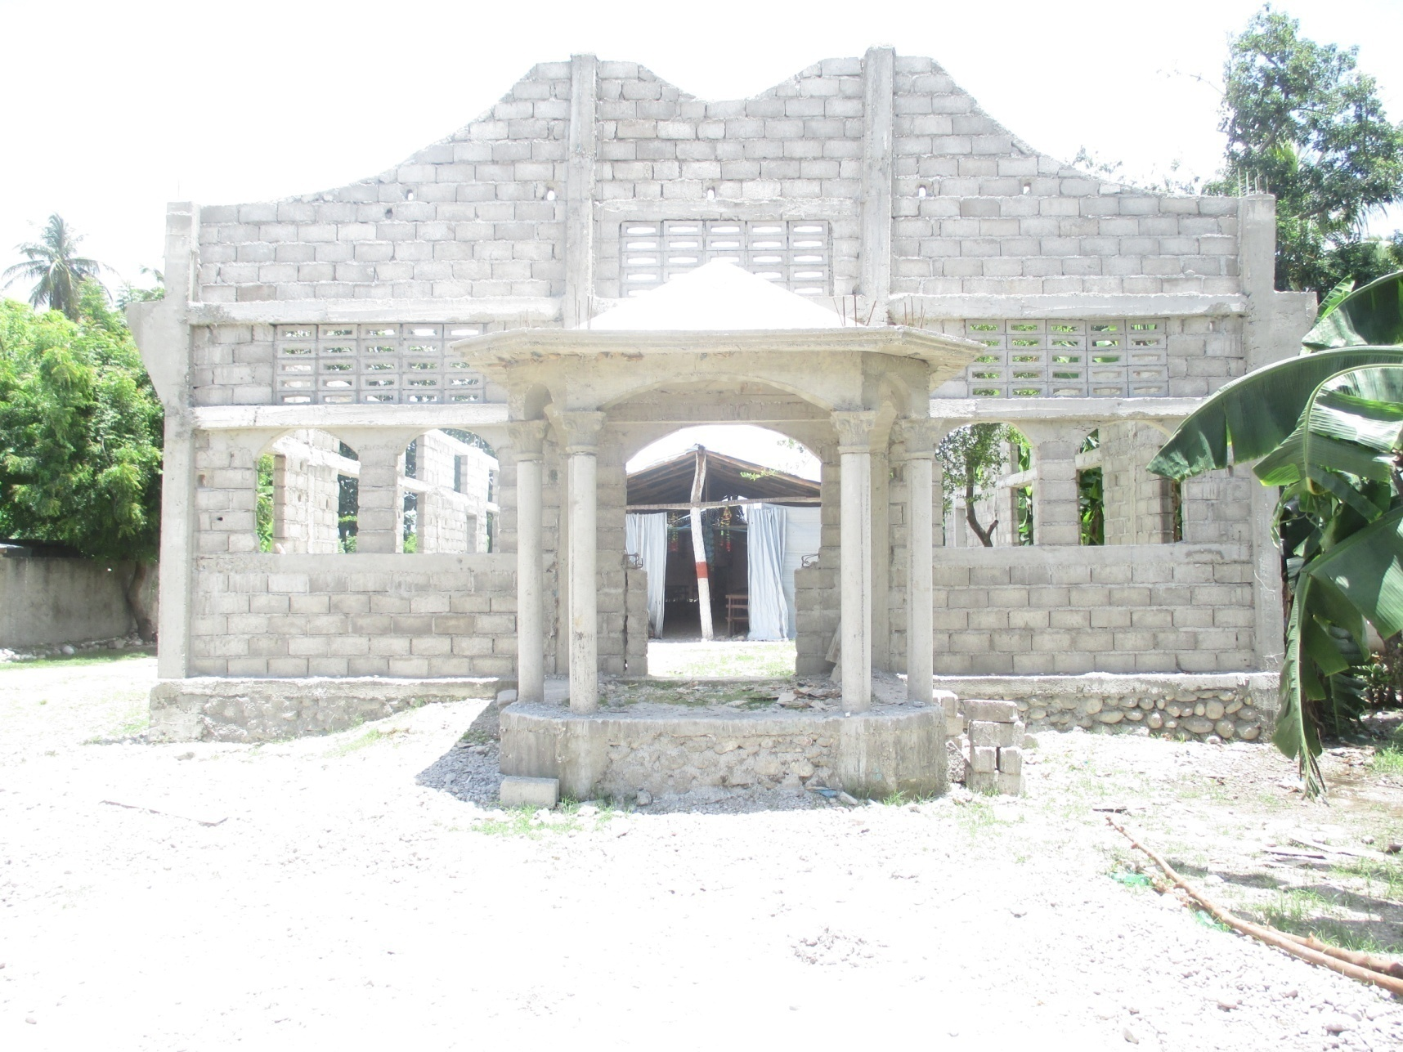
2016 – The Walls are Up – Need Roof

Slide 50
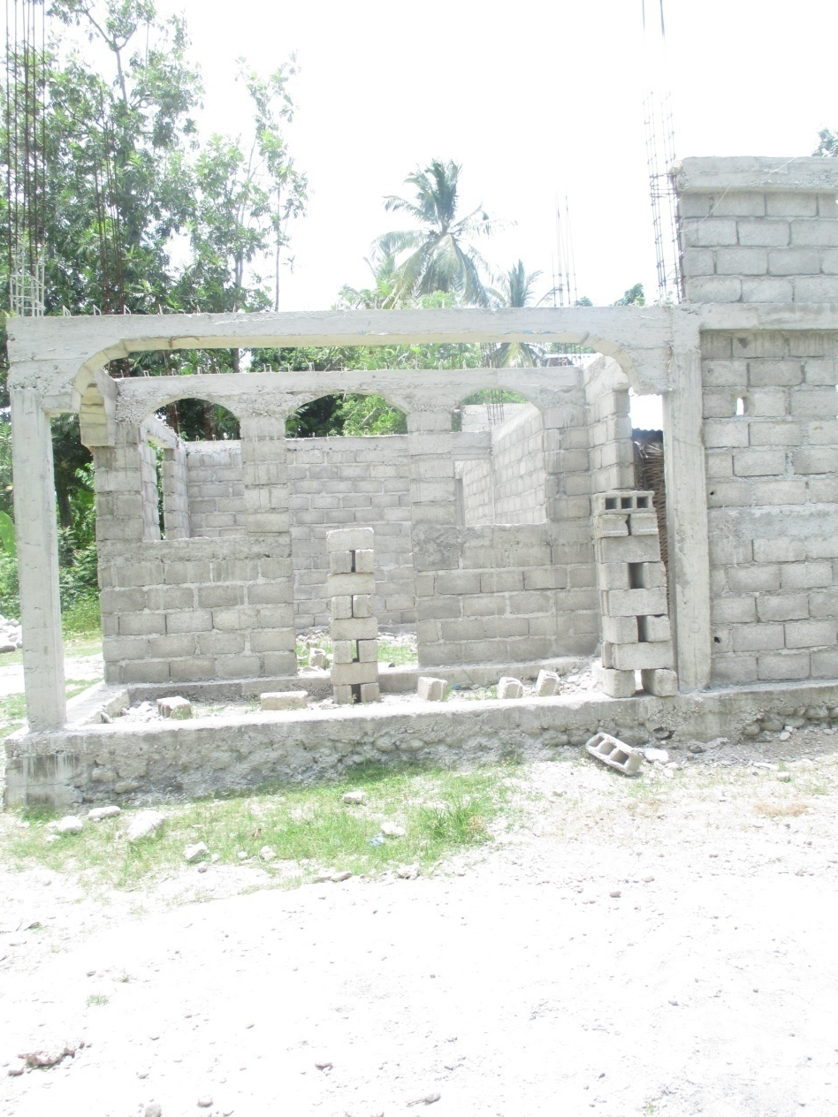
Rooms for Visiting Missionaries in Back of Beraud Church of God

Slide 51
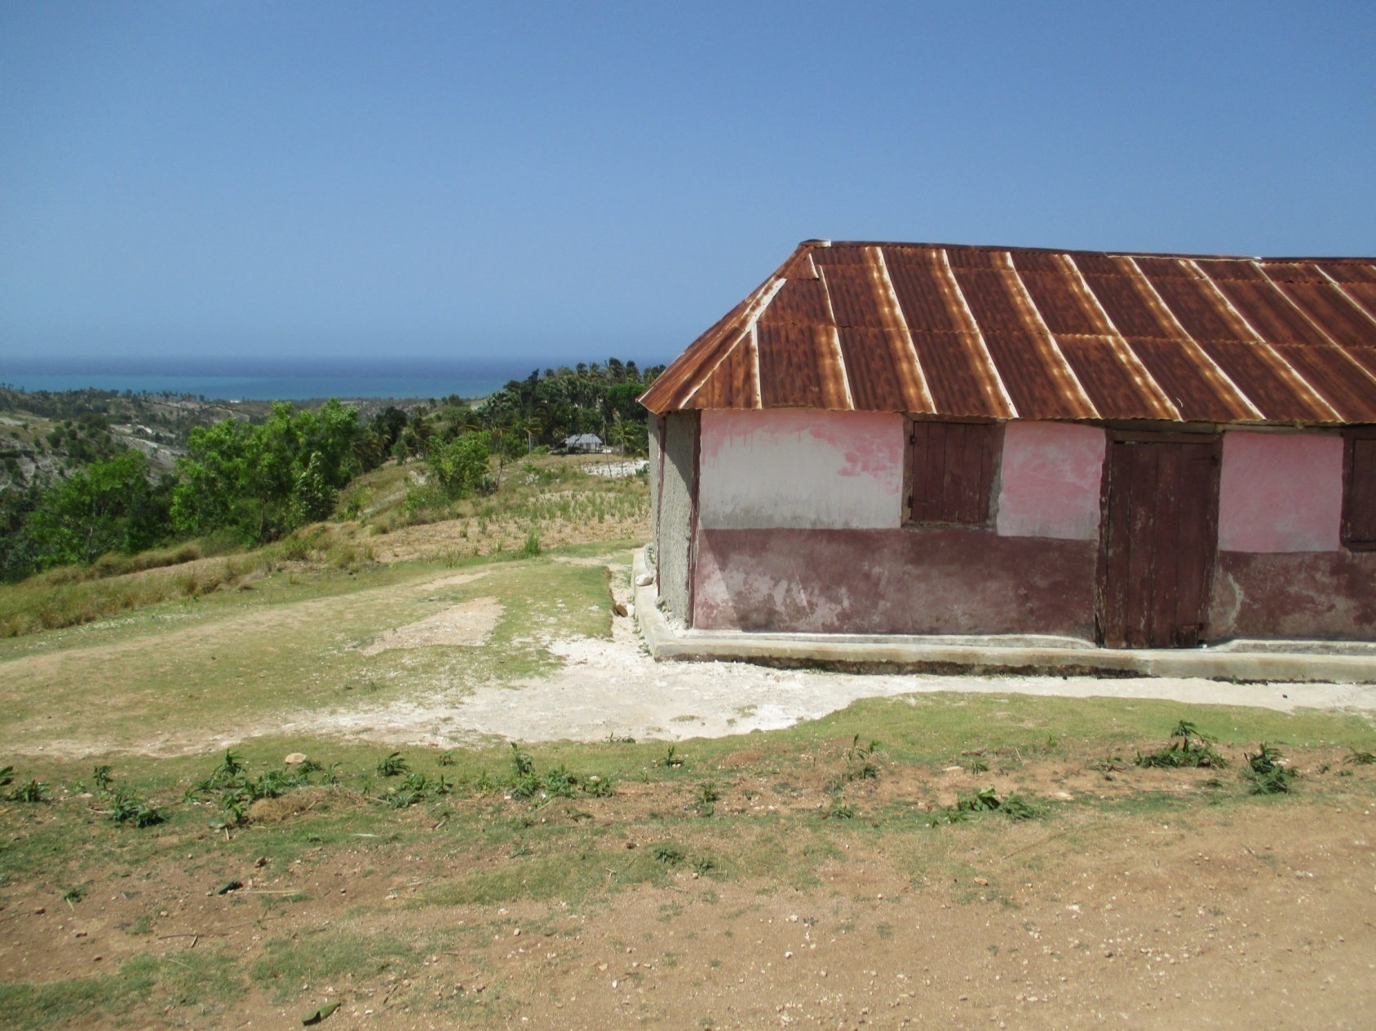
Church in St Jean Area Needs Bigger Building for Church & School

Slide 52

It is Next to Site of New High School; Pastor Lamarr’s Wedding

Slide 53

Baptist Church of Labie – Next Road

Slide 54


Slide 55

Needs Help to Build Church on Foundation

Slide 56

2016 - Nazarene Church in Overhang of Member’s Home

Slide 57

They Need Help to Build Church.

Slide 58

Pastor Mathieu at Site of Proposed Nazarene Church

Slide 59

Church Building Across the River

Slide 60

In Great Disrepair

Slide 61

Small Congregation – Not able to do Repair

Slide 62

Just Down the Road from This Church

Slide 63

Church in Platon – Turning From Error in Doctrine Needed Instruction

Slide 64


Slide 65

Providing Instruction in Small Church in Les Anglais

Slide 66
Haitians Accepting Christ
Mak 16:15
ale toupatou sou latè,
anonse Bon nouvèl
la bay tout moun.
“Go Ye into all the world and preach the Gospel.”

Slide 67

2015 - Clausel in Ducis Saved out of voodoo

Slide 68

2015 – Ducis - Menita Joseph -80 yrs

Slide 69

2015 - Fonds des Bleau Evan With Pastor Labodie – 3 Accept Christ

Slide 70

2015 –Jorque Area - Jean

Slide 71

Visitation With Church Plant Chantel
Mona Fevra Accepted Christ

Slide 72

Chantel Visitation Team – Pastor Junior, 2 Youth, Pastor Prince

Slide 73

1/27/16 Guerda Louis Accepted Christ

Slide 74

Evangelism With Pastor St Jean – Planting Church Past Ducis in Carriè

Slide 75

Walking to Duclair – Wordless Book -10 Children Accepted Christ

Slide 76


Slide 77

Prayer and Fasting on Mountain - Duclair

Slide 78

Pastor Branche d Homme invited us to go Evan in Coteaux with Him

Slide 79


Slide 80

Husband Accept Christ – Wife Said She Will Wait to See if it is Real

Slide 81

Evan With Church in Camp Perrin – Youth in Middle Accepted Christ

Slide 82

As did These 9 Children With Wordless Book

Slide 83

Back to Chantel – Alius Oracius Accpted Christ on 2nd Visit

Slide 84

Chantel – Privert Gerald & Emanie Lima – 83 Accept Christ on 2nd Visit

Slide 85

Pastor Prince Presents Gospel

Slide 86

In a Family Group This Young Man Accepted Christ

