Slide 1
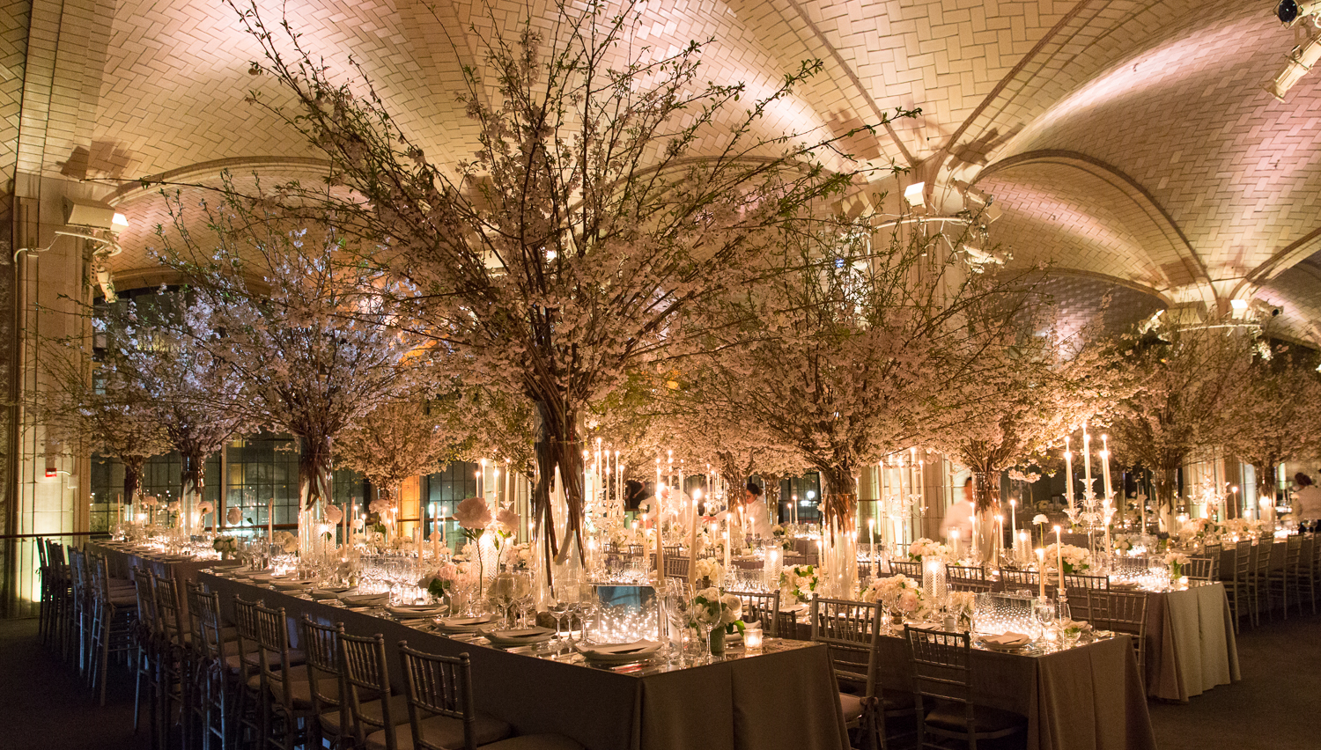
Parable of the
Wedding Feast
Matthew 22:1-14

Slide 2
A Parable
  An earthly story used to convey spiritual truth
  Parables enable people who believe to understand, but block the understanding of those who refuse to believe
And the disciples came and said to Him, “Why do You speak to them in parables?” Mt 13:10
He answered and said to them, “Because it has been given to you to know the mysteries of the kingdom of heaven, but to them it has not been given. Mt 13:11
For whoever has, to him more will be given, and he will have abundance; but whoever does not have, even what he has will be taken away from him. Mt 13:12

Slide 3
Notes about “The kingdom of heaven”
God is the King today over all things [Universal Kingdom]
Jesus Christ created all things
  Both physical
  And in the realm of kings and nations
Jesus Christ sustains all things
Today God’s kingdom of heaven is real but can only be seen by faith
When Christ returns God’s Kingdom will be seen in the physical world
“The kingdom of heaven is like a certain king who arranged a marriage for his son, Mt 22:2
The Lord has established His throne in heaven, And His kingdom rules over all. Ps 103:19
For by Him all things were created that are in heaven and that are on earth, visible and invisible, whether thrones or dominions or principalities or powers. All things were created through Him and for Him. Col 1:16
And He is before all things, and in Him all things consist. Col 1:17
…[I speak in parables]…“Because it has been given to you to know the mysteries of the kingdom of heaven, but to them it has not been given. Mt 13:11
“When the Son of Man comes in His glory, and all the holy angels with Him, then He will sit on the throne of His glory. Mt 25:31

Slide 4
  Those without faith see the effects of God’s rule –
    but reject the thought that God is the reason for things happening
  Jesus points out the fallacy of their rejection
  Jesus shows that the Kingdom is real and operating in their midst
Then one was brought to Him who was demon-possessed, blind and mute; and He healed him, so that the blind and mute man both spoke and saw. Mt 12:22
Now when the Pharisees heard it they said, “This fellow does not cast out demons except by Beelzebub, the ruler of the demons.” Mt 12:24
If Satan casts out Satan, he is divided against himself. How then will his kingdom stand? Mt 12:26
But if I cast out demons by the Spirit of God, surely the kingdom of God has come upon you. Mt 12:28

Slide 5
Why does Jesus give parables that show what the kingdom of heaven is like?
The kingdom of heaven is invisible to our physical eye
  These parables let believers see God at work behind the curtain of visibility
  They encourage us to live by faith and not by sight
“The kingdom of heaven is like … Mt 22:2
But the natural man does not receive the things of the Spirit of God, for they are foolishness to him; nor can he know them, because they are spiritually discerned. 1 Co 2:14
But blessed are your eyes for they see, and your ears for they hear; Mt 13:16
For we walk by faith, not by sight. 2 Co 5:7

Slide 6
Observations about interpreting this kingdom parable
Some parts of a parable are clearly meant to reveal spiritual truth about the kingdom of God
Other parts of a parable are only there to help the story along
Often the main point is stated at the beginning or end of the parable
The main point is often a key that helps us know how to interpret the parable properly
“The kingdom of heaven is like a certain king who arranged a marriage for his son, and sent out his servants to call those who were invited to the wedding; and they were not willing to come. Mt 22:2–3
“For many are called, but few are chosen.” Mt 22:14

Slide 7
Notice the main point of this parable
Question:
In what sense are many called?
  God desires everyone to be saved
  When people repent and trust Christ to save them, they are born again and will be chosen to enter into God’s kingdom
“For many are called, but few are chosen.” Mt 22:14
Therefore go into the highways, and as many as you find, invite to the wedding.’ Mt 22:9
The Lord …is longsuffering toward us, not willing that any should perish but that all should come to repentance. 2 Pe 3:9
Jesus answered and said to him, “Most assuredly, I say to you, unless one is born again, he cannot see the kingdom of God.” Jn 3:3

Slide 8
Questions:
In what sense are many called?
In what sense are few chosen?
  One day the invisible kingdom will become visible and only those who have trusted Christ will be allowed to enter
  Jesus indicates that few will be saved compared to the number that will be lost
“For many are called, but few are chosen.” Mt 22:14
Then the King will say to those on His right hand, ‘Come, you blessed of My Father, inherit the kingdom prepared for you from the foundation of the world: Mt 25:34
“Then He will also say to those on the left hand, ‘Depart from Me, you cursed, into the everlasting fire prepared for the devil and his angels: Mt 25:41
“Enter by the narrow gate; for wide is the gate and broad is the way that leads to destruction, and there are many who go in by it. Mt 7:13

Slide 9
In the parable of the Wedding Feast
  Who does the “certain king” represent?
  This “certain king” represents God Himself
    Since this king has a son he wants to honor
    Since this king decides who enters the kingdom of heaven and who does not
“The kingdom of heaven is like a certain king who arranged a marriage for his son, Mt 22:2
Yours, O Lord, is the greatness, The power and the glory, The victory and the majesty; For all that is in heaven and in earth is Yours; Yours is the kingdom, O Lord, And You are exalted as head over all. 1 Ch 29:11
…For He received from God the Father honor and glory when such a voice came to Him from the Excellent Glory: “This is My beloved Son, in whom I am well pleased.” 2 Pe 1:16–17
Then the king said to the servants, ‘Bind him hand and foot, take him away, and cast him into outer darkness; there will be weeping and gnashing of teeth. Mt 22:13

Slide 10
In the parable of the Wedding Feast
Who does the “certain king” represent?
Who does the “son” represent?
  Jesus often places Himself in His parables because He is the key to salvation for all people
“The kingdom of heaven is like a certain king who arranged a marriage for his son, Mt 22:2
“Hear another parable: There was a certain landowner who planted a vineyard and set a hedge around it, dug a winepress in it and built a tower. And he leased it to vinedressers and went into a far country. Mt 21:33
Then last of all he sent his son to them, saying, ‘They will respect my son.’ But when the vinedressers saw the son, they said among themselves, ‘This is the heir. Come, let us kill him and seize his inheritance.’ So they took him and cast him out of the vineyard and killed him. Mt 21:37–39

Slide 11
In the parable of the Wedding Feast
Who does the “certain king” represent?
Who does the “son” represent?
  Jesus often places Himself in His parables because He is the key to salvation for all people
  He is the Son that the Father desires to greatly honor
“The kingdom of heaven is like a certain king who arranged a marriage for his son, Mt 22:2
For the Father judges no one, but has committed all judgment to the Son, that all should honor the Son just as they honor the Father. He who does not honor the Son does not honor the Father who sent Him. Jn 5:22–23

Slide 12
In the parable of the Wedding Feast
Who does the “certain king” represent?
Who does the “son” represent?
  Jesus often places Himself in His parables because He is the key to salvation for all people
  He is the Son that the Father desires to greatly honor
“The kingdom of heaven is like a certain king who arranged a marriage for his son, Mt 22:2
…He humbled Himself and became obedient to the point of death, even the death of the cross. Therefore God also has highly exalted Him and given Him the name which is above every name, that at the name of Jesus every knee should bow, of those in heaven, and of those on earth, and of those under the earth, and that every tongue should confess that Jesus Christ is Lord, to the glory of God the Father. Php 2:8–11

Slide 13
In the parable of the Wedding Feast
Who does the “certain king” represent?
Who does the “son” represent?
Why is a marriage feast used in the parable?
  An event that perfectly sets the scene
  An occasion that gives a father the opportunity to greatly honor his son
  Very careful planning
  A very serious occasion
  Expense is not a consideration
  Exposes the foolishness of those who would not come
“The kingdom of heaven is like a certain king who arranged a marriage for his son, Mt 22:2
and sent out his servants to call those who were invited to the wedding; and they were not willing to come. Mt 22:3
Again, he sent out other servants, saying, ‘Tell those who are invited, “See, I have prepared my dinner; my oxen and fatted cattle are killed, and all things are ready. Come to the wedding.” ’ Mt 22:4

Slide 14
In the parable of the Wedding Feast
Who does the “certain king” represent?
Who does the “son” represent?
Why is a marriage feast used in the parable?
  Those who enter the kingdom are said in Revelation 19 to be “called” to the “marriage supper of the Lamb”
  In the parable of the Wedding Feast, those who are chosen guests are those who are allowed to be citizens of the kingdom of heaven
“The kingdom of heaven is like a certain king who arranged a marriage for his son, Mt 22:2
Then he said to me, “Write: ‘Blessed are those who are called to the marriage supper of the Lamb!’ ” … Re 19:9
…And the wedding hall was filled with guests. Mt 22:10

Slide 15
In the parable of the Wedding Feast
Who are the servants?
  The King’s servants are saved people who are willing to do whatever the King desires
  They call the invited
  They are willing to be rejected while giving the King’s message
  They are willing even to die for the King if necessary
  The King shares confidential information with them
  The King shares the goal with them and they are trusted to figure out how to accomplish the goal
and sent out his servants to call those who were invited to the wedding; Mt 22:3a
and they were not willing to come. Mt 22:3b
And the rest seized his servants, treated them spitefully, and killed them. Mt 22:6
Then he said to his servants, ‘The wedding is ready, but those who were invited were not worthy. Mt 22:8
Therefore go into the highways, and as many as you find, invite to the wedding.’ Mt 22:9
So those servants went out …And the wedding hall was filled with guests. Mt 22:10

Slide 16
In the parable of the Wedding Feast
Who are the chosen?
  Those who were willing to take advantage of the gracious offer of the king
    Had nothing to do with their worthiness, their wealth, their status in life
    Had only to do with their willingness to respond to the king’s invitation
So those servants went out into the highways and gathered together all whom they found, both bad and good. And the wedding hall was filled with guests. Mt 22:10

Slide 17
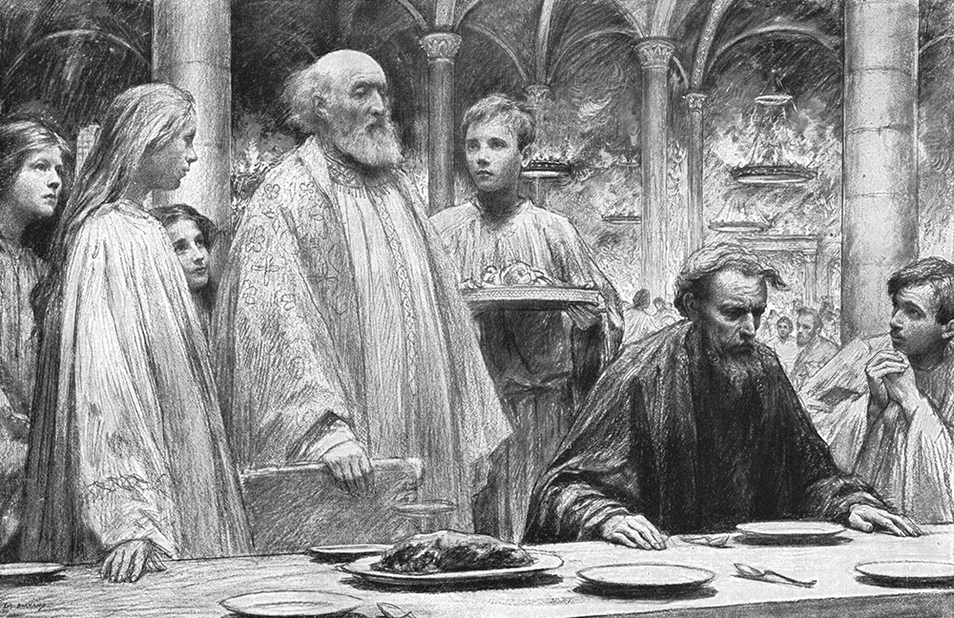
Required humility
  Had to accept the king’s wedding garment instead of their own
“But when the king came in to see the guests, he saw a man there who did not have on a wedding garment. Mt 22:11
Then the king said to the servants, ‘Bind him hand and foot, take him away… Mt 22:13
“By the Rivers of Babylon”
Psalm 137

Slide 18
  Required humility
    Had to accept the king’s wedding garment instead of their own
      Are you willing to admit that your righteousness is not sufficient to get you into the kingdom?
    Had to be willing to be looked down upon by scoffers
For I say to you, that unless your righteousness exceeds the righteousness of the scribes and Pharisees, you will by no means enter the kingdom of heaven. Mt 5:20
For He made Him who knew no sin to be sin for us, that we might become the righteousness of God in Him. 2 Co 5:21
…they were not willing to come. Mt 22:3
But they made light of it and went their ways, one to his own farm, another to his business. Mt 22:5

Slide 19
Are you a chosen citizen of the Kingdom?

