Slide 1
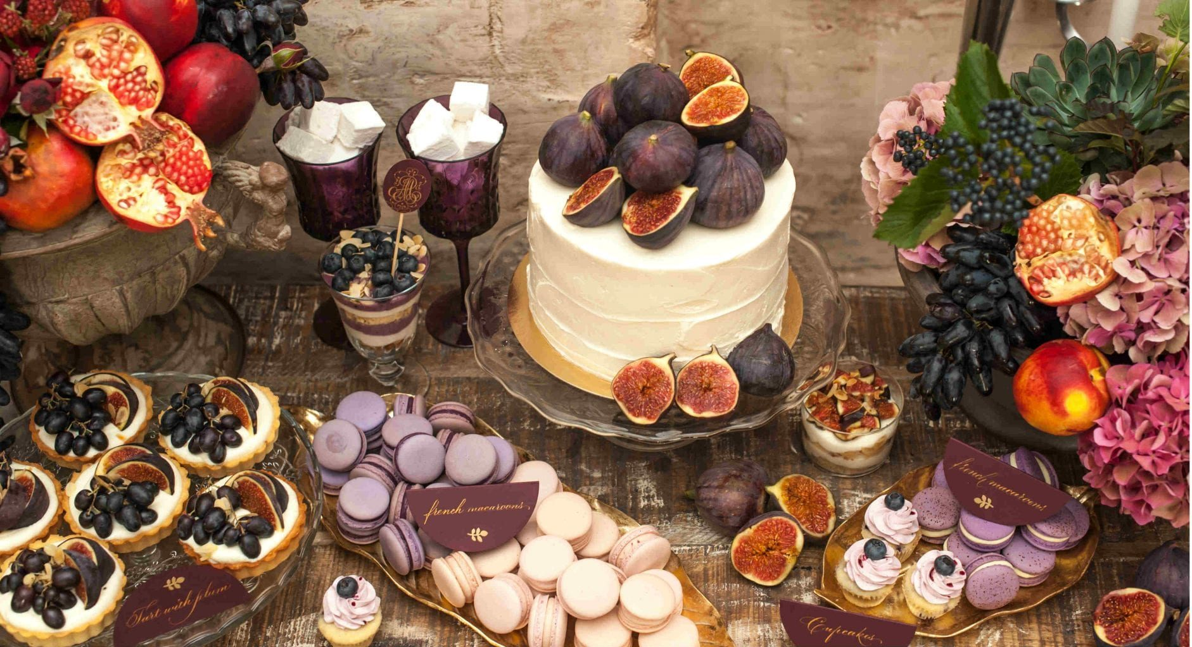
Parable of the
Wedding Feast
Matthew 22:1-14

Slide 2
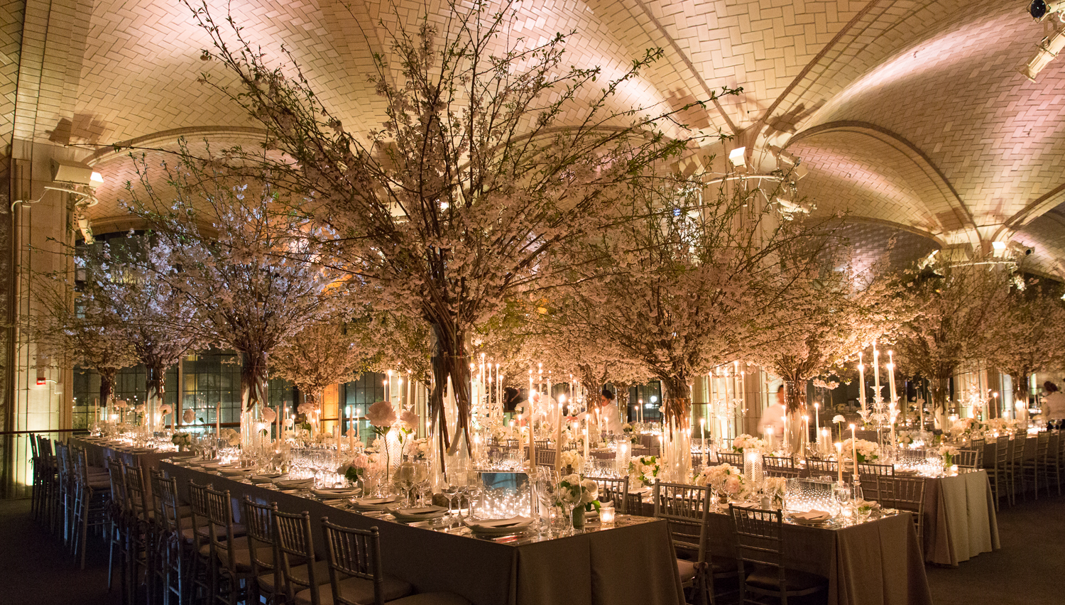
Part 2
Squandered Opportunities

Slide 3
In the parable of the Wedding Feast
The “certain king” represents God the Father who greatly desires to honor His Son
“The kingdom of heaven is like a certain king who arranged a marriage for his son, Mt 22:2

Slide 4
In the parable of the Wedding Feast
The “certain king” represents God the Father who greatly desires to honor His Son
His “son” represents Jesus Christ Himself
“The kingdom of heaven is like a certain king who arranged a marriage for his son, Mt 22:2

Slide 5
In the parable of the Wedding Feast
The “certain king” represents God the Father who greatly desires to honor His Son
His “son” represents Jesus Christ Himself
The “marriage” sets the scene for the parable
“The kingdom of heaven is like a certain king who arranged a marriage for his son, Mt 22:2

Slide 6
In the parable of the Wedding Feast
The “certain king” represents God the Father who greatly desires to honor His Son
His “son” represents Jesus Christ Himself
The “marriage” sets the scene for the parable
Very important occasion to the Father
Illustrates the Father’s greatest desire – to honor His Son
Gives important citizens in the earthly kingdom an opportunity to honor the King’s Son
“The kingdom of heaven is like a certain king who arranged a marriage for his son, Mt 22:2
and sent out his servants to call those who were invited to the wedding; Mt 22:3a

Slide 7
In the parable of the Wedding Feast
The invited citizens were not willing to come
This creates real consternation to the king
The invited guests surely know how important this is to the king
This is an opportunity to eat with the king and with his son
The finest food is provided
This is an opportunity for the citizens who benefit so much from the king’s goodness to them to honor the king and his son
After all he is the KING
“The kingdom of heaven is like a certain king who arranged a marriage for his son, Mt 22:2
and sent out his servants to call those who were invited to the wedding; and they were not willing to come. Mt 22:3

Slide 8
In the parable of the Wedding Feast
Notice the kind heart of the king
He sends out other servants
He did not jump to the conclusion that the citizens did not care or were hostile
Again, he sent out other servants, saying, ‘Tell those who are invited, “See, I have prepared my dinner; my oxen and fatted cattle are killed, and all things are ready. Come to the wedding.” ’ Mt 22:4

Slide 9
In the parable of the Wedding Feast
Notice the kind heart of the king
He did not jump to the conclusion that the citizens did not care or were bad
He sends out “other” servants
He is willing to give the citizens the benefit of the doubt
Maybe the first servants did not do a good job conveying the message
Maybe I sent them without giving them clear enough instruction
Maybe my servants did not understand or convey the sense of urgency
Again, he sent out other servants, saying, ‘Tell those who are invited, “See, I have prepared my dinner; my oxen and fatted cattle are killed, and all things are ready. Come to the wedding.” ’ Mt 22:4

Slide 10
In the parable of the Wedding Feast
Notice the kind heart of the king
He did not jump to the conclusion that the citizens did not care or were bad
He sends out “other” servants
This time he tells them exactly what to say
Again, he sent out other servants, saying, ‘Tell those who are invited, “See, I have prepared my dinner; my oxen and fatted cattle are killed, and all things are ready. Come to the wedding.” ’ Mt 22:4

Slide 11
In the parable of the Wedding Feast
Notice the kind heart of the king
He did not jump to the conclusion that the citizens did not care or were bad
He sends out “other” servants
This time he tells them exactly what to say
Explain clearly how important this is to me
Again, he sent out other servants, saying, ‘Tell those who are invited, “See, I have prepared my dinner; my oxen and fatted cattle are killed, and all things are ready. Come to the wedding.” ’ Mt 22:4

Slide 12
In the parable of the Wedding Feast
Notice the kind heart of the king
He did not jump to the conclusion that the citizens did not care or were bad
He sends out “other” servants
This time he tells them exactly what to say
Explain clearly how important this is to me
Explain that I have not spared any expense
Again, he sent out other servants, saying, ‘Tell those who are invited, “See, I have prepared my dinner; my oxen and fatted cattle are killed, and all things are ready. Come to the wedding.” ’ Mt 22:4

Slide 13
In the parable of the Wedding Feast
Notice the kind heart of the king
He did not jump to the conclusion that the citizens did not care or were bad
He sends out “other” servants
This time he tells them exactly what to say
Explain clearly how important this is to me
Explain that I have not spared any expense
Convey the importance and the urgency
Again, he sent out other servants, saying, ‘Tell those who are invited, “See, I have prepared my dinner; my oxen and fatted cattle are killed, and all things are ready. Come to the wedding.” ’ Mt 22:4
Application to us
To be chosen to enter fellowship with the King and His Son is to enter the kingdom of heaven
No expense was spared – Christ shed His blood so people can enter
It is not simply take it or leave it
Knowing, therefore, the terror of the Lord, we persuade men… 2 Co 5:11
Notes:
There was a discussion at the men’s meeting – Is the invitation an invitation, or is it a command?
If the invitation is not accepted, it will mean eternal condemnation.
Therefore, as Christ’s servants – we need to have a sense of urgency.
It is an invitation

Slide 14
The citizen’s attitude toward the king and his son becomes unmistakable – no way to think best of them
It was not the fault of the servants who had given the first message
It was not the king’s fault for not helping the servants to make the message clearer
But they made light of it and went their ways, one to his own farm, another to his business. And the rest seized his servants, treated them spitefully, and killed them. Mt 22:5–6

Slide 15
The citizen’s attitude toward the king and his son becomes unmistakable – no way to think best of them
These citizens could not care less about the king and his son and the wedding
Instead of showing honor they purposely send a message of insult
But they made light of it and went their ways, one to his own farm, another to his business. And the rest seized his servants, treated them spitefully, and killed them. Mt 22:5–6

Slide 16
The citizen’s attitude toward the king and his son becomes unmistakable – no way to think best of them
They could not care less about the king and his son and the wedding
Instead of showing honor they purposely send a message of insult
Instead of gratitude for the opportunity to have freedom and prosperity, their pride considered freedom and prosperity their right
“his own farm”
“his business”
But they made light of it and went their ways, one to his own farm, another to his business. And the rest seized his servants, treated them spitefully, and killed them. Mt 22:5–6

Slide 17
Instead of showing honor they purposely send a message of insult
Instead of gratitude for the opportunity to have freedom and prosperity, they are proud and arrogant
Instead of simply sending a message of rejection to the king, they show hatred and hostility toward the king’s servants
But they made light of it and went their ways, one to his own farm, another to his business. And the rest seized his servants, treated them spitefully, and killed them. Mt 22:5–6
“If the world hates you, you know that it hated Me before it hated you. If you were of the world, the world would love its own. Yet because you are not of the world, but I chose you out of the world, therefore the world hates you. Jn 15:18–19

Slide 18
Notice that the king gets the message
Notice the king’s response to those who hurt his faithful and good servants
There will be a judgment for all who reject the message of God’s servants
But when the king heard about it, he was furious. Mt 22:7a
And he sent out his armies, destroyed those murderers, and burned up their city. Mt 22:7b
…it is a righteous thing with God to repay with tribulation those who trouble you, … 2 Th 1:6
in flaming fire taking vengeance on those who do not know God, and on those who do not obey the gospel of our Lord Jesus Christ. 2 Th 1:8

Slide 19
Notice that the king gets the message
Notice the king’s response to those who hurt his faithful and good servants
There will be a judgment for all who have rejected God’s servants
There will be a separation
There will be punishment
There will be remorse and pain
Compare the same in this parable
So it will be at the end of the age. The angels will come forth, separate the wicked from among the just, Mt 13:49
and cast them into the furnace of fire. Mt 13:50a
There will be wailing and gnashing of teeth.” Mt 13:50b
Then the king said to the servants, ‘Bind him hand and foot, take him away, and cast him into outer darkness; there will be weeping and gnashing of teeth.’ Mt 22:13

Slide 20
Notice the king’s response to those who hurt his faithful and good servants
There will be a judgment for all who have rejected God’s message
Even if God’s servants are not the best examples and witnesses
So Lot went out and spoke to his sons-in-law, who had married his daughters, and said, “Get up, get out of this place; for the Lord will destroy this city!” But to his sons-in-law he seemed to be joking. Ge 19:14
Then the Lord rained brimstone and fire on Sodom and Gomorrah, from the Lord out of the heavens. Ge 19:24
Then I saw a great white throne and Him who sat on it, from whose face the earth and the heaven fled away. And there was found no place for them. Re 20:11
And anyone not found written in the Book of Life was cast into the lake of fire. Re 20:15

Slide 21
Notice the king’s heart to honor his son
He opens the invitation to all who would come
Two qualifications:
Be willing to come
Be willing to put on the garment the king provides
God wants the kingdom of His dear Son filled with guests
Then he said to his servants, ‘The wedding is ready, but those who were invited were not worthy. Therefore go into the highways, and as many as you find, invite to the wedding.’ Mt 22:8–9
So those servants went out into the highways and gathered together all whom they found, both bad and good. And the wedding hall was filled with guests. Mt 22:10
For whom He foreknew, He also predestined to be conformed to the image of His Son, that He might be the firstborn among many brethren. Ro 8:29

Slide 22
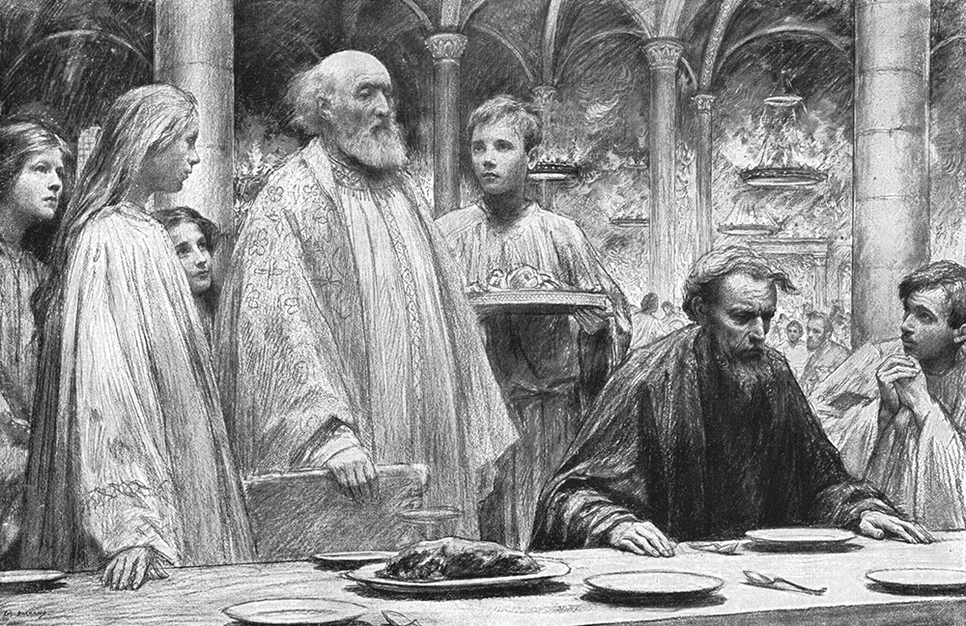
Required humility
Had to accept the king’s wedding garment instead of their own
“But when the king came in to see the guests, he saw a man there who did not have on a wedding garment. Mt 22:11
Then the king said to the servants, ‘Bind him hand and foot, take him away… Mt 22:13
“By the Rivers of Babylon”
Psalm 137

Slide 23
Required humility
We have to accept the garment of Christ’s righteousness to enter the kingdom
and be found in Him, not having my own righteousness, which is from the law, but that which is through faith in Christ, the righteousness which is from God by faith; Php 3:9
“By the Rivers of Babylon”
Psalm 137

Slide 24
“By the Rivers of Babylon”
Psalm 137
When He shall come with trumpet sound-- Oh, may I then in Him be found-- Dressed in His righteousness alone Faultless to stand before the throne

Slide 25
Lessons
God loves all men and desires all to be saved
There is a limit to God’s patient invitation and call
who desires all men to be saved and to come to the knowledge of the truth. 1 Ti 2:4
But when the king heard about it, he was furious. And he sent out his armies, destroyed those murderers, and burned up their city. Mt 22:7

Slide 26
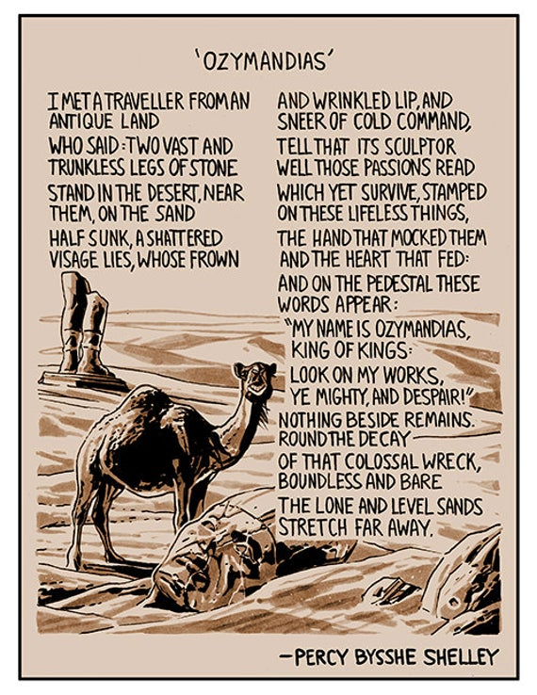
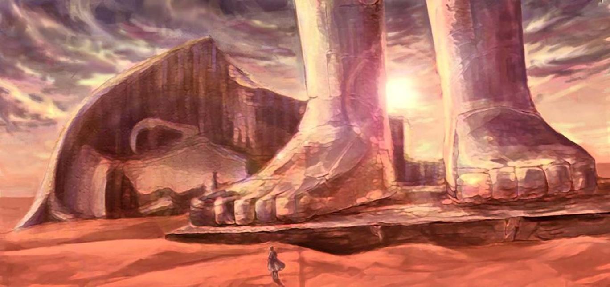
“By the Rivers of Babylon”
Psalm 137
Lessons:
Man’s time and glory are only for a moment
“The wind passes over it and it is gone”
Only those who trust Christ will become the “elect” who inherit the kingdom of God

Slide 27
Squandered opportunities?
“For many are called, but few are chosen.” Mt 22:14

Slide 28
You have been invited [called]. Are you willing to become a chosen citizen of Christ’s Kingdom?

