Slide 1
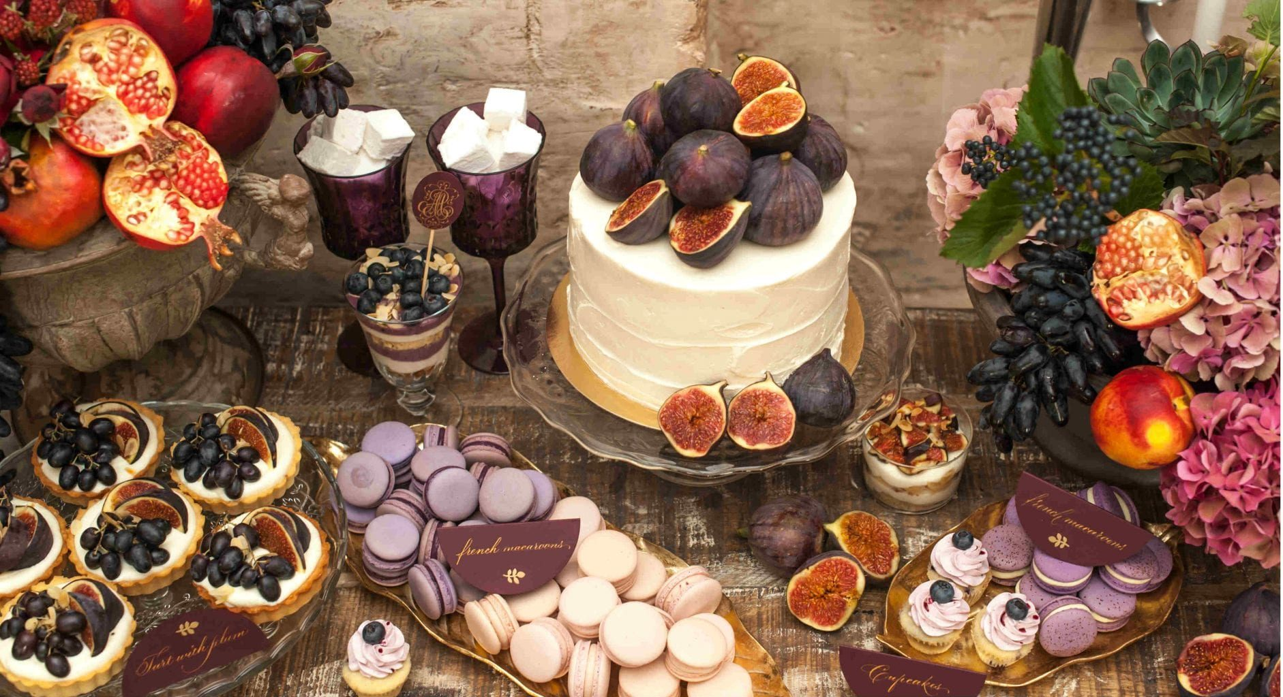
Parable of the
Wedding Feast
Matthew 22:1-14

Slide 2
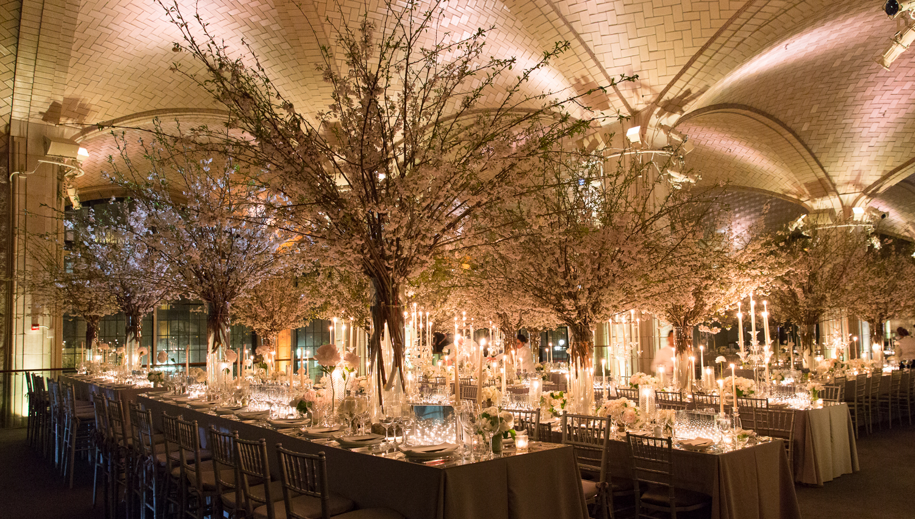
Part 3
Danger of Pride

Slide 3
Pride
Pride refers to an unwarranted attitude of confidence
Pride is often used in Scripture to refer to an unhealthy elevated view of one’s self, abilities, or possessions
Rebellious pride, which refuses to depend on God and be subject to Him, but attributes to self the honor due to Him, figures as the very root and essence of sin.
Pride goes before destruction, And a haughty spirit before a fall. Pr 16:18
Then the beast was captured, and with him the false prophet who worked signs in his presence…These two were cast alive into the lake of fire burning with brimstone. Re 19:20
The lofty looks of man shall be humbled, The haughtiness of men shall be bowed down, And the LORD alone shall be exalted in that day. Is 2:11
Notes:
Mike Tyson WHBC 40 to 1 favorite knocked out by Buster Douglas
Sadaam Hussien declared that War with US would be mother of all battles
All the great world rulers of the past 4000 years are dead and gone
Caroline Flack’s a popular TV host in the UK died yesterday at 40 years old. Very successful hosted “Love Island” "The X Factor" and "I'm a Celebrity... Get Me Out of Here! NOW!“ Her passing marks the third death from the "Love Island" cast. Contestants Mike Thalassitis and Sophie Gradon took their own lives in 2019 and 2018, respectively.

Slide 4
The parable of the Wedding Feast
  Is given to show why some people enter the kingdom of heaven and others do not
  Pride is the reason people are not allowed into the kingdom of heaven
  The “certain king” represents God the Father who greatly desires to honor His Son
  Jesus Christ presents Himself as the Son of the King
    Proud people reject Jesus Christ – the King’s Son
“For many are called, but few are chosen.” Mt 22:14
“Blessed are the poor in spirit, For theirs is the kingdom of heaven. Mt 5:3
“The kingdom of heaven is like a certain king Mt 22:2a
who arranged a marriage for his son, Mt 22:2b

Slide 5
In the parable of the Wedding Feast
  The “certain king” represents God the Father who greatly desires to honor His Son
  His “son” represents Jesus Christ Himself
  The “marriage” sets the scene for the parable
“The kingdom of heaven is like a certain king who arranged a marriage for his son, Mt 22:2

Slide 6
In the parable of the Wedding Feast
  The “certain king” represents God the Father who greatly desires to honor His Son
  His “son” represents Jesus Christ Himself
  The “marriage” sets the scene for the parable
    Very important occasion to the Father
    Illustrates the Father’s greatest desire – to honor His Son
    Gives important citizens in the earthly kingdom an opportunity to honor the King’s Son
“The kingdom of heaven is like a certain king who arranged a marriage for his son, Mt 22:2
and sent out his servants to call those who were invited to the wedding; Mt 22:3a

Slide 7
In the parable of the Wedding Feast
The invited citizens were not willing to come
  This creates real consternation to the king
    Honoring his son is the most important matter in life to the king
    Wise citizens would understand and see this
“The kingdom of heaven is like a certain king who arranged a marriage for his son, Mt 22:2
and sent out his servants to call those who were invited to the wedding; and they were not willing to come. Mt 22:3

Slide 8
In the parable of the Wedding Feast
  Notice the kind heart of the king
  He sends out other servants
  He did not jump to the conclusion that the citizens did not care or were hostile
Again, he sent out other servants, saying, ‘Tell those who are invited, “See, I have prepared my dinner; my oxen and fatted cattle are killed, and all things are ready. Come to the wedding.” ’ Mt 22:4

Slide 9
In the parable of the Wedding Feast
Notice the kind heart of the king
  He did not jump to the conclusion that the citizens did not care or were bad
  He sends out “other” servants
    He is willing to give the citizens the benefit of the doubt
    Maybe the first servants did not do a good job conveying the message
    Maybe I sent them without giving them clear enough instruction
    Maybe my servants did not understand or convey the sense of urgency
Again, he sent out other servants, saying, ‘Tell those who are invited, “See, I have prepared my dinner; my oxen and fatted cattle are killed, and all things are ready. Come to the wedding.” ’ Mt 22:4

Slide 10
In the parable of the Wedding Feast
Notice the kind heart of the king
  He did not jump to the conclusion that the citizens did not care or were bad
  He sends out “other” servants
    This time he tells them exactly what to say
Again, he sent out other servants, saying, ‘Tell those who are invited, “See, I have prepared my dinner; my oxen and fatted cattle are killed, and all things are ready. Come to the wedding.” ’ Mt 22:4

Slide 11
In the parable of the Wedding Feast
Notice the kind heart of the king
  He did not jump to the conclusion that the citizens did not care or were bad
  He sends out “other” servants
    This time he tells them exactly what to say
    Explain clearly how important this is to me
Again, he sent out other servants, saying, ‘Tell those who are invited, “See, I have prepared my dinner; my oxen and fatted cattle are killed, and all things are ready. Come to the wedding.” ’ Mt 22:4

Slide 12
In the parable of the Wedding Feast
Notice the kind heart of the king
  He did not jump to the conclusion that the citizens did not care or were bad
  He sends out “other” servants
    This time he tells them exactly what to say
    Explain clearly how important this is to me
    Explain that I have not spared any expense
Again, he sent out other servants, saying, ‘Tell those who are invited, “See, I have prepared my dinner; my oxen and fatted cattle are killed, and all things are ready. Come to the wedding.” ’ Mt 22:4

Slide 13
In the parable of the Wedding Feast
Notice the kind heart of the king
  He did not jump to the conclusion that the citizens did not care or were bad
  He sends out “other” servants
    This time he tells them exactly what to say
    Explain clearly how important this is to me
    Explain that I have not spared any expense
    Convey the importance and the urgency
Again, he sent out other servants, saying, ‘Tell those who are invited, “See, I have prepared my dinner; my oxen and fatted cattle are killed, and all things are ready. Come to the wedding.” ’ Mt 22:4
Application to us
  To be chosen to enter fellowship with the King and His Son is to enter the kingdom of heaven
  No expense was spared – Christ shed His blood so people can enter
  It is not simply take it or leave it
Knowing, therefore, the terror of the Lord, we persuade men… 2 Co 5:11
Notes:
There was a discussion at the men’s meeting – Is the invitation an invitation, or is it a command?
If the invitation is not accepted, it will mean eternal condemnation.
Therefore, as Christ’s servants – we need to have a sense of urgency.
It is an invitation

Slide 14
The citizen’s attitude of pride against the king and his son becomes unmistakable
These citizens purposely sent a message to offend the king
But they made light of it and went their ways, one to his own farm, another to his business. And the rest seized his servants, treated them spitefully, and killed them. Mt 22:5–6

Slide 15
The citizen’s attitude toward the king and his son becomes unmistakable
They were proud and arrogant
  “his own farm”
  “his business”
But they made light of it and went their ways, one to his own farm, another to his business. And the rest seized his servants, treated them spitefully, and killed them. Mt 22:5–6

Slide 16
Instead of showing honor they purposely send a message of insult
Instead of gratitude for the opportunity to have freedom and prosperity, they are proud and arrogant
Instead of simply sending a message of rejection to the king, they show hatred and hostility toward the king’s servants
But they made light of it and went their ways, one to his own farm, another to his business. And the rest seized his servants, treated them spitefully, and killed them. Mt 22:5–6

Slide 17
Notice that the king gets the message
Notice the king’s response to those who hurt his faithful and good servants
There will be a judgment for all who reject the message of God’s servants
But when the king heard about it, he was furious. Mt 22:7a
And he sent out his armies, destroyed those murderers, and burned up their city. Mt 22:7b
…it is a righteous thing with God to repay with tribulation those who trouble you… 2 Th 1:6
in flaming fire taking vengeance on those who do not know God, and on those who do not obey the gospel of our Lord Jesus Christ. 2 Th 1:8
Notes:
It is not wise to bite the hand that feeds you
It is not wise to make fun of the judge of your eternal soul

Slide 18
Notice the king’s response to those who hurt his faithful and good servants
There will be a judgment for all who have rejected God’s message
Jesus answered and said to him, “Most assuredly, I say to you, unless one is born again, he cannot see the kingdom of God.” Jn 3:3
And anyone not found written in the Book of Life was cast into the lake of fire. Re 20:15

Slide 19
Notice the king’s heart to honor his son
  He opens the invitation to all who would come
  God wants the kingdom of His dear Son filled with guests
Then he said to his servants, ‘The wedding is ready, but those who were invited were not worthy. Therefore go into the highways, and as many as you find, invite to the wedding.’ Mt 22:8–9
So those servants went out into the highways and gathered together all whom they found, both bad and good. And the wedding hall was filled with guests. Mt 22:10
For whom He foreknew, He also predestined to be conformed to the image of His Son, that He might be the firstborn among many brethren. Ro 8:29

Slide 20
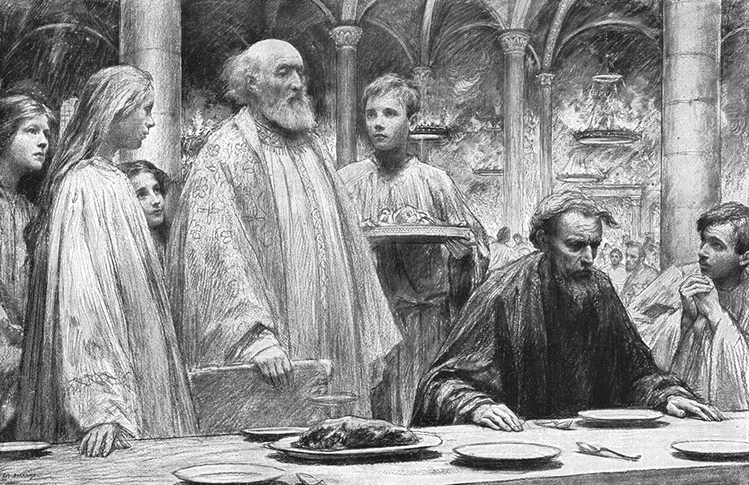
“But when the king came in to see the guests, he saw a man there who did not have on a wedding garment. Mt 22:11
How important was the wedding garment to the king?
  It is the first thing he sees in the vast banquet hall filled with guests
  Before he greets any guest
  Before any festivity begins
“By the Rivers of Babylon”
Psalm 137

Slide 21
So he said to him, ‘Friend, how did you come in here without a wedding garment?... Mt 22:12a
“How…?”–Not “Why…?”
Observations:
“How” could imply that he had snuck in
  But:
  Every other guest had on a wedding garment
  He could not have been unnoticed by the servants and the rest of the guests
“By the Rivers of Babylon”
Psalm 137

Slide 22
The most likely scenario is:
He was stopped at the door by the faithful and conscientious servants and informed of the importance of the wedding garment
Even if he had snuck past, he would have been quickly noticed
The servants would have informed him of the need for a wedding garment
  “Sir you cannot come in here without a proper garment provided by the king
  “Having the right garment is very important to the king
Being arrogant, as he clearly was, he assured them that he was going in with his own garment
  He did not care about the expectations or desires of the king
So he said to him, ‘Friend, how did you come in here without a wedding garment?... Mt 22:12a

Slide 23
Consider again the question:
Reveals the kind heart of the king
  Calls him “friend”
…‘Friend, how did you come in here without a wedding garment?’ Mt 22:12a

Slide 24

Consider again the question:
Reveals the kind heart of the king
  Calls him “friend”
  “how did you…” [Greek = “how”, “by what means”]
    Gives the opportunity to explain
      “I did not realize…
      “No one offered a garment to me
      “Your servants did not explain the need to me
      “No garment was my size
      “I have a fabric allergy
…‘Friend, how did you come in here without a wedding garment?’ Mt 22:12a

Slide 25
Consider the response:
He could not answer because:
  The true answer was:
    “Oh, your servants made it very clear to me that you expected all guests to put on your wedding garment”
    “But, I don’t really care what you think, king”
    “I told your servants to stand back and get out of the way because I alone will decide what garment I will wear”
    “No king is going to tell me what to do”
…‘Friend, how did you come in here without a wedding garment?’ Mt 22:12a
And he was speechless. Mt 22:12b

Slide 26
Consider the application to us:
Notice the illusion to the final judgment in Romans 3:19
  As people are being brought to the throne for final judgment, they may be analyzing what answer to give
  Consider God’s probable response:
  Before you open your mouth to give your defense consider two things:
  My righteous requirement
  The facts
Now we know that whatever the law says, it says to those who are under the law, that every mouth may be stopped, and all the world may become guilty before God. Ro 3:19
For whoever shall keep the whole law, and yet stumble in one point, he is guilty of all. Jas 2:10
For there is nothing covered that will not be revealed, nor hidden that will not be known. Therefore whatever you have spoken in the dark will be heard in the light, and what you have spoken in the ear in inner rooms will be proclaimed on the housetops. Lk 12:2–3

Slide 27
Consider the application to us:
Paul is referring to the final judgment in Romans 3:19
  As people are being brought to the throne for final judgment, they may be analyzing what answer to give
  Consider God’s probable response:
  Before you open your mouth to give your defense consider two things:
  My righteous requirement
  The facts
  The result
Now we know that whatever the law says, it says to those who are under the law, that every mouth may be stopped, and all the world may become guilty before God. Ro 3:19
And he was speechless. Mt 22:12b

Slide 28
Then the king said to the servants, ‘Bind him hand and foot, take him away, and cast him into outer darkness; there will be weeping and gnashing of teeth.’ Mt 22:13
“By the Rivers of Babylon”
Psalm 137

Slide 29
Two requirements:
  Repent – Admit that our righteousness is not acceptable
  Pride says:
  “I have my own way
  “I don’t care what God says
  “I have my own religion
  “If God does not like it, He can lump it
  “God’s method does not appeal to me
“By the Rivers of Babylon”
Psalm 137

Slide 30
Two requirements:
  Repent – Admit that our righteousness is not acceptable
  Believe – Place your faith in Christ to receive His righteousness
…“Believe on the Lord Jesus Christ, and you will be saved…” Ac 16:1
“By the Rivers of Babylon”
Psalm 137

Slide 31
Two requirements:
  Repent – Admit that our righteousness is not acceptable
  Believe – Place your faith in Christ to receive His righteousness
and be found in Him, not having my own righteousness, which is from the law, but that which is through faith in Christ, the righteousness which is from God by faith; Php 3:9
“By the Rivers of Babylon”
Psalm 137

Slide 32
Dear Savior! when before Thy bar
All tribes and tongues assembled are,
Among Thy chosen will I be,
At Thy right hand— complete in Thee.
When he shall come with trumpet sound,
O may I then in him be found,
Dressed in his righteousness alone,
Faultless to stand before the throne.
“For many are called, but few are chosen.” Mt 22:14

Slide 33
Thank you for coming!

